Slide 1
Keynote Speech at AST@ICSE 2018
Software Testing
as
A Problem of Machine Learning
Prof. Hong Zhu
School of Engineering, Computing & Mathematics
Oxford Brookes University
Oxford, UK
Email: hzhu@brookes.ac.uk

Slide 2
Abstract
Personal critical review of the research on application of inductive inference/machine learning theories to software testing, especially the adequacy problem
Pointing out the open problems from a theoretical perspective

Slide 3
First Publication on the Subject
Weyuker, E. J. ‘Assessing test data adequacy through program inference’, ACM Transactions on Programming Languages and Systems, 5(4), 641-655, Oct. 1983.
Inference result is I_{T}, i.e. I_{T} is the result of “machine learning” from test cases T.
The test set T is inference adequate, if I_{T} ⬄ P and I_{T} ⬄ S
Test set T is the input to inference, i.e. input to the “machine learning” algorithm.
Notes:
References:
Weyuker, E. J. ‘Assessing test data adequacy through program inference’, ACM Transactions on Programming Languages and Systems, 5(4), 641-655, Oct. 1983.

Slide 4
Weyuker’s Main Results
Theorem: If program P can be inferred from test set T, then T is branch adequate for P.
Branch coverage
Theorem: Let P be a program intended to fulfil specification S. If test set T is inference adequate for P relative to S, then T is an ideal test set for P.
Ideal test is a notion from Goodenough and Gerhart [1977], which is not formally defined.
Theorem: There exists a test set T which is ideal for P, but is not inference adequate for P relative to S.

Slide 5
Weyuker’s Contributions
A definition of test data adequacy which requires that the test data be sufficient to infer both the intended and actual computations.
Pointed out pragmatic limitations of this definition and considered plausible approximations to the requirements.
  Restriction on a subset of programs, such as finite state machines => “This direction is not likely to be productive.”
  Relax on the conditions that the inference result is equivalent to both program and the intended specification:
    If test set is generated from specification, use “program-adequate”
    If test set is generated from program, use “specification-adequate”
It is not clear that such [program inference] systems will ever be practically available.
It would be both interesting and useful to attempt to develop practical approximations to program inference.

Slide 6
Program Synthesis from Examples
The Question:
  Input: Instances of input/output pairs
  Output: A program that can compute the output on the input, but more
Example:
  [Summers, 1977]
  [Smith & Angluin, 1983]
  [Zhu&Jin, 1989, 1991]
Problem:
  The scale and complexity of the program is very limited
This is “inductive inference”, or “machine learning”: from examples to a general rule.
Weyuker used examples drawn from Summers 1977 to illustrate her ideas.
Applying program algebra and a theory of infinite expansion of programs.
Notes:
References:
Summers, P. D., A methodology for LISP program construction from examples. J. ACM 24(1), 161-75, Jan. 1977.
Smith, C. H. and Angluin, D., Inductive inference: theory and methods, Computing Surveys, 15(3), 235-269, 1983.
Zhu, H. and Jin, L., A knowledge-based system to synthesize FP programs from examples, Proc. of EPIA'89, Lecture Notes in Computer Science, Vol. 390, 1989.
Zhu, H. and Jin, L., A knowledge-based approach to program synthesis from examples, Journal of Computer Science and Technology, January 1991.

Slide 7
Examples of Program Synthesis
What we can do by the end of 1980s.
Zhu, H. and Jin, L., A knowledge-based approach to program synthesis from examples, Journal of Computer Science and Technology 6(1), pp48-58, January 1991.
Notes:
References:
Zhu, H. and Jin, L., A knowledge-based approach to program synthesis from examples, Journal of Computer Science and Technology 6(1), pp48-58, January 1991.

Slide 8
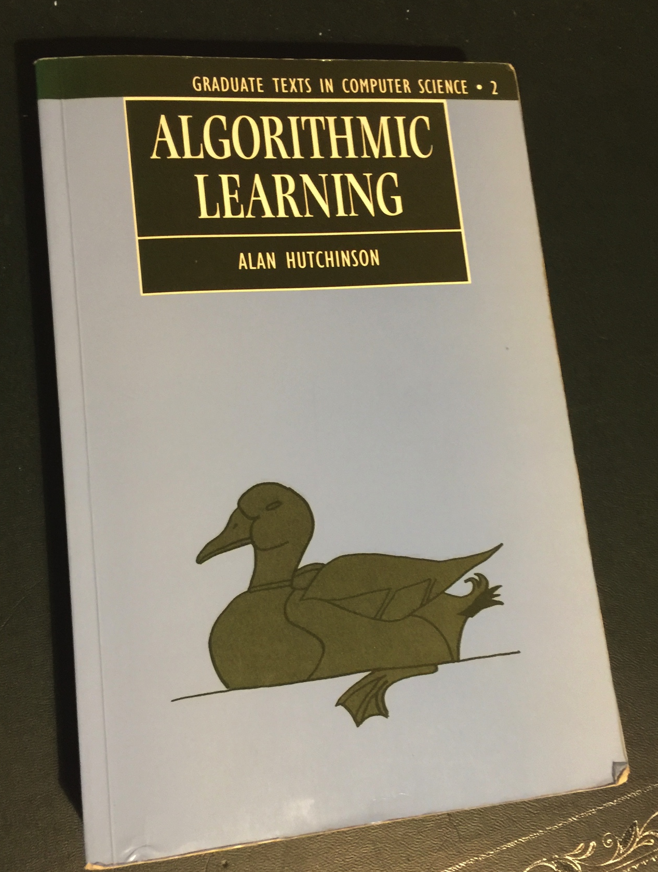
Alan Hutchinson, Algorithmic Learning, Graduate Tests in Computer Science, Clarendon Press, Oxford, 1994.
Section 6.3. Program Synthesis, pp.254-280.
Notes:
References:
Alan Hutchinson, Algorithmic Learning, Graduate Tests in Computer Science, Clarendon Press, Oxford, 1994. (Program Synthesis, Section 6.3. pp.254-280).

Slide 9
Questions
Is the synthesis of programs from test cases
  theoretically feasible?
  practically cost effective?

Slide 10
Testing vs Inductive Inference
Zhu, H., Hall, P., and May, J. 1992. Inductive inference and software testing. Journal of Software Testing, Verification, and Reliability, 2:69-81.
Notes:
References:
Zhu, H., Hall, P., and May, J., Inductive inference and software testing. Journal of Software Testing, Verification, and Reliability, 2, 69-81, 1992.

Slide 11
Structure of inductive inference
Testing itself is inductive inference
Test adequacy criteria should play the role of convergence criteria

Slide 12
Test Adequacy Criteria
As a stop rule:
  Used during testing process to determine when enough testing has been done and thus the testing can stop.
As a design rule:
  Used during test design to determine the test cases/data
As a metric:
  To measure to what extent the test has been done adequately
  A test data adequacy criterion C is a function C: P 􏰏x S 􏰏x T → {true, false}. C(p, s, t) 􏰐= true means that t is adequate for testing program p against specification s according to the criterion C, otherwise t is inadequate.
Mathematically equivalent
  A test data adequacy criterion C is a function C: P 􏰏x S 􏰏→ P(T). t C(p, s) means that t is an adequate test set for testing program p against specification s according to the criterion C, otherwise t is inadequate.
A test data adequacy criterion is a function C, C: P􏰏xS􏰏xT→[0,1]. C(p,s,t)=􏰐r means
that the adequacy of testing the program p by the test set t with respect to the specification s is of degree r according to the criterion C. The greater the real number r, the more adequate the testing.

Slide 13
Question
Are test adequacy criteria used in practice actually convergence criteria of the inductive inference underlying testing?

Slide 14
Examples of Adequacy Criteria
[Zhu, Hall & May, ACM Computing Survey, 1997]
Each criterion is regarded as an approximation of Goodenough & Gerhart’s ideal test adequacy criterion.
It is not clear how these test adequacy criteria relates to inductive inference underneath testing process!
Notes:
References:
Zhu, H., Hall, P. and May, J., Software unit test coverage and adequacy, ACM Computing Survey 29(4), 366~427, Dec. 1997.

Slide 15
Weyuker’s Axioms of Adequacy Criteria (1986)
Finite Applicability: For every program, there exists a finite adequate test set.
Non-exhaustive Applicability: There is a program p and a test set t such that p is adequately tested by t and t is not an exhaustive test set.
Monotonicity: If t is adequate for p and t 􏰦 t􏰑, then t􏰑 is adequate for p.
Inadequate Empty Set: The empty set is not adequate for any program.
Anti-extensionality: There are semantically equivalent programs p and q such that there is a test set t that is adequate for p, but not adequate for q.
General Multiple Change: There are programs p and q which are of the same shape and a test set t such that t is adequate for p, but not adequate for q.
Anti-decomposition: There exist a program p, its component q and a test set t such that t is adequate for p, but t' is not adequate for q, where t' is the set of vectors of values that variables can assume on entrance to q for some x in t.
Anti-composition: There exist programs p and q and a test set t such that t is adequate for p and p(t) is adequate for q, but t is not adequate for (p;q), where (p;q) is the sequential composition of p to q.
Notes:
References:
Weyuker, E. J., Axiomatizing software test data adequacy, IEEE Transactions on Software Engineering, 12(12), 1128-1138, 1986.

Slide 16
Weyuker’s Additional Axioms (1988)
Renaming Property: Let p be obtained by systematically renaming some variables in q. Then t is adequate for p if and only if t is adequate for q.
Complexity property: For every n, there is a program p, such that p can be adequately tested by a size n test set, but not by any size n-1 test set.
Statement Coverage Property: If t is adequate for p, then, every feasible statement of p will be executed when p is tested on t.
Weyuker, E. J. The evaluation of program-based software test data adequacy criteria, Communications of the ACM, 31(6), 668-675, 1988.
Notes:
References:
Weyuker, E. J. The evaluation of program-based software test data adequacy criteria, Communications of the ACM, 31(6), 668-675, 1988.

Slide 17
Weyuker’s Assessment of Adequacy Criteria
Baker, Howatt and Bieman (1986) proposed five properties as requirements of control flow based adequacy criteria
Zhu (1995) revised Baker et al’s required properties and combined with Weyuker’s axiom, assessed 11 control-flow test adequacy criteria
Notes:
References:
Baker, A.L., Howatt, J. W., and Bieman, J. M, Criteria for finite sets of paths that characterize control flow. Proc. of Nineteenth Annual Hawaii Int Conf. on System Sciences, pp. 158-163, 1986.
Zhu, H., Axiomatic assessment of control flow based software test adequacy criteria, Software Engineering Journal, UK, Sept. 1995.

Slide 18
Axioms of Adequacy Measurement [Zhu&Hall 1993 ]
Inadequacy of an empty test: The empty set is inadequate as a test set for all software.
Adequacy of exhaustive testing: The exhaustive test set is adequate for all software.
Monotonicity: The more test cases are used, the more adequate the test.
Law of diminishing returns: The more a program has been tested, the less a test set can further contribute to test adequacy in the context.
Convergence: For all sequences of test sets t₁, t₂, ..., t_{n}, ... ,
Finite applicability: An adequacy criterion is finitely applicable if, for all degrees of adequacy less than 1, there always exists a finite set of test cases that achieves the required adequacy degree.
Notes:
References:
Zhu, H. and Hall, P., Test data adequacy measurement, Software Engineering Journal, 8(1), pp12-30, Jan. 1993.

Slide 19
Question
Have the axiom systems of test adequacy criteria captured the nature of adequacy criteria as convergence criteria of the inductive inference underlying testing?

Slide 20
Analysis of Weyuker’s Axioms [Zhu, 1996]
This is just a re-definition of Weyuker’s inference adequacy without referring to the specification, because Weyuker’s axioms are for program-based adequacy criteria
This means the notion of inference adequacy is consistent with the key axioms of test adequacy for certain types of inductive inference /machine learning algorithms
Notes:
Zhu, H., A formal interpretation of software testing as inductive inference. Journal of Software Testing, Verification and Reliability, 6, 3-31, 1996.

Slide 21
Learnability vs Testability
Practical implication:
We do not need a written specification to test a program is correct with respect to the specification. We only need the specification is learnable and testing as an inductive inference process converges on the test set.

Slide 22
How to Test Like Inductive Inference
If we know both the program and its specifications are learnable, then we do not need to actually learn the program and specification. We only need to test if the program is correct on a test set on which the program and specification can be learned.

Slide 23
Questions
Is the synthesis of programs from test cases
  theoretically feasible?
  practically cost effective?

Slide 24
Identification in The Limit
M : an inductive inference device
A=a₁, a₂,..,a_{n},... : an infinite sequence of instances of a given rule f
f_{n}=M({a₁, a₂,..,a_{n}})
If there is a natural number K such that for all n, m >= K, f_{m} =f_{n}, then
  M converges to f_{K} on a, and
  M behaviourally identifies f correctly in the limit, or simply, f is behaviourally learnable by M
If f_{K} = f, then
  M explanatorily identifies f correctly in the limit
Let P be a set of rules. If for all f in P, f is behaviourally (or explanatorily) learnable by M, then
  P is said to be behaviourally (or explanatorily) learnable by M

Slide 25
What is learnable?
Learnable (in EX):
  One variable polynomial functions
Not learnable in BC:
  Total computable functions (but learnable in BC*)
Not learnable in polynomial time: (Angluin 1990)
  Boolean formulae in disjunctive (conjunctive) normal forms
  regular languages
  context-free languages
Case and Smith 1978, 1983,
Allow any finite number of errors
Allow n errors
Notes:
Angluin, D., Negative results for equivalence queries, Machine Learning, 5 (2), 121-150, 1990.
Case, J. and Smith, C., Anomaly hierarchies of mechanized inductive inference, Proc. 10th ACM Symposium on the Theory of Computing, San Diego, California, pp. 314-319, May 1978.
Case, J. and Smith, C., Comparison of identification criteria for machine inductive inference, Theoretical Computer Science, 25(2), 193-220, 1983.

Slide 26
Question
Conclusion
Question: Is the synthesis of programs from test cases theoretically feasible?
Answer: NO, not in the most general sense!
Can the synthesis of programs from test cases practically cost effective only on a limited sub-domain/context?

Slide 27
PAC Inductive Inference [Valiant, 1984]
PAC: Probably Approximately Correct
Two parameters about inductive inference quality: Error rate and Confidence
Notes:
References:
Valiant, L. C., A theory of the learnable, Communications of the ACM, 27(11), 1134-1142, 1984.

Slide 28
From PAC Learning to Adequacy Measurement
Definition
Theorem
Using PAC learning’s error rate as a test adequacy criterion, the criterion is consistent with the key axioms of test adequacy measurement.

Slide 29
δ-Probable Reliability
The δ-probable reliability of a software system is r if, with likelihood at least δ, the software’s p.f.d. is at most r.
This is an extension to Hamlet’s probable correctness.
A software system is said to be δ-probably correct if the probability that the software is correct is at least δ. (Hamlet 1987).
Practical implication:
Reliability estimation based on random testing depends on the complexity of the program and specification under test!
Notes:
Hamlet, R. G., Probable correctness theory, Information Processing Letters, 25(1), 17-25, 1987.

Slide 30
Pseudo Dimension and PAC Learnability
Definition of Pseudo Dimension
Haussler Theorem (1992)
Notes:
References:
Haussler, D., Decision theoretic generalizations of the PAC model for neural net and other learning applications, Information and Computation, 100(l), 78-150, 1992.

Slide 31
How Many Random Test Cases Are Needed?
Question
How to find out the pseudo dimension of a set of functions?
A partial solution: To relate computational complexity to pseudo dimension [Zhu, 1998; in Chinese]
Notes:
References:
Hong Zhu, Towards a relationship between software reliability estimation and complexity analysis, Chinese Journal of Software, 9(9), 713-717, Sept. 1998. (In Chinese) 《朱鸿， 软件可靠性估计与计算复杂性的关系浅析，软件学报，第9卷第9期，1998年9月，第713-717页。》

Slide 32
Question
Conclusion
We do not need to actually generate a program / specification from test cases to “prove a software is correct” by testing.
We only need to know the program/specification in a context of learnable set of “hypothesis”.
We still need to check the correctness of the program on each test case ==> a problem of test oracle!
Can we generate a test oracle through machine learning?

Slide 33
Some Recent Interesting Work
Dickinson, W., Leon, D., Podgurski, A., "Finding failures by cluster analysis of execution profiles", Software Engineering 2001. ICSE 2001. Proceedings of the 23rd International Conference on, pp. 339-348, May 2001.
Bowring J. F., Rehg J. M. and Harrold M. J., "Active Learning for Automatic Classification of Software Behavior," Proc. ACM International Symposium on Software Testing and Analysis, 2004.
Frounchi, K., Briand, L.C., Grady, L., Labiche, Y. and Subramanyan, R., "Automating image segmentation verification and validation by learning test oracles", Inf. Softw. Technol., vol. 53, no. 12, pp. 1337-1348, Dec. 2011.
Shahamiri, S., Wan-Kadir, W., Ibrahim, S., Hashim, S., "Artificial neural networks as multi-networks automated test oracle", Automated Software Engineering, vol. 19, no. 3, pp. 303-334, 2012.
Agarwal, D., Tamir, D. E., Last M. and Kandel, A., "A Comparative Study of Artificial Neural Networks and Info-Fuzzy Networks as Automated Oracles in Software Testing," in IEEE Transactions on Systems, Man, and Cybernetics - Part A: Systems and Humans, vol. 42, no. 5, pp. 1183-1193, Sept. 2012.
Almaghairbe, R., and Roper, M. "Separating passing and failing test executions by clustering anomalies", Software Quality Journal, pp.803-840, 2017(25).
Almaghairbe, R., Formulating Test Oracles via Anomaly Detection Techniques. PhD Thesis, University of Strathclyde, UK, 2017.

Slide 34
The Current Frontier
Fraser and Walkingshaw (2015):
  “test sets with higher behavioural coverage significantly outperform current baseline test criteria in terms of detected faults”.
Notes:
References:
Fraser, G and Neil Walkinshaw, N., Assessing and generating test sets in terms of behavioural adequacy. Software Testing, Verification And Reliability, 25:749–780, 2015.

Slide 35
Lionel Briand’s Observation [2008]
“There is very little evidence, for all existing applications of machine learning in software testing, that such [machine learning] techniques bring any benefits.”
Lionel C. Briand, Novel Applications of Machine Learning in Software Testing, The Eighth International Conference on Quality Software, 2008, pp3-10.
After 10 years since Briand’s paper published in 2008, this statement is still valid.
Notes:
References:
Lionel C. Briand, Novel Applications of Machine Learning in Software Testing, The Eighth International Conference on Quality Software, pp3-10, 2008.

Slide 36
Open Questions
How many test cases is needed to perform a supervised learning in order to obtain a reasonable good test oracle?
Will a test oracle’s sample complexity smaller than that of the program/specification? Or
Is a test oracle (checker) easier to learn than the program (constructor)? (It is likely to be true, at least for some computational problems.)
How about un-supervised learning and reinforcement learning?
Some of the known results on the application of inductive inference theory to software testing for the adequacy criterion problem also applied to test oracle problem.

Slide 37
A Clue for Future Research
Every finite hypothesis class is PAC learnable with sample complexity
An artificial neural network of n nodes and each node has k-bits can be regarded as a finite set of hypothesis of size
Existing empirical study results are most with error rates about 10% to 20%

Slide 38
Thank You

