Slide 1
An Intelligent Broker Approach to Semantics-based Service Composition
Yufeng Zhang
National Lab. for Parallel and Distributed Processing
Department of Computing Science
National Univ. of Defense Technology, Changsha, China
Email: yufengzhang@nudt.edu.cn
Hong Zhu
Department of Computing and Communication Technology
Oxford Brookes University
Oxford OX33 1HX, UK
Email: hzhu@brookes.ac.uk

Slide 2
Approaches to service composition
Workflow:
  Workflow definition + workflow engines:
    e.g. orchestration and choreography; BPEL4WS; OWL-S
Planning:
  E.g. OWLS-Xplan, SHOP2, etc.
Broker:
  Sycara et al. [2003, 2004] :
    high flexibility
    wide applicability

Slide 3
Current state of service brokers
The functions of service brokers:
  Interpreting the semantics of service queries and the registered capabilities of service providers;
  Searching for the service providers that matches a requester's query and sometime selecting the one with best track record of quality of services;
  Invoking the selected service provider on the requester's behalf and interacting with the provider if necessary to fulfil the query;
  Returning query results to the requester.

Slide 4
The goal
To enhance the power of service brokers with the capability of:
  decomposing requested services into a number of subtasks,
  searching for the best fit services for each subtask,
  composing and coordinating these services in execution.

Slide 5
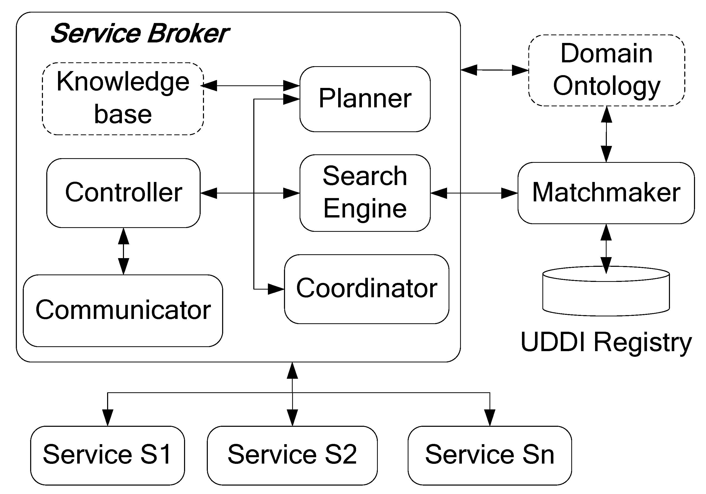
I-Broker: Architecture

Slide 6
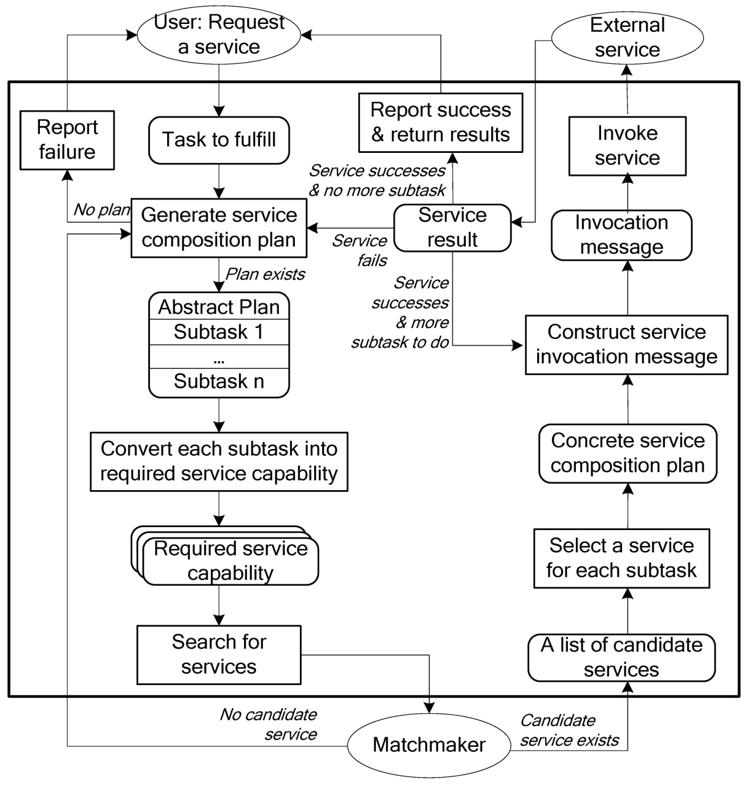
I-Broker: Control Process

Slide 7
Knowledge-base
It contains codified knowledge on how a task can be fulfilled by a number of subtasks.
Each type of tasks is defined by a set of parameters
  descriptive parameters
    describes the functionality of the task, such as the activity of the task, the execution environment of the task, and so on.
  functional parameters
    gives the data to be transformed by the task, including input and output data.
The values of parameters are concepts defined in the ontology of the application domain.
The knowledge is represented in the form of rules:
T(p₁,…, p_{n}) ⇒ T'₁(p_{1,1},…,p_{1,n1});…; T'_{k}(p_{k,1},…,p_{k,nk})

Slide 8
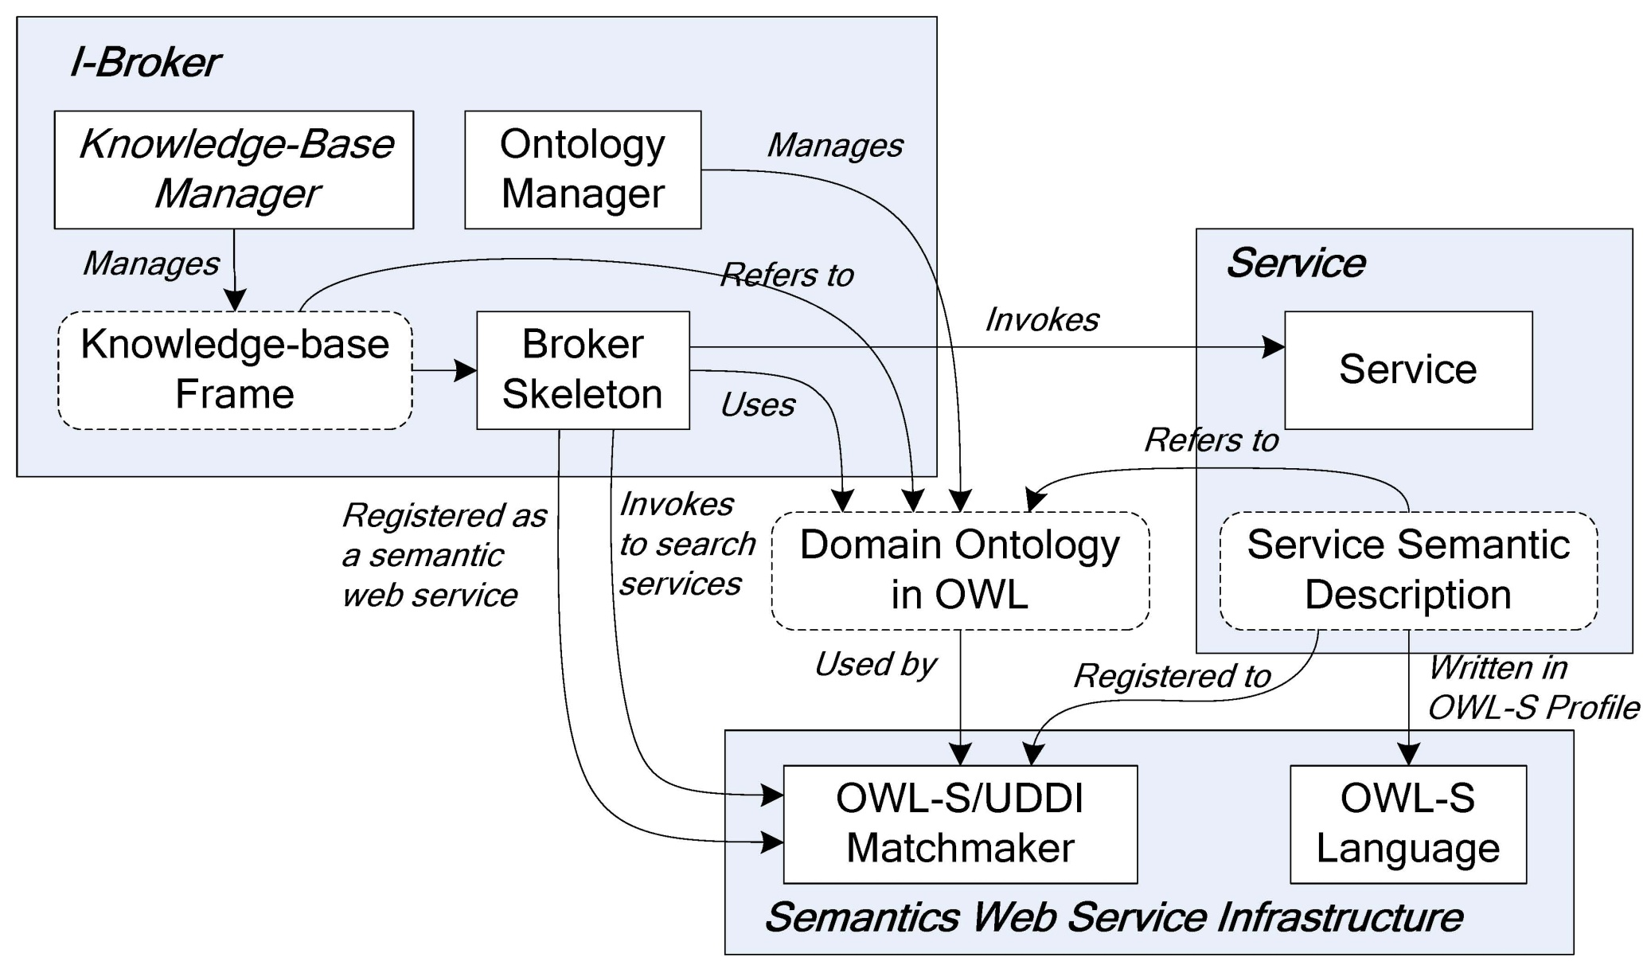
Prototype Implementation

Slide 9
Experimental Evaluation
Goal:
  to evaluate the scalability of the proposed approach
Design of the experiments
  Three types of objects in the experiments:
    Services:
      registered to the semantic WS registry.
      capabilities represented in the form of service profiles.
    Rules in knowledge-base:
      represented in the form of XML files
      stored locally within the broker as the knowledge-bases.
    Service requests:
      represented in the format of XML using the ontology.
    The services that test broker searches for
    About the workflow in the application domain and the usages of specific services
The service requests submitted to the brokers

Slide 10
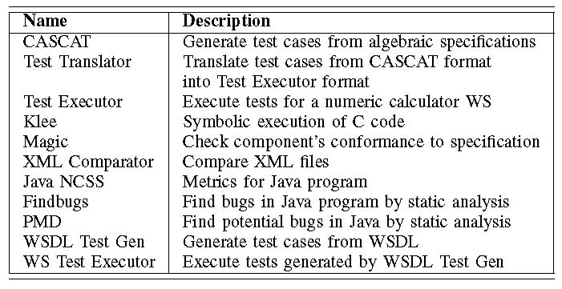
Experiment method
Data mutation technique: [Shan&Zhu 2009]
  Seeds of test data
  Mutation operators
Test data
(mutant test cases)
Seeds of Services

Slide 11
Mutation operators
Given an ontology.
Let $x$ be any of the parameters in service profiles.
RxF:
  Replace the $x$ parameter in the profile, which is a class in the ontology, by its father class in the ontology;
RxS:
  Replace the $x$ parameter in the profile by one of its subclasses in the ontology;
RxB:
  Replace the $x$ parameter in the profile by one of its brother classes in the ontology;
RxN:
  Replace the $x$ parameter in the profile by a class in the ontology that has no relation to the parameter.
 | seeds | Mutants | Total
Service | 11 | 460 | 471
Rule | 40 | 2049 | 2089

Slide 12
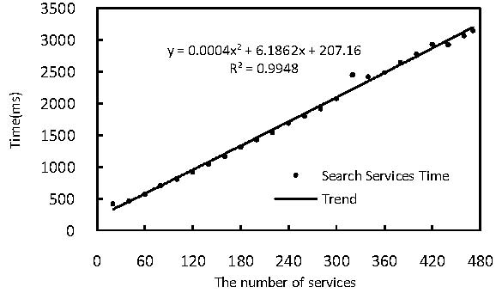
Scalability w.r.t. the number of services
Vary the registry size from 20 to 471
Execute the broker repeatedly for 30 times
almost a linear function

Slide 13
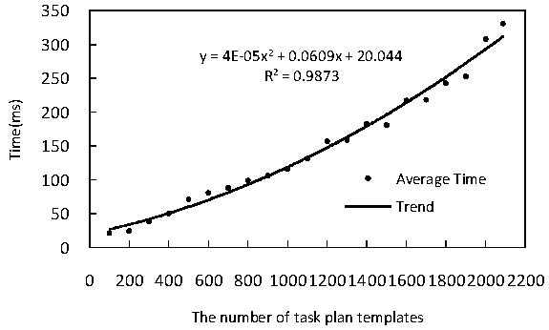
Scalability w.r.t. the size of KB
Vary the knowledge size from 100 to 2089
execute the broker on each service request for 20 times
a quadratic polynomial function

Slide 14
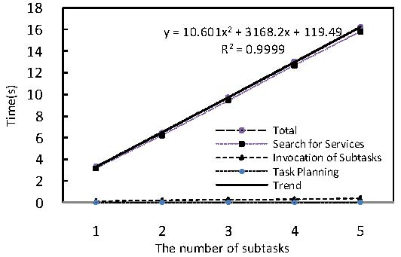
Scalability w.r.t. to task complexity
vary the service requests (5 classes of requests)
execute the broker on each service request for 30 times
A quadratic polynomial function

Slide 15
Comparison with Related Works
Workflow | Planning | I-Broker
Workflow encoded in executable form | Workflow knowledge is represented in the form of task decomposition rules | Workflow knowledge is represented in the form of task decomposition rules
 | The knowledge of workflow is simply converted from OWL-S | Workflow knowledge is treated as domain knowledge
Workflow knowledge is used statically | Plans are mostly generated by a brutal force of inference Use the whole service registry as the search space | Use workflow to generate service plan dynamically Use rules as a means of reduce search space: scalable efficient
 |  | Knowledge-base and ontology are open, and composible

Slide 16
Future work
Develop knowledge-based manager
  Enable user to write rules in a language of high level of abstraction rather than directly in XML
  Support populating, updating, and testing the knowledge-base
Embed service monitoring functionality in the service broker
  QoS directed service selection
Replace Semantic Web Service with a better semantic inference mechanism

