Slide 1
COMPSAc 2012 Panel 3
Creative Computing: Reconciling Objective Precision with Subjective Ambiguity
POSITION STATEMENT
Can Software Design Benefit From Creative Computing?
Hong Zhu
Department of Computing and Communication Technologies
Oxford Brookes University, Oxford OX33 1HX, UK
Email: hzhu@brookes.ac.uk

Slide 2
Design is a creative activity
The most elusive one
  Design problems are wicked [Rittel and Webber, 1984] or ill-structured [Simon, 1973].
  Software design is even more difficult because software is the most complicated man-made artifact and system.
Research on design methodologies
  Mastering design through education and learning
  Developing tools (CAD) to support design activities
  Performing design mechanically and automatically
Can design benefit from creative computing?
  Creative computing provides an approach to bridge the gap between
Domain knowledge
Objective precision
Subjective
Ambiguity
Position Statement 1:
Design in general and software design in particular can benefit from the research on creative computing; while the key to achieve this goal is the domain knowledge.

Slide 3
Knowledge of software design
Two approaches to the knowledge representation and application
  Design space => General design theory
  Design patterns => Algebra of design patterns

Slide 4
Design space
A design space for a particular subject area is a space in which design decisions can be made.
  Each concrete design of an object/system in the subject domain is then a point in this space.
  Design can be regarded as navigation in this space.
Understanding the design space of a particular domain plays a significant role in design.
  For example, Shaw [2012] demonstrated the differences between designs without aware of the design space and designs with explicitly and systematically exploring a design space.
Position Statement 2:
Design space is the key to the quest of design as a subject of creative computing.

Slide 5
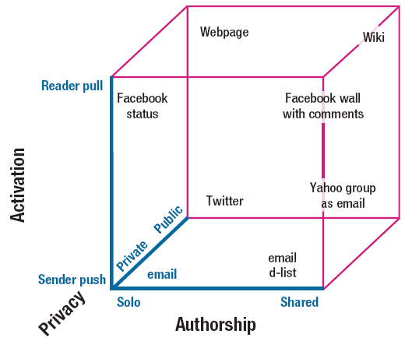
Representations of design spaces
Method 1: Multi-dimensional discrete Cartesian space
  Each dimension represents a design decision and its values are the choices of the decision.
Problems:
Most interesting design spaces are too rich to represent directly in such a way.
Design dimensions are not independent, so choosing an alternative for one decision might preclude alternatives for other decisions or make them irrelevant
Example: A small design space for Web information sharing. [Shaw, 2012]

Slide 6
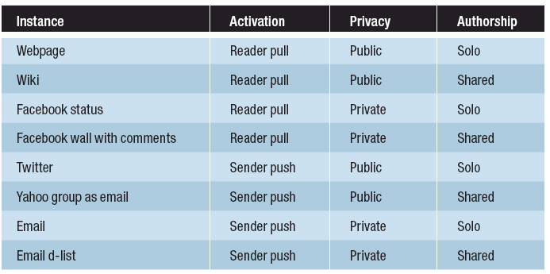
Method 2: Instance List
A list of a number of representative instances in the domain with their design decisions.
Example: The design space for Web information sharing in the form of an instance list. [Shaw, 2012]
Problems:
Unclear about what are valid combinations and what are not.
The overall structure is unclear

Slide 7
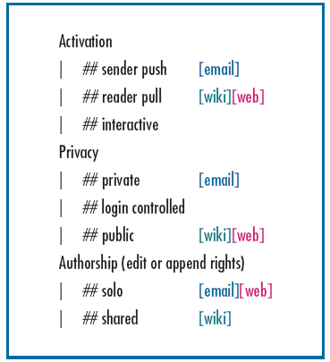
Methods 3: Hierarchical Structure [Brooks, 2010]
Nodes: represent a design decision
Branches: alternative values of the decision, which could also be dependent design sub-decisions.
Problems:
Unclear about what are valid combinations and what are not.
Dependences may exist between different branches
Example: The design space for Web information sharing in the form of a tree. [Shaw, 2012]

Slide 8
General Design Theory [Yoshikawa1980]
The notion of design space is generalised in order to achieve design automation.
  A design space is divided into two views:
    The observable/structural features of the designs
    The functional properties of the designs
  These two views are linked together by the instances of the domain
    To show which combination of properties in structural view is associated to the combination of properties in the functional view
    Two types of design problems can be solved automatically

Slide 9
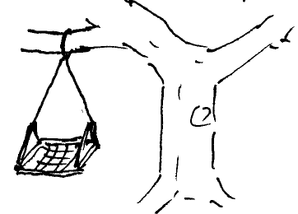
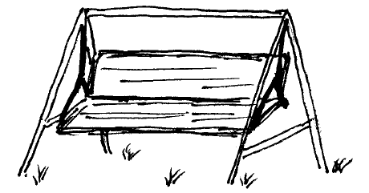
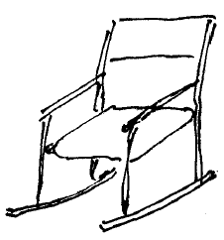
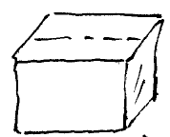
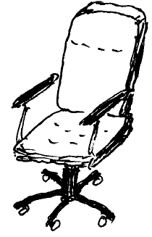
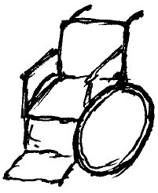
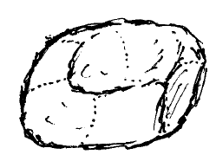
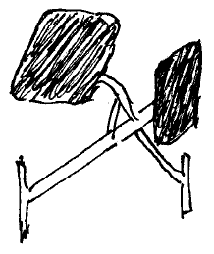
Example of Design Space: Chairs
A: Box
C: Suspended Chair 2
B: Suspended Chair 1
D: Rocking Chair
E: Scandinavian Chair
H: ‘Bean-Bag’ Chair
G: Wheel Chair
F: Office Chair

Slide 10
Example: Observable properties of chairs
Structure | Chair
 | A | B | C | D | E | F | G | H
Has a seat | + | + | + | + | − | + | + | +
Has a back support | − | − | + | + | + | + | + | −
Has legs | − | − | + | − | − | + | − | −
Has wheels | − | − | − | − | − | + | + | −
Has a vertical axis | − | − | − | − | − | + | − | −
Is lightweight | + | + | − | + | + | + | + | +
Has a hanger | − | + | + | − | − | − | − | −
Has a brake | − | − | − | − | − | − | + | −

Slide 11
Example: Functional properties of chairs
Function | Chair
 | A | B | C | D | E | F | G | H
Seats: prevents a downward movement of the body | + | + | + | + | + | + | + | +
Supports back: supports an upright posture | − | − | + | + | + | + | + | −
Revolves: revolves around a vertical axis | + | + | − | − | − | + | + | +
Movable: can be easily moved | + | − | − | − | − | + | + | +
Constrains back: constrains backward movement of back | − | − | − | − | + | + | + | −
Easy to manufacture: has a simple design with standard components | + | + | − | − | − | + | − | +
Aesthetic | − | − | + | + | + | − | − | −

Slide 12
Solving design problems in GDT
Types of design problems
  Synthesis problem
    When the functional properties are given, to find an artefact structure that satisfies the functionalities, i.e. to satisfy a set of functional properties
    A set of functional properties ⇒ a set of observable properties
  Analysis problem
    When a description of an object is given, to find out the functional properties of the object.
    A set of observable properties ⇒ a set of functional properties

Slide 13
Solving synthesis problem
The specification of our design task:
  to design a chair that is
    (a) movable and
    (b) constrains the back.
Using the knowledge of chairs depicted in slide 11 about the functional properties of chairs, we can find that
  the office chair (F) and the wheelchair (G) satisfy the functional requirements (a) and (b).
The common observable structure properties of objects (F) and (G) (as in slide 10) are:
  Has a seat
  Has a back support
  Has wheels
  Is lightweight
Solution to the design problem

Slide 14
Solving analysis problem
Description of design:
  a chair that has legs and has a hanger.
Using the empirical knowledge codified in Slide 10, we can find that
  Suspended Chair 2 (C) is the only one that has this structure.
Using the empirical knowledge codified in Slide 11, we can find that it has the following properties:
  Seats,
  Supports back,
  Does not revolve,
  Not movable,
  Does not constraints back,
  Not easy to manufacture,
  Aesthetic.
Result of analysis of the design

Slide 15
SW Architectural Design Space
Behavioural properties (dynamic properties)
  The properties of the software architectural element exhibited during the execution and related to the dynamic behaviour
Structural properties (static properties)
  The structure of the element and features that are irrelevant to the execution
List of instances:
Component | Matching Connector(s)
Procedure /function | Procedure/function call
Module | Importation (access to variables, calls to procedures)
Object/class | Method call/attribute access
Thread | Send/receive messages, access shared data
Process | Send/receive messages
Distributed process | Send/receive messages,
Remote procedure | Remote procedural call
Filter | Pipe
Global data | Access data
File | Read/write/open/close operations
Database | Database queries and updates

Slide 16
Design patterns
A design pattern contains encoded knowledge of design solutions to recurring design problems.
Much work on patterns in software engineering:
  OO Design Patterns:
    Identification, catalogues, formalisation, composition, tools
  Other Design Patterns:
    HCI designs, architectural designs, fault tolerance architecture, enterprise architecture, security design patterns, etc.
  Beyond design patterns:
    Analysis patterns, Process patterns, Testing patterns, Attack patterns, etc.

Slide 17
What Do OO Design Patterns Offer?
Identification and Catalogues of OO DPs:
  Application of design patterns in OO software design helps designer to solve difficult design problems (with instantiation tools)
  Detecting design errors at design stage and/or in the code by matching DPs against designs (e.g. in UML) and code (in Java, C++, etc.) (with recognition tools)
  Reverse engineering, it greatly helps programmer to understand the design in legacy systems
  Empirical studies have show that this can significantly improve software quality and productivity
Formalisation and Formal Reasoning about OO DPs:
  Reducing the ambiguity in the definition of patterns, which is the main source of errors in the uses of design patterns.
  Providing solid foundation for the construction of DP support tools, large differences in the tools have been observed.
  Automating DP-based software design process, which is far beyond the applications of DP via instantiation and recognition.

Slide 18
Example of DP-based OO Design
Example: design a request handling framework:
  The requests issued by clients must be objectified => Command pattern
  The independent requests from multiple clients must be coordinated => CommandProcessor pattern
  It must support the undoing of actions performed in response to requests => Memento pattern
  The requests must be logged. Different users may want to log the requests different => Strategy pattern
  A request can be atomic, or a aggregate of other request, which must executed in certain order => Composite pattern
Information about how these patterns are to be connected is omitted for the sake of space.

Slide 19
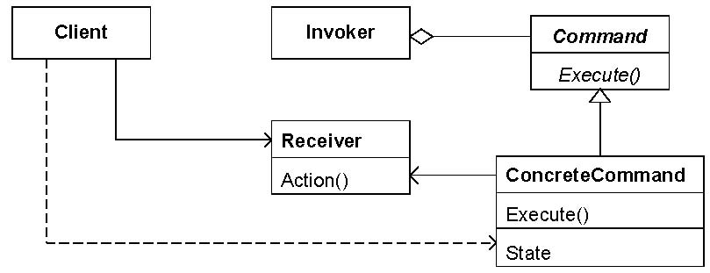
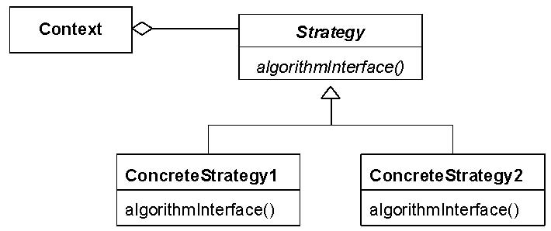
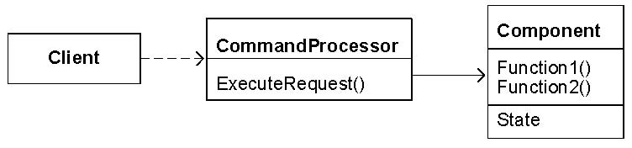
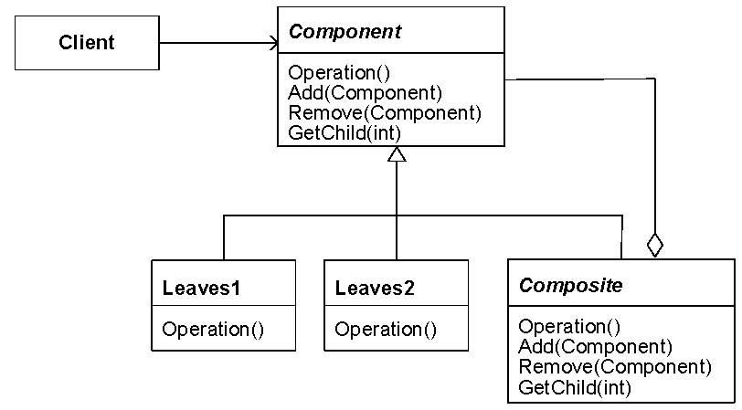
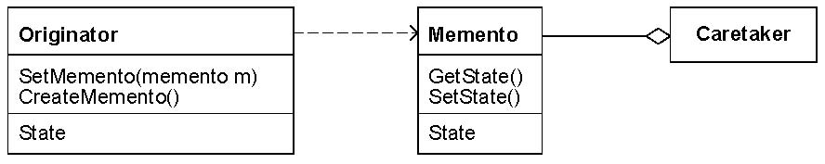
The patterns used in the example
The Command Pattern
The Strategy Pattern
The Command Processor Pattern
The Composite Pattern
The Memento Pattern

Slide 20
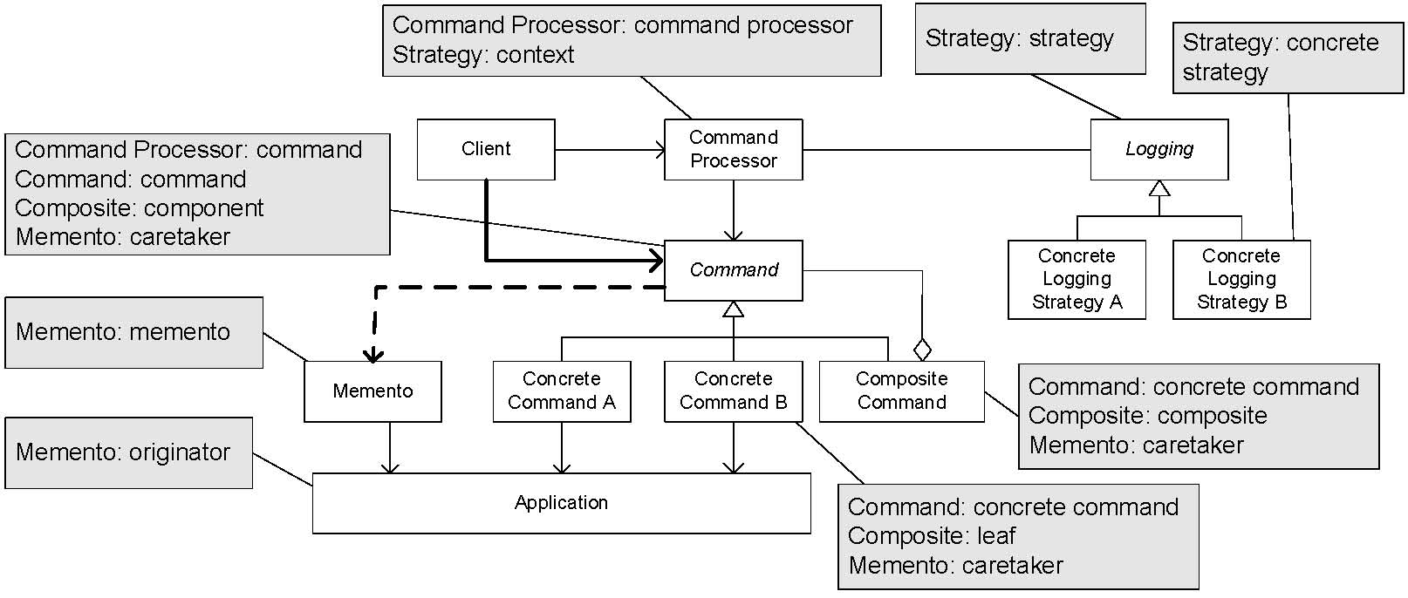
Result of The Composition
[Buschmann et al., 2007]

Slide 21
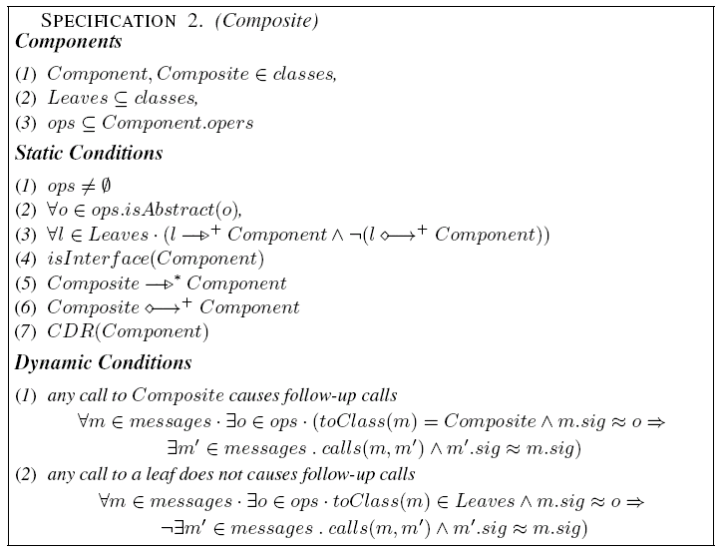
How does a formal theory help?
1. FORMAL DEFINITION OF PATTERNS
Formal specification of the Composite pattern

Slide 22
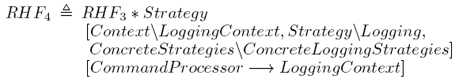

2. Formal description of design decisions
  The requests issued by clients must be objectified => Command pattern
  The independent requests from multiple clients must be coordinated => CommandProcessor pattern
  It must support the undoing of actions performed in response to requests => Memento pattern
  The requests must be logged. Different users may want to log the requests different => Strategy pattern
  A request can be atomic, or a aggregate of other request, which must executed in certain order => Composite pattern

Slide 23
Six operators on DPs
Restriction P[C]:
  to impose an additional constraint C to pattern P;
Superposition P₁ * P₂:
  to require the design to conform to both pattern P₁ and P₂;
Generalisation P⇑x:
  to allow an element x in pattern P become a set of elements of the same type of x.
Flatten P⇓x:
  to enforce a set x of element in the pattern P to be a singleton.
Lift P↑x:
  to duplicate the number of instances of pattern P in such a way that the set of components in each copy satisfies the relationship as in P and the copies are configured in the way that element x serves as the primary key as in a relational database.
Extension P#(V•C):
  to add components in V into P and connect them to the existing components of P as specified by predicate C.
See [Bayley, I. and Zhu, H. 2011] for the formal definitions of the operators.

Slide 24
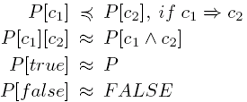
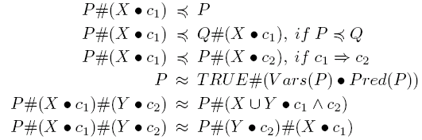


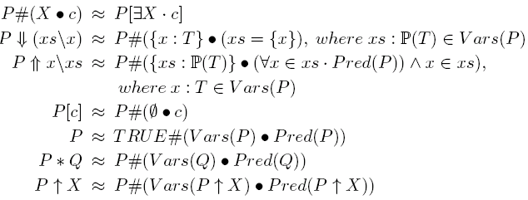

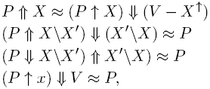

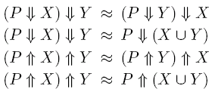


3. Apply Algebraic Laws OF DP
[Zhu, H. and Bayley, I. An Algebra of DP, ACM TOSEM, (in press)]

Slide 25
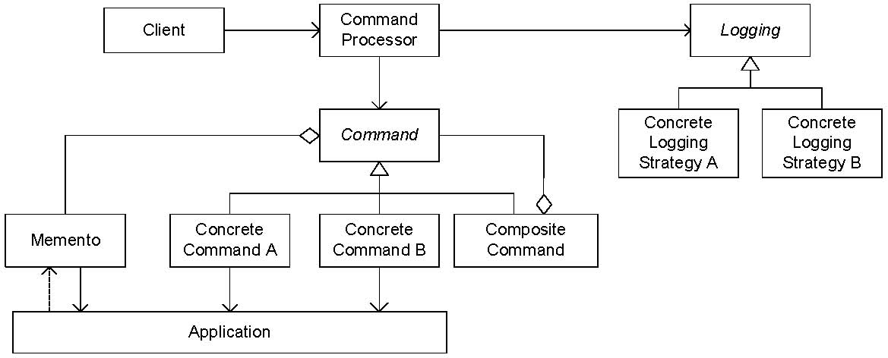
4. Work out the results formally
An error is detected by comparing with the original solution.

Slide 26
Can the theory of OO DP be generalised?
The Structure of Our OO DP Theory
Definition of UML abstract syntax in GEBNF (Graphic extension of BNF)
Derivation of a Predicate Logic Language from GEBNF syntax definition
Formal specification of DPs in the Predicate Logic Language
Formal definition of operators on OO DPs based on GEBNF syntax definition using Predicate Logic
Algebraic laws proved for
  Correctness: in predicate logic
  Completeness: existence of a normal form + a normalisation process
Position Statement 3:
The theories of design space and design pattern should be and can be unified to form a solid foundation for automating software design.

Slide 27
A proposal
Definition of the design space
  A types of elements in a system
  A number of views: each has a set of properties of the system
Derivation of a Predicate Logic Language from design space definition.
DPs are specified as a subset of points in the space using the predicate logic language
Applications of the operators on patterns and the algebraic laws to represent designs

Slide 28
Future research directions
Formalisation of the intension of design patterns so that the knowledge of design patterns can fit into the framework of General Design Theory, thus enable both synthesis and analysis design problems be solved computationally.
Generalisation of the formal theory of OO design to the patterns of other software design aspects so that a wide range of software design issues and aspects can be computed.
Representation of software architectural styles in the framework of General Design Theory.

