Slide 1
CATest: A Test Automation Framework for Multi-agent Systems
Shufeng Wang
National Laboratory for Parallel and Distributed Processing
National University of Defense Technology
Changsha, 410073, China
Email: shufeng.wang@gmail.com
Hong Zhu
Dept of Computing and Communication Technologies
Oxford Brookes University
Oxford, OX33 1HX, UK
Email: hzhu@brookes.ac.uk

Slide 2
Outline
Motivation
Review of the current state of art
Overview of the proposed framework
Prototype tool CATest
Experiments results
Conclusion and further works

Slide 3
Motivation
Software test automation
Testing is labour intensive and expensive
Test automation is imperative to reduce the cost and improve the effectiveness of testing
A great amount of research efforts has been reported and a significant progress has been made
Test automation has become a common practice in IT industry
Agent-oriented software development methodologies
Agents are autonomous, active and collaborative computational entities (such as services)
Widely perceived as a promising new paradigm suitable for the Internet-based computing
Extremely difficult to test
poor on both controllability and observability aspects of software testability
Research question
Can automated testing tools deal with the complexity of agent-oriented systems?

Slide 4
Test Automation Frameworks (TAFs)
A TAF provides a facility for setting up the environment in which test methods and assertion methods are executed and enables test results to be reported.
associating each program unit (e.g. class) with a test unit that contains a collection of test methods, each for a test.
specifying the expected test results for each test in the form of calls to assertion methods in the test class;
aggregating a collection of tests into test suites that can be run as a single operation by calling the test methods;
executing test suites and reporting the results when the code of the program is tested.
For OO programming languages, the test unit is a declared as a subclass of the class under test and called test class.

Slide 5
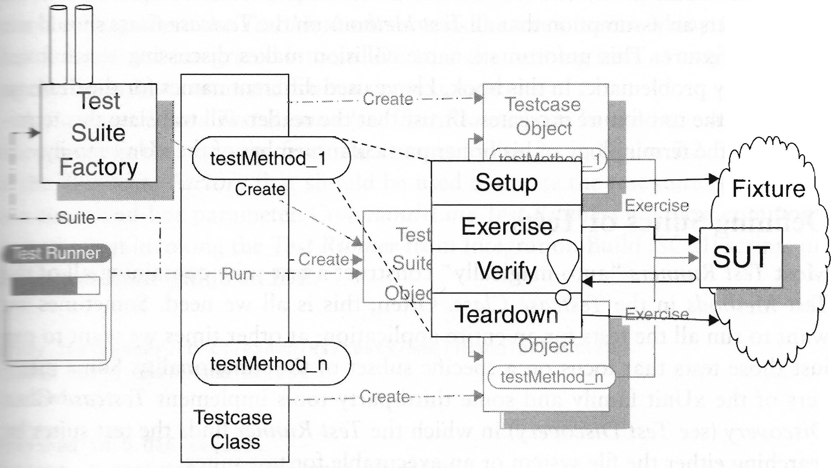
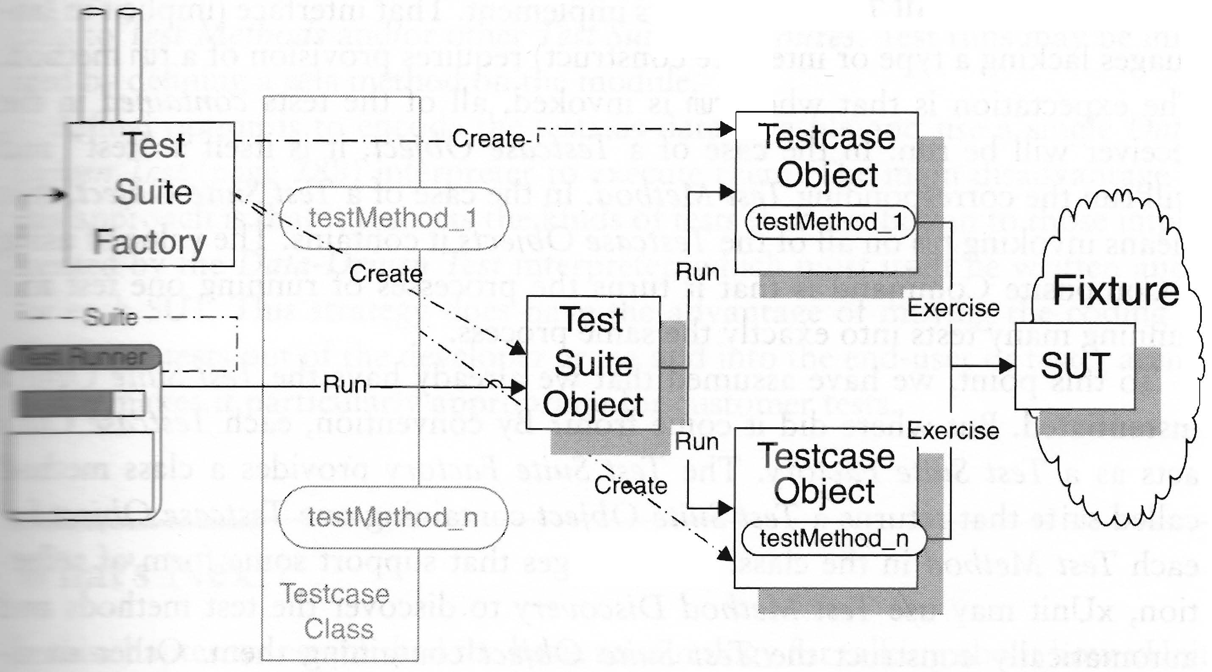
Architecture of TAFs
Dynamic View of Test Automation Frameworks
Static View of Test Automation Frameworks
[Meszaros, G., Xunit Test Patterns, Addison Wesley, 2007]

Slide 6
The current state of art
Test Automation frameworks
Best practice of test automation in IT industry
Wide range of products are available, some as open source, e.g.,
JUnit for testing software written in Java
CppUnit for C++, NUnit for .NET
RUnit for Ruby, PyUnit for Python
VbUnit for Visual Basic
Selenium for Web Services, etc.
TAFs can significantly reduce test costs and increase test efficiency, especially when
the program code is revised frequently
testing is repeated for many times
in agile development processes
The test code is a valuable and tangible asset and can be sold to component customers

Slide 7
Weakness of Existing TAFs
This is not only labour intensive, but also error prone.
Manual coding of test classes
write test code to represent test cases in test methods
translate specification into assertion methods
Lack of support to the measurement of test adequacy
There is no facility in the existing TAFs that enables the measurement of test adequacy.
Weak in the support to correctness checking
The assertion methods can only access the local variables and methods of the unit under test.
Implications:
correctness cannot be checked against the context in which the unit is called
correctness checking cannot across multiple executions of the unit under test
Well, it is doable, but needs advanced programming to achieve this.

Slide 8
Testing Agent-based Software
Research on testing agent-based systems have addressed the following aspects of testing MAS
correctness of interaction and communication [6]–[10]
correctness of processing internal states [11]–[14]
generation of test cases [12], [15]
control of test executions [16]–[18]
Adequacy criteria
Low et al. [1999] proposed a set of coverage criteria defined on the structure of plans for testing BDI (Belief-Desire-Intention) agents.
Test automation frameworks
SUnit for Seagent by extending JUnit [17]
JAT for Jade [7]
the testing facility in INGENIAS [18]
in Prometheus methodology [13]
All of these are extensions of OO TAFs with slight additional features of agents.

Slide 9
Why need a new type of TAFs
Insufficient support to correctness checking:
What the facility supports:
The mechanism replies on the internal information of the unit under test (i.e. object or agent) and the data at a single time point
What we require:
Agents are autonomous, proactive, context-aware and adaptive
They often deliver the functionality through emergent behaviours that involve multiple agents
The specifications of the required behaviours in a MAS are often hard to translate into assertion methods manually
Most MAS are continuous running systems.
to determine when to stop a test execution
to measure test adequacy during testing executions
The correctness of agent’s behaviours must be judged
in the context of the dynamic and open environments
the histories that agents have experienced in previous executions

Slide 10
Proposed approach
1. Division of testing objectives into 4 layers
Infrastructure level
Devoting to the validation and verification of the correctness of the implementation of the infrastructure facilities that support agent communication and interactions
Caste level
Focusing on validating and verifying the correctness of each individual agent’s behaviour
Cluster level
Aiming at validating and verifying the correctness of the behaviours of a group of agents in interaction and collaboration processes
Global level
Aiming at validating and verifying the correctness of the whole system’s behaviour, especially the emergent behaviour
Equivalent to class in object-orientation

Slide 11
Key Components of the Architecture
Runtime facility for behavior observation
A library provides support to the observation of the dynamic behaviors
Invocations of the library methods are inserted into the source code
When the AUT is executed, its behavior is observed and recorded
It enables both correctness checking and adequacy measurement
Test oracle
Takes a formal specification or model and recorded behaviors as input
Checks automatically the correctness of the recorded behaviors against the formal specification
Generic test coverage calculator
Takes a formal specification and a set of recorded behavior as input
Translates formal specification into test requirements according to user selected test adequacy criteria
Calculates specification coverage while checking the correctness
Test execution controller
Runs the coverage calculator in parallel to the system under test
Stops one test when an elemental adequacy criterion is satisfied
Stops the whole testing when satisfies a collective adequacy criterion
In SLABS (Specification Language for Agent-Bases Systems)

Slide 12
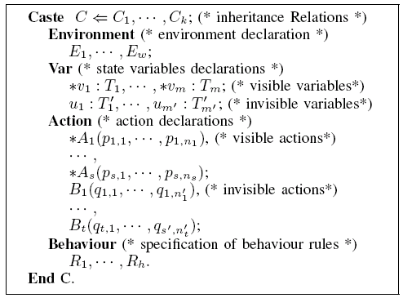

A quick overview of SLABS
Agents are instances of castes;
An agent can be multiple castes;
Agents can dynamically change their casteships by joining or quitting a caste;
Environment determines a set of other agents in the system whose behaviour are the input to the specified agent
Behaviour rules are in the form of
See [Zhu 2001] for details.
For the sake of simplicity, here we write in the following form.

Slide 13
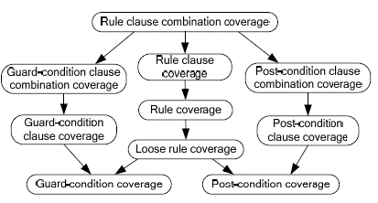
Test Adequacy criteria
A set of adequacy criteria have been defined and implemented based on guard-condition semantics of behavior rules
The criteria have the following subsumption relations

Slide 14
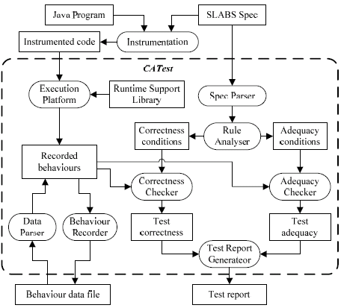
CATEST: TAFs for caste level testing
Architecture of CATest

Slide 15
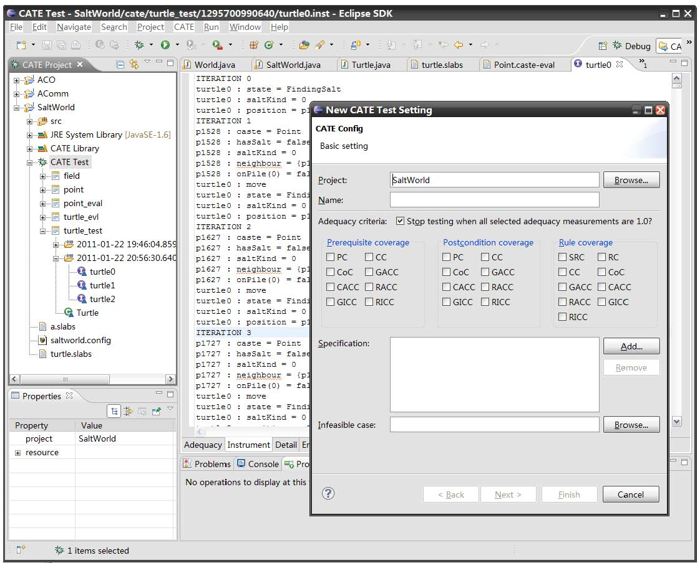
CATest UGI For Set Test Parameters

Slide 16
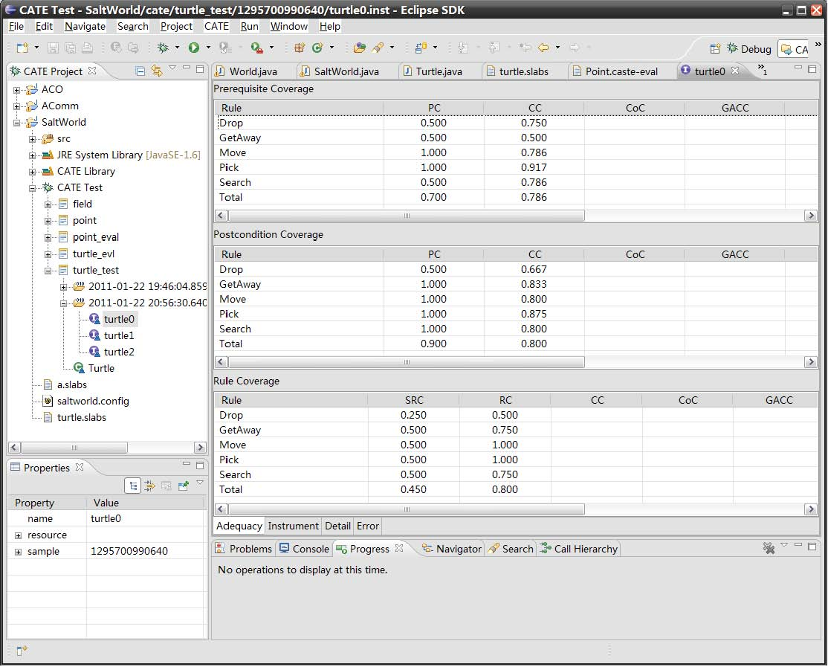
CATest GUI: Report Test Results

Slide 17
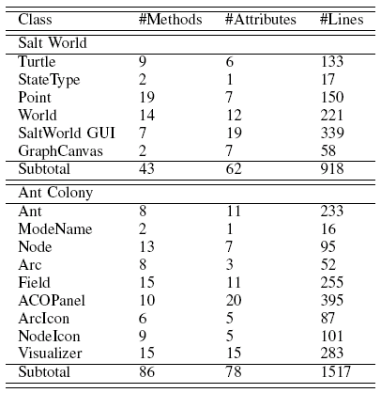
Experiments: The Subjects

Slide 18
Experiments: Process
Generation of mutants
The muJava testing tool is used to generate mutants of the Java class that implements the caste under test.
Analysis of mutants
Each mutant is compiled and those contain syntax errors are deleted. Those equivalent to the original are also removed.
Test on mutants
The original class is replaced by the mutants one by one and tested using our tool. The test cases were generated at random. The test executions stop when the Rule Coverage Criterion is satisfied, or the execution stops abnormally when an interrupting exception occurs.
Classification of mutants
A mutant is regarded as killed if an error is detected, i.e. when the specification is violated. Otherwise, the mutant is regarded as alive.
This is different from traditional definition of dead mutants, which does not work because the non-deterministic nature of the system.

Slide 19
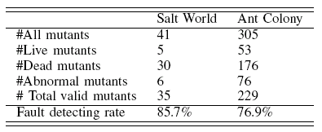
Experiments: Results

Slide 20
Analysis of Experiment Results
Observations:
Mutants that represent faults at the caste level, such as in the behaviour rules, are detected 100% in our experiments using the rule coverage criterion.
The kinds of mutants that are not killed
Mutants that change the code that initializes the agent’s state
Mutants that change the code that sends/receives messages to/from the others agents
Mutants that change the code inside the functions/ methods of actions
Mutants that change the infrastructure code
Conclusions:
The method works well at caste level
Testing at other levels are necessary
These mutants correspond to faults that are either at a higher or a lower level than caste level.

Slide 21
Conclusion and Further works
Main Contribution 1: Architecture of TAFs:
Proposed a novel architecture of TAFs
Presented a prototype tool CATest for testing MAS
Conducted experiments with the CATest tool
Key features:
It automatically checks the correctness of software dynamic behaviours against formal specifications without the need to manually write assertion methods.
It fully supports automatic measurement of test adequacy and use the adequacy measurement to control test executions.
Applicability:
All levels of MAS testing
Can be easily adapted for testing OO software.
Further work:
Experiments in larger scale
Note:
1. Overcoming the weakness of existing TAFs.
2. Test cases generation is not a part of the TAF, but can be easily integrated to the framework.
Note: We have developed a test environment called CATE-Test that supports all levels of agent test. CATest is a part of CATE-Test.
Work in Progress:
Experiments with MAS testing at other levels.

Slide 22
Main Contribution 2: Testing MAS
Proposed a new hierarchy of adequacy criteria for specification-based testing
Implemented these adequacy criteria in the CATest tool
Key features:
Treat guard-conditions differently from pre/post-conditions
Reflect better the semantics of guard conditions in testing
Take full consideration of non-determinism
Applicability
Applicable to MAS at caste level
All systems that
are running continuously, non-deterministically and event-driven
specified by a set of behaviour rules with guard-conditions
e.g. distributed and service-oriented systems
Note: Other levels will need different adequacy criteria
Future Work :
Testing service-oriented systems: TAFs and adaptation of the adequacy criteria
Work in Progress:
Study of adequacy criteria and their effectiveness in detecting faults at other levels.

Slide 23
Thank you
Questions?

