Slide 1
CloudCom 2012
Self-Adaptive Management of
The Sleep Depths of Idle Nodes
in Large Scale Systems
to Balance Between Energy Consumption and Response Times
Yongpeng Liu⁽¹⁾, Hong Zhu⁽²⁾, Kai Lu⁽¹⁾，Xiaoping Wang⁽¹⁾
⁽¹⁾ School of Computer Science, National University of Defense Technology, Changsha, P. R. China
⁽²⁾ Department of Computing and Communication Technologies, Oxford Brookes University, Oxford, U.K

Slide 2
Motivation
the power usage of a middle scale city
Large scale high performance computing systems consume a tremendous amount of energy
The average power consumption of Top10: 4.34 MW
The peak power consumption of the K computer: 12.659 MW
Power management is essential for cloud computing
In 2006, US data centers: ≈ 61 billion kWh
In 2007, global cloud computing: 623 billion kWh
The power consumption of an idle node: about 50% of its peak power
> the electricity demand of India (the 5th largest demand country in the world)
4.5 billion U.S. $
15 typical power plants

Slide 3
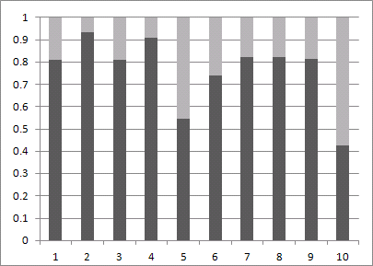
Energy Efficiency of Top10 (June 2012)

Slide 4
Availability of Hardware Support
Dynamic sleep
mechanism:
S₀: Active
S_{n}:
Shut down
S₁: Sleep 1
S₂: Sleep 2
S_{n-1}: Sleep n-1
Data of a typical node:
Sleep state | Energy Consumption (Watts) | Time delay (second)
S0 | 207 | 0
S1 | 171 | 2
S3 | 32 | 10
S4 | 26 | 190
S5 | 0

Slide 5
The Research Problem
Key features of dynamic sleep mechanism
The deeper the node sleeps, the less power it consumes (always less than idling in the active state)
The deeper the node sleeps, the more time delay to wake up
Question:
How to balance between performance and energy consumption

Slide 6
Related Works
Multiple sleep states are not used.
Single sleep state
Server consolidation
Finding an active portion of the cluster dynamically
The idle remainders are simply turned off
(Xue, et al., 2007)
Active resource pools whose capacity is determined by the workload demand
Spare nodes are simply turned off
Multiple sleep states
(Gandhi, Harchol-Balter and Kozuch, 2011)
Does not dynamically manage the sleep depth of idle servers
(Horvath and Skadron, 2008)
Predicate the incoming workload based on history
Select a number of spare servers for each power states according to heuristic rules
Extra spare servers are put in the deepest possible sleep states

Slide 7
The Proposed Model ASDMIN: Adaptive Sleep Depth Management of Idle Nodes
The Structure of ASDMIN

Slide 8
The management Algorithms
Resource Allocation and Reclaim
Allocation:
Allocate nodes from top level(s) of resources pool(s)
Reclaim:
Place nodes to the top level resource pool.
Changing the states of Idle nodes
Upgrading: (called after allocation)
For i from the top level to the bottom level do
if N_{i} < R_{i} , Move (R_{i} - N_{i}) nodes from B_{i-1} into B_{i}
Downgrading:
For i from the top level to the bottom level do
if ((t_{i} > T_{i}) && (N_{i} > R_{i})), Move N_{i}-R_{i} nodes of B_{i} to B_{i-1} ;
Level i reserve pool
reserve capacity threshold
state continuance threshold
Continuous time period without piercing

Slide 9
Adjustment of Reserve Capacity Threshold
In this case, at least one node in the lower level reserve pool is used.
Piercing a reserve pool
A reserve pool is pierced at a time moment, if all the nodes in the pool are allocated but the resource is still insufficient to meet the need.
Algorithm (invoked after each resource allocation)
When piercing of a reserve pool occurs, its reserve capacity threshold R_{i} is increased;
When there are residual nodes in a reserve pool after its providing enough nodes, its reserve capacity threshold R_{i} is increased;

Slide 10
Implementation and Evaluation
Parallel Workload Archive [14]
Dozens of workload logs on real parallel systems.
Each log contains the following job information:
submit time
wait time
run time and
number of allocated processors
The ANL Intrepid log
40,960 quad-core nodes
Simulations start at the time 0 of the log.
The data of the first 24 hours are neglected
Used the data of workload on the following 48 hours
From the information and the system scale, one can work out the number of nodes in the system at each second.
This is the largest system scale among all published logs.
To avoid the fulfilling effect

Slide 11
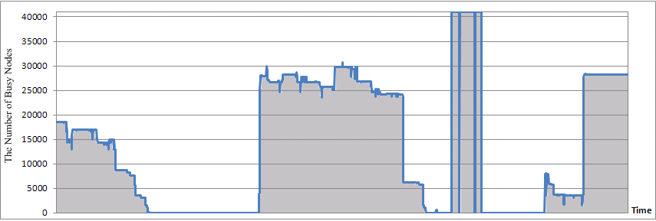
Workload of the ANL Intrepid Log
There is a large number of idle nodes in about 94.79% of the time.

Slide 12
Simulation Environment
Compute node: The Tianhe-1A
Two 6-core Xeon CPUs and 8 GB DIMMs
Simulation scenarios:
Flat reserve pool structures (S0, S1, S3, S4)
Hierarchical reserve pool structure (ASDMIN)
The measurement and metrics:
Performance:
Power efficiency:

Slide 13
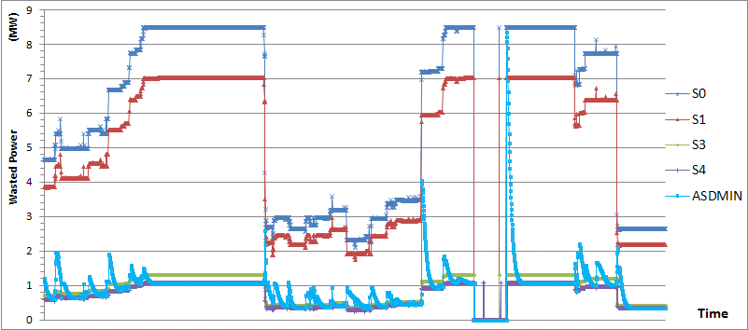
Main Results 1: Comparison on Power Efficiency

Slide 14
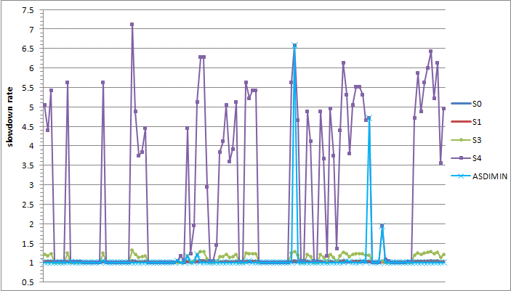
Main Results 2: Comparison on Performance

Slide 15
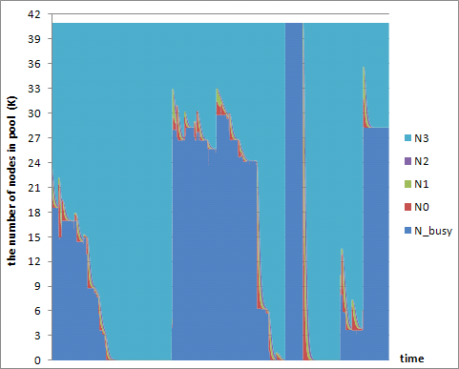
The Self-Adaptive Behaviour

Slide 16
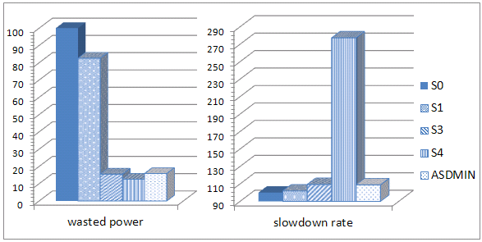
Main Results 3: Overall Effects
84.12%
87.44%
8.85%

Slide 17
Conclusion and Future Work
Conclusion:
The simulation experiments demonstrated that our solution can reduce the power consumption of idle nodes by 84.12% with the cost of slowdown rate being only 8.85%.
Future work:
Conducting more experiment with the system in order to gain a full understanding of the relationships between various parameters.
Exploring the combination of various policies in the selection of idle node for downgrading and upgrading sleep states

Slide 18
Thank you

