Slide 1
Towards A General Theory of Patterns
Hong Zhu
Dept of Computing and Communication Technologies
Oxford Brookes University
Oxford, OX33 1HX, UK
Email: hzhu@brookes.ac.uk

Slide 2
Motivation
Much work on patterns in software engineering:
OO Design Patterns:
Identification, catalogues, formalisation, composition, tools
Other Design Patterns:
HCI designs, architectural designs, fault tolerance architecture, enterprise architecture, Security design patterns, etc.
Beyond design patterns:
Analysis patterns, Process patterns, Testing patterns, Attack patterns, Forensic patterns?, etc.
An Observation:
The notions of patterns in different subject areas carry a great deal of similarity
Lack of a general theory that applies to all types of patterns
Research Question:
Is it possible to have a general theory of patterns?
If yes, what are the benefit for such a theory?

Slide 3
What Do OO Design Patterns Offer?
Identification and Catalogues of OO DPs:
Application of design patterns in OO software design helps designer to solve difficult design problems (with instantiation tools)
Detecting design errors at design stage and/or in the code by matching DPs against designs (e.g. in UML) and code (in Java, C++, etc.) (with recognition tools)
Reverse engineering, it greatly helps programmer to understand the design in legacy systems
Empirical studies have show that this can significantly improve software quality and productivity
Formalisation and Formal Reasoning about OO DPs:
Reducing the ambiguity in the definition of patterns, which is the main source of errors in the uses of design patterns.
Providing solid foundation for the construction of DP support tools, large differences in the tools have been observed.
Automating DP-based software design process, which is far beyond the applications of DP via instantiation and recognition.

Slide 4
Example of DP-based OO Design
Example: design a request handling framework:
The requests issued by clients must be objectified => Command pattern
The independent requests from multiple clients must be coordinated => CommandProcessor pattern
It must support the undoing of actions performed in response to requests => Memento pattern
The requests must be logged. Different users may want to log the requests different => Strategy pattern
A request can be atomic, or a aggregate of other request, which must executed in certain order => Composite pattern
Information about how these patterns are to be connected is omitted for the sake of space.

Slide 5
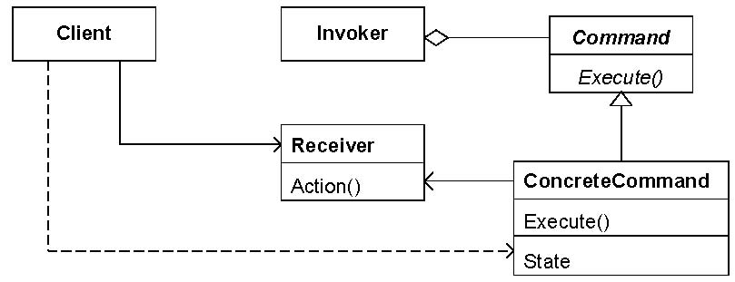
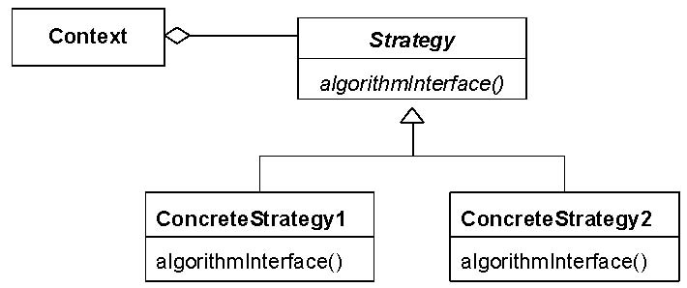
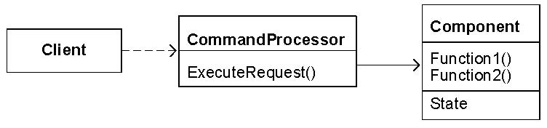
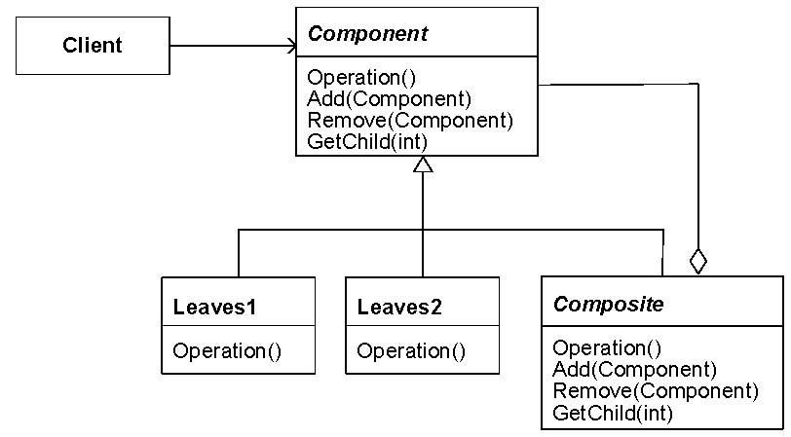
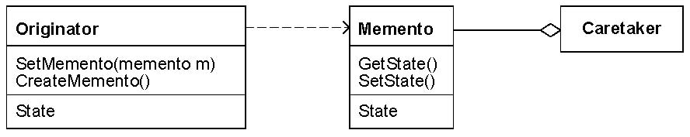
The patterns used in the example
The Command Pattern
The Strategy Pattern
The Command Processor Pattern
The Composite Pattern
The Memento Pattern

Slide 6
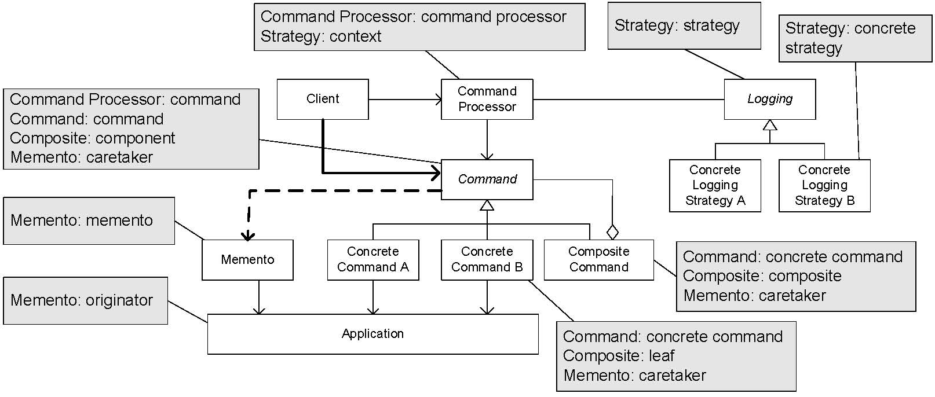
Result of The Composition
[Buschmann et al., 2007]

Slide 7
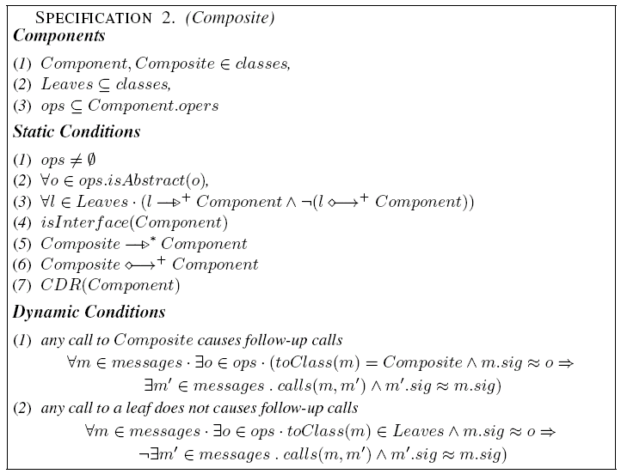
How does a formal theory help?
1. FORMAL DEFINITION OF PATTERNS
Formal specification of the Composite pattern

Slide 8
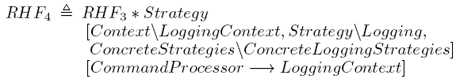

2. Formal description of design decisions
The requests issued by clients must be objectified => Command pattern
The independent requests from multiple clients must be coordinated => CommandProcessor pattern
It must support the undoing of actions performed in response to requests => Memento pattern
The requests must be logged. Different users may want to log the requests different => Strategy pattern
A request can be atomic, or a aggregate of other request, which must executed in certain order => Composite pattern

Slide 9
Six operators on DPs
Restriction P[C]:
to impose an additional constraint C to pattern P;
Superposition P₁ * P₂:
to require the design to conform to both pattern P₁ and P₂;
Generalisation P⇑x:
to allow an element x in pattern P become a set of elements of the same type of x.
Flatten P⇓x:
to enforce a set x of element in the pattern P to be a singleton.
Lift P↑x:
to duplicate the number of instances of pattern P in such a way that the set of components in each copy satisfies the relationship as in P and the copies are configured in the way that element x serves as the primary key as in a relational database.
Extension P#(V•C):
to add components in V into P and connect them to the existing components of P as specified by predicate C.
See [Bayley, I. and Zhu, H. 2011] for the formal definitions of the operators.

Slide 10
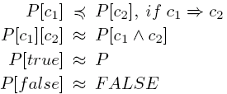
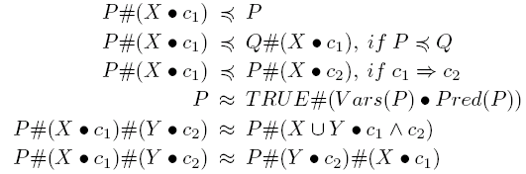


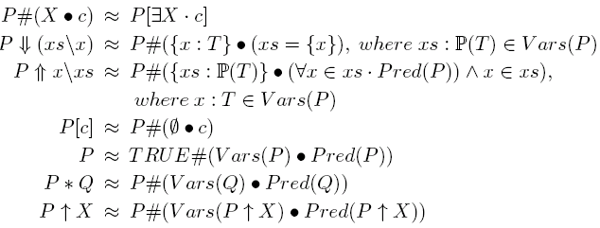

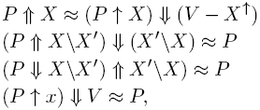

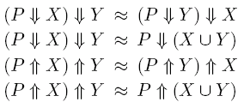


3. Apply Algebraic Laws OF DP
Zhu, H. and Bayley, I. An Algebra of DP, ACM TOSEM, (in press)

Slide 11
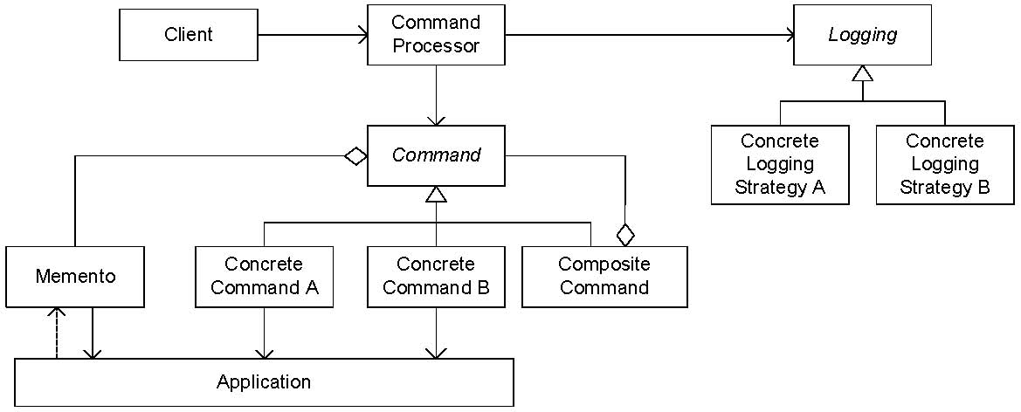
4. Work out the results formally
An error is detected by comparing with the original solution.

Slide 12
Can the theory of OO DP be generalised?
The Structure of OO DP Theory
Definition of UML abstract syntax in GEBNF (Graphic extension of BNF)
Derivation of a Predicate Logic Language from GEBNF syntax definition
Formal specification of DPs in the Predicate Logic Language
Formal definition of operators on OO DPs based on GEBNF syntax definition using Predicate Logic
Algebraic laws proved for
Correctness: in predicate logic
Completeness: existence of a normal form + a normalisation process
Proposed Generalisation
Definition of the design space using GEBNF
Derivation of a Predicate Logic Language from GEBNF syntax definition. (This is a functor in category theory)
Formal specification of DPs in the predicate logic language
Generalise the definitions of the operators for all design spaces
Re-prove the algebraic laws

Slide 13
Design space of Security DPs
DESIGN SPACE SecuritySystems;
TYPE
Subsystem:
name: STRING, content: [Value], description: [STRING];
InfoFlow:
name: STRING, from, to: Subsystem, type: [STRING];
VIEW Structure;
PROPERTY
type: Subsystem -> {aataStore, computation};
mode: Subsystem -> {active, passive};
RELATION
Is-a-part-of: Subsystem x Subsystem;
END structure;
VIEW Behaviour;
…
END Behaviour;
END SecuritySystems
Entity types
Properties of the entities in a certain view of the system
Relationships between the entities in a view
There may be multiple different views of the system

Slide 14
Security System Design Patterns
architecture of an indirect in-line authentication architecture
Claimant
Trusted Third party
AI
Claim AI
Verify AI
Verified AI
Verifier
Claim AI
PATTERN Indirect-In-Line-Authentication IN SecuritySystem;
COMPONENT
Claimant, TrustedThirdParty, Verifier, ClaimAI1, VerifyAI, ClaimAI2: Subsystem;
ClaimAI12VerifyAI, VerifyAI2ClaimAI2, ClaimAI22Verifier: InfoFlow;
CONSTRAINT
ClaimAI is-a-part-of Claimant; VerifyAI is-a-part-of TrustedThirdParty;
ClaimAI2 is-a-part-of TrustedThirdParty;
ClaimAI12VerifyAI.from = ClaimAI1; ClaimAI12VerifyAI.to = VerifyAI;
VerifyAI2ClaimAI2.from= VerifyAI; VerifyAI2ClaimAI2.to = VerifyAI;
ClaimAI22Verifier.from = ClaimAI2; ClaimAI22Verifier.to = Verifier;
END

Slide 15
encryption and decryption
Source Text
Recovered text
Encrypt
Ciphertext
Decrypt
Key1
Key2
PATTERN EncryptDecrypt IN SecuritySystem;
COMPONENT
encrypt, decrypt, source, ciphered, recovered, key1, key2: Subsystem;
source2encrypt, encrypt2ciphered, ciphered2decrypt, decrypt2recovered,
key12encript, key22decrypt: InfoFlow;
CONSTRAINT
encrypt.type=computation; decrypt.type=computation;
source.type=dataStore; ciphered. type=dataStore;
recovered. type=dataStore; key1.type=dataStore; Key2.type=dataStore;
source2encrypt.from=source; source2encrypt.to= encrypt;
encrypt2ciphered.from= encrypt; encrypt2ciphered.to= ciphered;
ciphered2decrypt.from= ciphered; ciphered2decrypt.to= decrypt;
decrypt2recovered.from= decrypt; decrypt2recovered.to= recovered;
…
END

Slide 16
symmetric and asymmetric encryption/ decryption
PATTERN SymetricEnDEcryppt in SecuritySystem EQUALS
EncryptDecrypt [key1.content = key2.content]
END
PATTERN AsymetricEnDEcryppt in SecuritySystem
EQUALS
EncryptDecrypt [not (key1.content = key2.content)] END
Application of the restriction operator

Slide 17
Open questions and further research
More details of the security design space and DPs must be worked out
Can attack patterns be specified in the same way?
Can composition of attack patterns be formally described in the same way?
To what extent will forensics of cybercrimes be performed as matching traces of behaviour against an attack pattern?
Problems not investigated in the research on OO DPs, but important for security:
Can we define formally what means by a security pattern is against an attack pattern? And how to prove that such a claim is true?
Can we prove a composition of two security patterns can prevent all compositions of the attack patterns that each is supposed to prevent by a security pattern?

Slide 18
Thank you

