Slide 1
Keynote at
Cybermatics 2017, Exeter, UK
Cyberpatterns
-- Towards a Pattern Oriented Study of Cyberspace
Prof. Hong Zhu
Department of Computing and Communication Technologies
Oxford Brookes University, Oxford OX33 1HX, UK
Email: hzhu@brookes.ac.uk

Slide 2
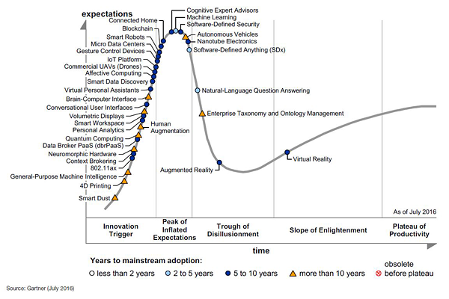



Background

Slide 3
Pattern
  A pattern represents a discernible regularity in the nature or in manmade systems and objects.
Examples:
  Patterns in nature
  Patterns in art
  Patterns of human behaviour
  Patterns in nurture

Slide 4


Patterns in Nature

Slide 5


Patterns in Art Design

Slide 6
Patterns of Human Behaviours
Patterns of individual’s behaviours
  Going to a friend’s house to play cards every Saturday evening
  Going to work every workday morning by driving on certain route
    On Thursday during semester week: leave home 8am;
    On other days: leave home 9am;
Patterns of collective behaviours
  For UK Newspaper Websites, the home pages have a pattern of change frequency:
    First peak around 12:00
    Second peak around 17:00
Zhang, Y., Huo, Q., Zhang, L., Zhu, H., Greenwood, S., Measuring the timeliness of websites, Proc. of the Fourth European Conference on Software Measurement and ICT Control, Heidelberg, Germany, 8-11 May 2001, pp 139~147.

Slide 7
Pattern-Oriented Research Methodology
Research questions are asked and answered with pattern as the central concept.
Discovering patterns:
  Facilitating the observations of the phenomena in a subject domain, such as the cyberspace
  Finding the regularities in the observed phenomena
  Representing the regularities (descriptively and/or prescriptively)
Understanding patterns:
  Discovering the structures and mechanisms underlying such repeating phenomena
  Determining the relationships between various repeating phenomena
  Classifying and categorising such phenomena
  Standardising the vocabulary of such phenomena to form pattern languages, etc.
Applying patterns:
  Devising the operations and facilities to detect, predict and prevent and/or reproduce such phenomena with clearly defined purposes

Slide 8
Example of POR: Software Design Patterns
The subject domain: Software systems
  The most complex manmade artefacts
  A vast range of different application domains
  Notoriously difficult to design and implement
  A great number of software systems that have been developed
    Some are very successful
    Some completely failed
The research question:
  Can design knowledge contained in the successful software systems be extracted and reused in the design of other software systems?
POR approach:
  Regarding knowledge of successful designs as patterns, i.e. repeated success stories as reusable solutions to recurring design problems

Slide 9
Review of Research on DPs
Identification and documentation of design patterns
Catalogues of patterns and pattern languages
Formal specification of design patterns
Development of software tools
  Detection of design patterns in program code and in designs models for reverse engineering
  Instantiation of patterns for software design
  Visual and graphical representation of patterns
Composition of design patterns
  Visual notations, such as the Pattern:Role annotation and a forebear based on Venn diagrams,
  Operators on design patterns for representation of the composition and instantiation of design patterns
  Algebraic laws of DP operators for reasoning about patterns

Slide 10
Example: The Object Adapter DP
In GoF book:
In general, there can be a set of such methods!
Indicate where messages can be sent to rather than a component of the pattern!

Slide 11
Alexandrian Format
Synopsis
Context
Forces
Solution
Consequences
Implementation
Examples
Related patterns
Explained in informal English
Clarified with illustrative diagrams
Specific code examples

Slide 12
Identified and Catalogued DPs
General OO software designs [Grand 2002b; 1999];
Enterprise architectures [Alur et al. 2003; Grand 2002a; Fowler 2003; Hohpe and Woolf 2004];
Distributed computing [Grand 2002a; Buschmann et al. 2007a; Voelter et al. 2004],
Security [Schumacher et al. 2005; Steel 2005],
Real-time and embedded systems [DiPippo and Gill 2005; Douglass 2002],
Fault tolerance [Hanmer 2007], etc.

Slide 13
Current State of Art
Increasingly wide uses in the practice of software development
Taught in almost all university course on computing
Supported by many software tools
  Coding: Instantiation of design patterns, esp. in IDE
  Reverse engineering: Recovery of uses of design patterns in existing code (e.g. PINOT, Mapelsden et al. 2002),
  Analysis of design: Validation of design represented in UML (e.g. LAMBDES-DP)

Slide 14
How Are Design Patterns Used in Practice?
Example: Design of a request-handling framework [Buschmann et al., 2007]
  The structure of the framework should be organized in such a way that the requests issued by clients can be objectified. ➔ use of the Command pattern
  It is required to coordinate independent requests from multiple clients ➔ use of the CommandProcessor pattern
  To support the undoing of actions performed in response to requests, ➔use of the Memento pattern
  It needs a mechanism for logging requests differently for different users ➔ use of the Strategy pattern

Slide 15
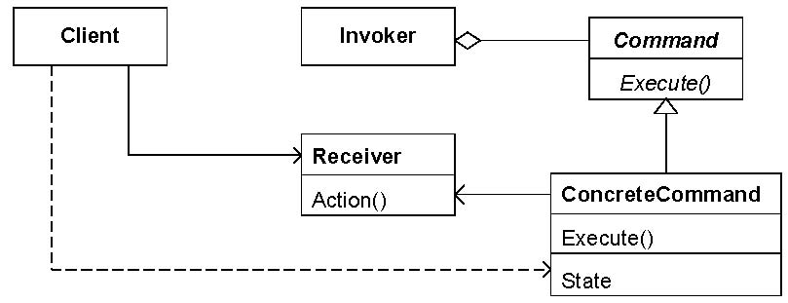
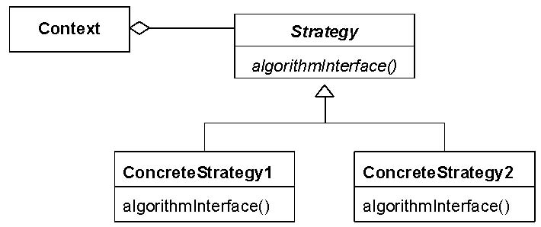
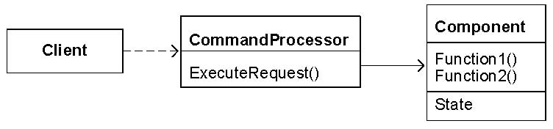
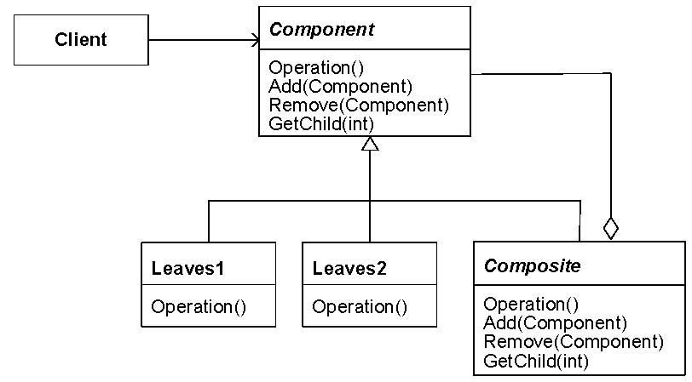
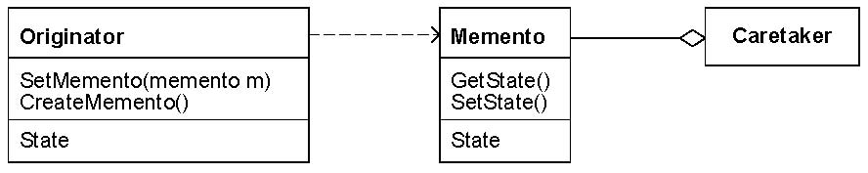
The patterns used in the example
The Command Pattern
The Strategy Pattern
The Command Processor Pattern
The Composite Pattern
The Memento Pattern

Slide 16
Design Derived from Patterns
Original design given in [Buschmann et al., 2007a].

Slide 17
Formal Specification of DPs
Semi-formal approaches
  Uses of graphic meta-modelling languages
  Existing work: RBML, DPML, PDL, etc.
Formal approaches
  Eden's approach
    Formal logic predicates on the structural features of the source code of object-oriented programs (Gasparis et al. 2008)
  Taibi's approach
    Formal logic predicates on the structural features of the source code
    Temporal logic statements for behavioural features
  Our approach (Bayley & Zhu, 2007, 2008, 2009)
    Formal logic predicates for both structural and behavioural features of designs in UML class and sequence diagrams
    The primitive predicates are induced from GEBNF definition of UML
    Based on the formal semantics of UML (Description Semantics)
Extension of BNF for graphical modelling languages

Slide 18
Example:
Formal Specification of the Object Adapter Design Pattern

Slide 19
Formal Specification of DPs
A formal specification of a design pattern P is an ordered pair ⟨Vars, Pred⟩, where
Vars={v₁ :T₁,···,v_{n} :T_{n}} is a set of “variables”
  Each v_{i} represents a component in the pattern
  T_{i} is the corresponding type of the component v_{i}, which can be class, method, attribute, message, lifeline, etc. in the design model
Pred is a predicate on the domain of software systems,
  It can only contain v₁, …, v_{n} as free variables
  It defines how these components are connected together (i.e. the relationships between them)
The semantics of a specification is a ground predicate:
Spec(P) = ∃v₁ : T₁ · · · ∃v_{n} : T_{n} · (Pred)

Slide 20
Benefits of Formalisation
Study the relationships between patterns on a solid foundation
  Inclusion relationship between DPs becomes logic implication relationship
    Inclusion relation can be defined formally:
    Proving inclusion relation becomes logic inference
Validation of the correct uses of a pattern can be automated
  Validation becomes logic inference
  Pattern specification becomes input to validation tool (i.e. tool becomes more flexible and general)

Slide 21
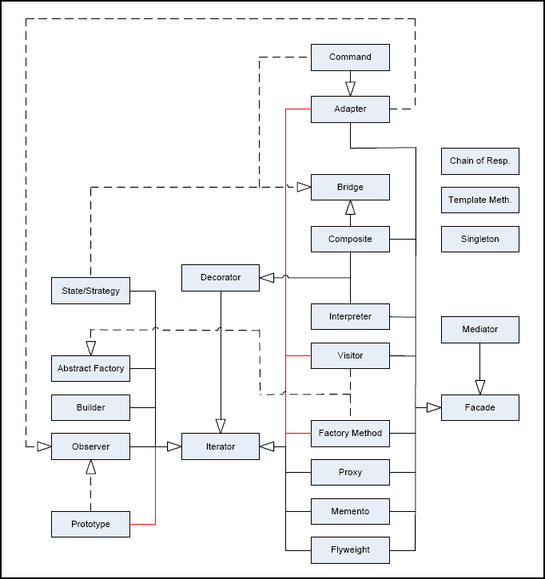
Inclusions between DP Specs

Slide 22
The Tool LAMBDES-DP

Slide 23
Composition of Patterns
  Design patterns are usually to be found composed with each other in real applications. But, as atomic units of design knowledge, there is little support to the effective uses of DPs in compositions.
  Phenomenon 1: Most errors in the uses of DPs are incorrect composition.
  Phenomenon 2: DP compositions are difficult to represent and reasoning about its correctness.
Research Question:
  Can we make pattern-oriented design a rigorous and disciplined methodology?

Slide 24
Existing Works on DP Compositions: 1
In practice, pattern composition are represented in the form of diagrams:
    Role: Annotation
    Venn Diagram
    Pattern Instance Notation (PIN) [Smith 2011]
[Vlissides 1998]

Slide 25
Example: Role: Annotation
[Buschmann et al., Vol. 5, 2007]

Slide 26
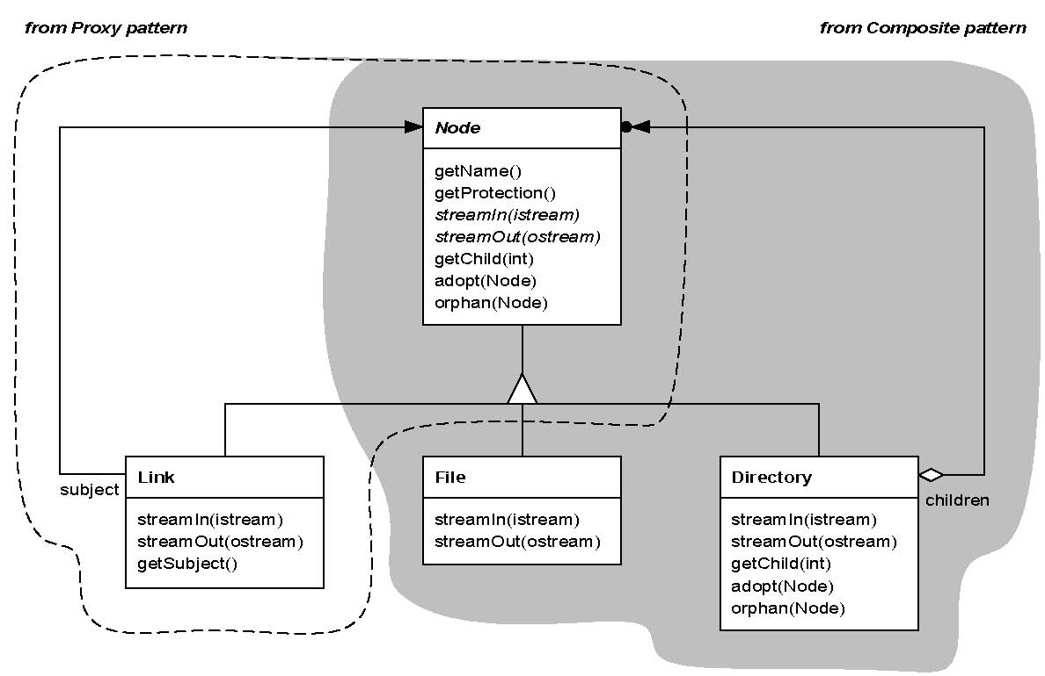
Example: Venn Diagram
[Vlissides 1998]

Slide 27
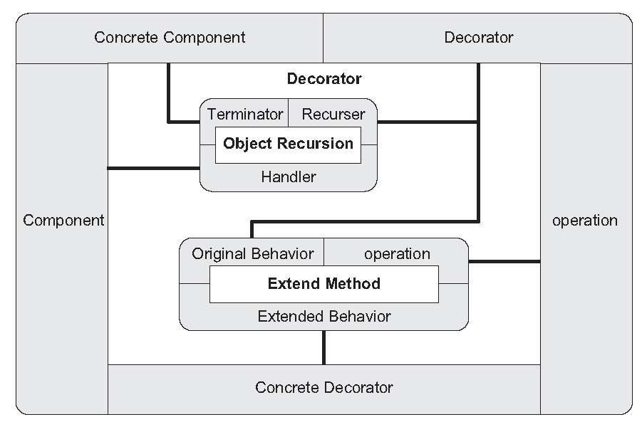
Example: PIN Diagram
Roles
Connections
[Smith 2011]

Slide 28
Operators on Patterns
We define a set of six operators on DPs so that compositions of DPs can be formally represented as expressions
  Restriction P[c]: P× Pr → P
  Superposition P*Q : P × P → P
  Extension P#(V •c): P × V × Pr → P
  Flatten P ⇓ x\ x': P × V → P
  Generalisation P ⇑ x\x': P × V → P
  Lift P↑X\X’: P × V → P
Zhu, H. and Bayley, I. An Algebra of Design Patterns, ACM Transactions on Software Engineering and Methodology (ACM TOSEM), Vol. 22, No. 3, Article 23, Sept. 2013.

Slide 29
Explanation of Pattern Operators
R=
=R⇓Bs/B

Slide 30
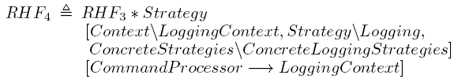

Example: Design of a request-handling framework
  The requests issued by clients must be objectified => Command pattern
  The independent requests from multiple clients must be coordinated => CommandProcessor pattern
  It must support the undoing of actions performed in response to requests => Memento pattern
  The requests must be logged. Different users may want to log the requests different => Strategy pattern
  A request can be atomic, or a aggregate of other request, which must executed in certain order => Composite pattern
Design decisions (i.e. the uses of specific patterns) can be represented formally as applying pattern operators on the existing patterns.

Slide 31
Derivation of Design
Software designs can be obtained by applying the pattern operators on known patterns.
It is derived by applying the pattern operators.
It is different from the original one

Slide 32
Algebraic Laws of the Operators
Definitions of the notions of equivalence between two pattern expressions.
Let P and Q be design patterns.
Definition: (Specialisation relation)
  Let P and Q be design patterns. Pattern P is a specialisation of Q, written P ≤ Q, if for all models m, whenever m conforms to P, then, m also conforms to Q.
Definition: (Equivalence relation)
  Pattern P is equivalent to Q, written P = Q, if P ≤ Q and Q ≤ P.
Lemma:
m |= P

Slide 33
Laws of Pattern Operators

Slide 34
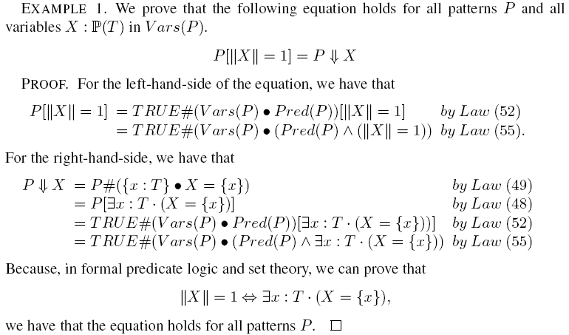
Example

Slide 35
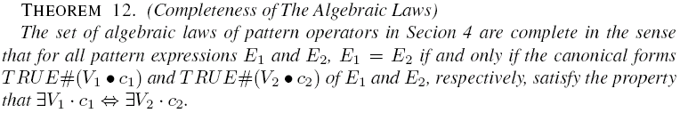
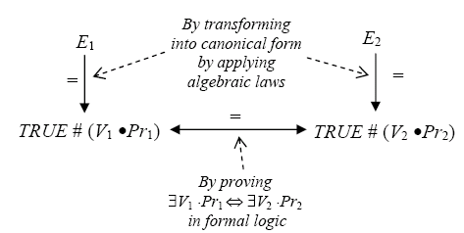
Completeness of The Laws
Proof:

Slide 36
Lessons Learned
Patterns can be formally specified
  Reduce ambiguity in pattern definition
  Directly usable in tools, more flexible
Composition and instantiation of patterns can be formally expressed as pattern expression using our operators
  Formally express design decisions
  Derive design results automatically
  Support validation and and verification of designs

Slide 37
Advantages and Benefits of POR
Learnability:
  Patterns, being self-contained, can be described and documented with high readability and learnability.
Verifiability:
  Each pattern as a piece of domain knowledge can be relatively easily validated and formally specified relatively independent of the other patterns.
Composibility:
  Patterns represent domain knowledge in an appropriate granularity that the complicated knowledge of the subject domain is divided into self-contained composable pieces.
Expresiveness:
  The relationships between the patterns and the way patterns are composed and combined are also important parts of the domain knowledge, which can also be formally define, specified, and applied as patterns.

Slide 38
Incrementality:
  A complete knowledge of the subject domain can be developed incrementally
    gradually identifying more and more patterns
    the whole picture of the domain knowledge emerges in the form of catalogues of the patterns when a sufficient number of patterns are identified
  The incompleteness of a set of patterns often does not affect the usefulness of the known knowledge
Applicability:
  Each pattern’s applicability can be recognised
  They can be flexibly combined through pattern composition
  Automated tools can be developed and employed for various uses of the knowledge

Slide 39
Cyber-Patterns: Patterns in Cyber Space
Scope: Cyberspace
  Internet culture and human behaviours
  Web-based applications, Cloud computing, and Big data,
  Sensor networks, Cyber-physical systems, Internet of things
  Computer networks, Wireless communication, Mobile computing, etc.
Characteristics:
  Enormous scale
  Notorious complexity
  Intangible virtual world
  Complicated relations to the real world
Challenges:
  How to understand, operate, manage, protect and further develop this space
Opportunities:
  Availability of data of the nature and human behaviours
  Emergence of facilities for processing big data
  Recognition of the great scientific and economic values

Slide 40
Example Types of Cyberpatterns
User behaviour patterns
Systems’ workload patterns
Network traffic patterns
Social network patterns (for example, Small World and Power Law of scale-free networks)
Attack patterns
Security design patterns
Patterns of vulnerabilities
Digital forensic patterns
etc

Slide 42







Can the Algebra of Patterns Be Generalised?
Example: Wall Tiles
  Element Type: Tile
  Features of Titles:
    Shape: Square, Rectangle, …
    Image: The graphic image of the tile;
      Symmetric: { Central, Vertical, Horizontal,
      Diagonal, None}
      Connect: {Vertically, Horizontally, None}
    Size:
      Width: Real /* cm */
      Height: Real /* cm */
  Layout: /* Relation of a tile with other titles when laid */
    Direction : real
    Position:
      X, Y: real
Central symmetric ➔ Vertical symmetric
Central symmetric ➔ Horizontal symmetric
Central symmetric ➔ Diagonal symmetric

Slide 43
Example:
Group4:
Components:
  T1, T2, T3, T4: Titles
Constraints:
  T1.Image = T2.Image = T3.Image = T4.Image
  T1.Image Is Diagonally Symmetric
  T1.Shape = T2.Shape = T3.Shape = T4.Shape = Square
  T2.Direction = T1.Direction+90;
  T3.Direction = T1.Direction+180;
  T4.Direction = T1.Direction+270;
  T2.Position.X=T1.Position.X+T1.Width
  T2.Position.Y=T1.Position.Y
  T3.Poistion.X=T1.Position.X+T1.Width
  T3.Poistion.Y=T1.Position.Y+T1.Height
  T4.Poistion.X=T1.Position.X
  T4.Poistion.Y=T1.Position.X+T1.Height
DSS=
Image:
  Diagonally symmetric
Shape: Square
Group4 = T1 + T2 + T3 + T4
T2 = T1 [T2.Direction=T1.Direction+90, … ]
T1= DDS
Diagonally Symmetric
Square
T2=
Rotate(T1)
Right(T1)
T3=
Rotate(T2)
Below(T2)
T4=
Rotate(T3)
Below(T1)

Slide 44
Reasoning about Designs
Group4:
Image:
  Central symmetric
Connect:
  Horizonally
  Vertically
Shape: Square
(Group4 ⬆)⬆

Slide 45
How to Generalise The Pattern Algebra?
Developing a general purpose pattern specification and application language called PORD, which has the following facilities:
Facility for defining the phenomena spaces
Facility for defining patterns in a specific phenomena space
Facility for specification of composition and instantiation of patterns through pattern operators
Implementing a tool that has the following functionalities
Parsing the modules of PORD into pattern repositories
Logic reasoning about patterns based on the pattern algebra
Interface with cloud computer system’s dynamic monitoring tools to detect the occurrences of patterns
Interface with machine learning tools to automatically discover patterns and add patterns into pattern repository

Slide 46
Example: Space of Security Designs
SPACE SecuritySystems;
TYPE
Subsystem:
name: STRING, content: [Value], description: [STRING];
InfoFlow:
name: STRING, from, to: Subsystem, type: [STRING];
VIEW Structure;
PROPERTY
type: Subsystem -> {dataStore, computation};
mode: Subsystem -> {active, passive};
RELATION
Is-a-part-of: Subsystem x Subsystem;
END structure;
VIEW Behaviour;
…
END Behaviour;
END SecuritySystems
Entity types
Properties of the entities in a certain view of the system
Relationships between the entities in a view
There may be multiple different views of the system

Slide 47
Security System Design Patterns
Architecture of an indirect in-line authentication architecture
Claimant
Trusted Third party
AI
Claim AI
Verify AI
Verified AI
Verifier
Claim AI
PATTERN Indirect-In-Line-Authentication IN SecuritySystem;
COMPONENT
Claimant, TrustedThirdParty, Verifier, ClaimAI1, VerifyAI, ClaimAI2: Subsystem;
ClaimAI12VerifyAI, VerifyAI2ClaimAI2, ClaimAI22Verifier: InfoFlow;
CONSTRAINT
ClaimAI is-a-part-of Claimant; VerifyAI is-a-part-of TrustedThirdParty;
ClaimAI2 is-a-part-of TrustedThirdParty;
ClaimAI12VerifyAI.from = ClaimAI1; ClaimAI12VerifyAI.to = VerifyAI;
VerifyAI2ClaimAI2.from= VerifyAI; VerifyAI2ClaimAI2.to = VerifyAI;
ClaimAI22Verifier.from = ClaimAI2; ClaimAI22Verifier.to = Verifier;
END

Slide 48
Encryption and Decryption
Source Text
Recovered text
Encrypt
Ciphertext
Decrypt
Key1
Key2
PATTERN EncryptDecrypt IN SecuritySystem;
COMPONENT
encrypt, decrypt, source, ciphered, recovered, key1, key2: Subsystem;
source2encrypt, encrypt2ciphered, ciphered2decrypt, decrypt2recovered,
key12encript, key22decrypt: InfoFlow;
CONSTRAINT
encrypt.type=computation; decrypt.type=computation;
source.type=dataStore; ciphered. type=dataStore;
recovered. type=dataStore; key1.type=dataStore; Key2.type=dataStore;
source2encrypt.from=source; source2encrypt.to= encrypt;
encrypt2ciphered.from= encrypt; encrypt2ciphered.to= ciphered;
ciphered2decrypt.from= ciphered; ciphered2decrypt.to= decrypt;
decrypt2recovered.from= decrypt; decrypt2recovered.to= recovered;
…
END

Slide 49
Symmetric & Asymmetric Encryption/ Decryption
PATTERN SymetricEnDEcryppt in SecuritySystem EQUALS
EncryptDecrypt [key1.content = key2.content]
END
PATTERN AsymetricEnDEcryppt in SecuritySystem
EQUALS
EncryptDecrypt [not (key1.content = key2.content)] END
Application of the restriction operator

Slide 50
Conclusion
“All science is either physics or stamp collecting”.
Ernest Rutherford
Physics: clean and succinct principles that apply to diverse phenomena
Stamp collecting: the cataloguing and organising of large sets and varieties of observations
Patterns can form a bridge that possibly spans the gap from “stamp collecting” to “physics”, because POR method
  Recognises, catalogues and organises observations
  Discovers regularities as well as interrelationships and interactions between such regularities
  Such knowledge is the mother of clean, succinct principles

Slide 51
“Scientists are not dependent on the ideas of a single man, but on the combined wisdom of thousands of men, all thinking of the same problem, and each doing his little bit to add to the great structure of knowledge which is gradually being erected”.
Ernest Rutherford
Pattern-oriented research methodology offers a platform for many people to contribute to a structure of knowledge, because
POR is incremental so that knowledge can be accumulated
Patterns represents knowledge in a reusable, and transferable form
Patterns and their uses can be validated and verified

Slide 52
References
Hong Zhu and Ian Bayley, An Algebra of Design Patterns, ACM TOSEM, 22(3), Article 23. July 2013.
Ian Bayley and Hong Zhu, A Formal Language for Expressions of Pattern Compositions, IJAS, 4(3&4), 354 – 366, Dec. 2011.
Ian Bayley and Hong Zhu, A formal Language of Pattern Composition, Proc. of PATTERNS’10, Nov. 2010.
Hong Zhu and Ian Bayley, Laws of Pattern Composition, Proc. of ICFEM’10, Nov. 2010.
Ian Bayley and Hong Zhu, Formal specification of the variants and behavioural features of design patterns, JSS, 83(2), 209–221. Feb 2010
Hong Zhu, Ian Bayley, Lijun Shan and Richard Amphlett, Tool Support for Design Pattern Recognition at Model Level, Proc. of COMPSAC'09, July 2009.
Ian Bayley and Hong Zhu, Specifying Behavioural Features of Design Patterns in First Order Logic, Proc. of COMPSAC’08, 203-210, 2008. (Winner of Best Paper Award)
H. Zhu, L. Shan, I. Bayley and R. Amphlett, A Formal Descriptive Semantics of UML And Its Applications, in UML 2 Semantics and Applications, Kevin Lano (Eds.), John Wiley & Sons, pp95-123, Nov. 2009.

Slide 53
A Book
Clive Blackwell and Hong Zhu (eds.), CyberPatterns: Unifying Design Patterns with Security Patterns and Attack Patterns; Springer 2014.

Slide 54
H. Zhu, Cyberpatterns: Towards a Pattern Oriented Study of Cyberspace, Chapter 1, in Clive Blackwell and Hong Zhu (eds.), CyberPatterns: Unifying Design Patterns with Security Patterns and Attack Patterns; Springer 2014.
H. Zhu, Design Space-Based Pattern Representation, Chapter in CyberPatterns: Unifying Design Patterns with Security Patterns and Attack Patterns; Clive Blackwell and Hong Zhu (eds.), Springer 2014.
C. Blackwell and H. Zhu, Future Directions for Research on Cyberpatterns, Conclusion Chapter in CyberPatterns: Unifying Design Patterns with Security Patterns and Attack Patterns; Clive Blackwell and Hong Zhu (eds.), Springer 2014.

