Slide 1
IWSC 2012 16 July 2012, Izmir, Turkey
Software Cybernetics in the Age of Cloud Computing
Hong Zhu
Department of Computing and Communication Technologies
Oxford Brookes University, Oxford OX33 1HX, UK
Email: hzhu@brookes.ac.uk

Slide 2
Outline
Part I: Software cybernetics
Part II: Cloud computing in the light of software cybernetics

Slide 3
What is cybernetics?
Cybernetics is the interdisciplinary scientific study of control and communication in the animal and the machine
[Nobert Wiener, Cybernetics: Communication and Control in the Animal and the Machine, Cambridge: MIT Press, 1948]
Divisions of the scientific disciplines:
biology, psychology, sociology, art, management, mathematics, engineering and computer science, etc.
Dynamic systems,
Information theory,
Systems theory,
etc.
Adaptive systems,
Systems engineering,
etc.
Robotics,
Decision support systems,
Artificial intelligence,
etc.

Slide 4
From Cybernetics to Software Cybernetics
“The successful application of the same concepts (of cybernetics) to control/regulate the behavior of software systems and/or of the software development process in all its aspects is what we now refer to as Software Cybernetics.”
[J.W. Cangussu, S. D. Miller, K. Y. Cai, A. P. Mathur, "Software Cybernetics", in Encyclopedia of Computer Science and Engineering, John Wiley & Sons.]
Software cybernetics is a subdivision of cybernetics in the domain of software engineering.

Slide 5
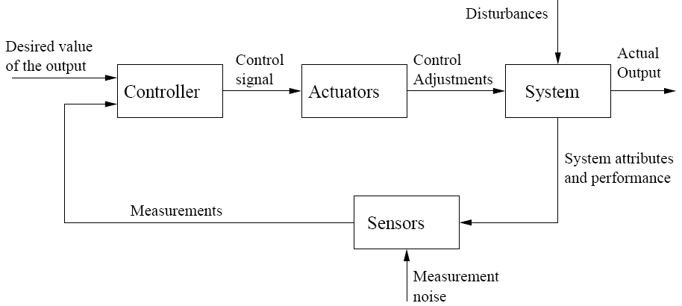
Some Case Studies
Examples of software engineering research that demonstrate explicit or implicit applications of the principles of cybernetics and system thinking
SBSE: Search-based software engineering
Trustie: software engineering based on crowd intelligence
CAMLE: Agent-oriented SW development methodology
Is there something bigger than the typical feedback loop out there?
Typical feedback loop

Slide 6










CASE 1: SBSE
Search-Based Software Engineering

Slide 7
Search-Based Software Engineering (SBSE)
Search Based Software Engineering (SBSE) is the name given to a body of work in which Search Based Optimisation is applied to Software Engineering.
Basic idea:
Search Based Optimisation as a general approach to Software Engineering
The term SBSE was coined by Harman and Jones in 2001
There were other authors who had previously applied search based optimisation to various aspects of software engineering
Has been applied to many fields within the general area of software engineering,
surveys and overviews, covering SBSE for requirements, design and testing, etc.
general surveys of the whole field of SBSE
The first paper explicitly promote SBSE.

Slide 8
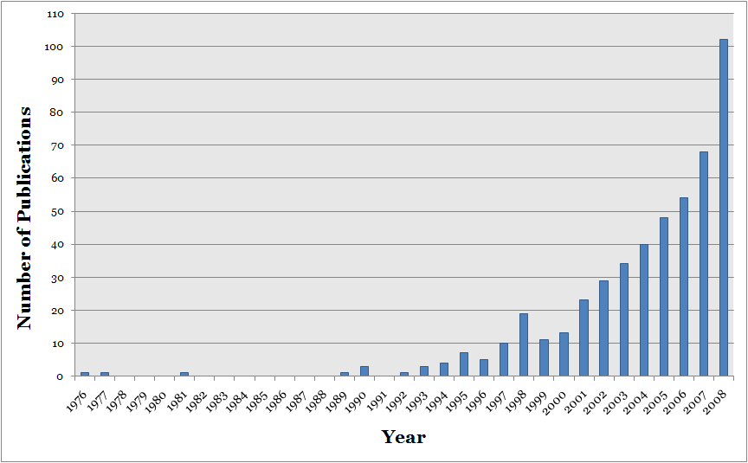
The Trend of Publications on SBSE (up to 2008)
Mark Harman, Afshin Mansouri, and Yuanyuan Zhang. Search based software engineering: A comprehensive analysis and review of trends techniques and applications. Technical Report TR-09-03, Department of Computer Science, King's College London, April 2009.

Slide 9
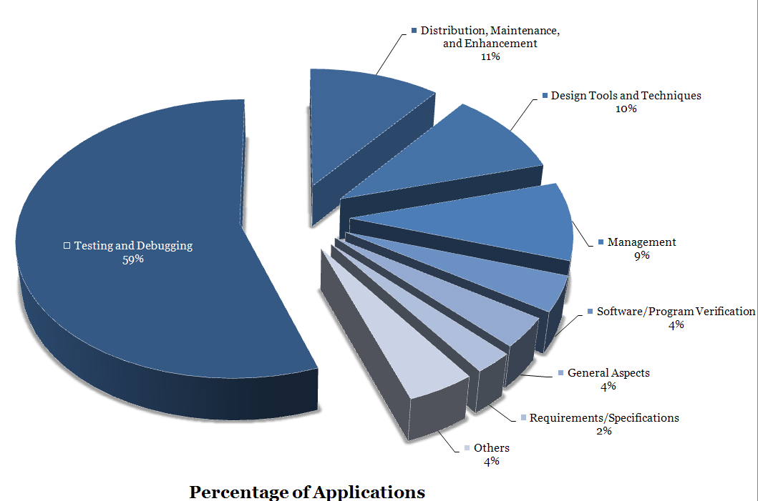
Spread of SBSE Papers

Slide 10
SBSE Principles (1)
To represent SE problems as optimation problems
“Software Engineering questions are often phrased in a language that simply cries out for an optimisation-based solution.”
1. What is the smallest set of test cases that cover all branches in this program?
2. What is the best way to structure the architecture of this system?
3. What is the set of requirements that balances software development cost and customer satisfaction?
4. What is the best allocation of resources to this software development project?
5. What is the best sequence of refactoring steps to apply to this system?
“All of these questions and many more like them, can (and have been) addressed by work on SBSE.”
[Harman, et al. 2010]

Slide 11
SBSE Principles (2)
Direct Fitness Computation
“The search (for the optimal solution) is performed directly on the engineering material itself (i.e. software), not a simulation of a model of the real material (as with traditional engineering optimisations)”.
A finness function that measures the quality of a solution is explicitly defined and used to direct the search!

Slide 12
The Method
SBSE starts with only two key ingredients:
1. The choice of the representation of the problem.
2. The definition of the fitness function.
Utilization of search algorithms to find the best solution
Random search
Hill climbing
Simulated Annealing
Genetic Algorithms

Slide 13

Advanced Techniques: (1) Pareto Optimal SBSE
The problem:
To handle scenarios in which several optimisation objectives are combined without needing to decide which take precedence over the others
The method:
Suppose a problem is to be solved that has n fitness functions, f₁, … , f_{n} that take some vector of parameters x. Pareto optimality combines a set of measurements, f_{i}, into a single ordinal scale metric F as follows:
One solution is better than another if it is better according to at least one of the individual fitness functions and no worse according to all of the others.

Slide 14
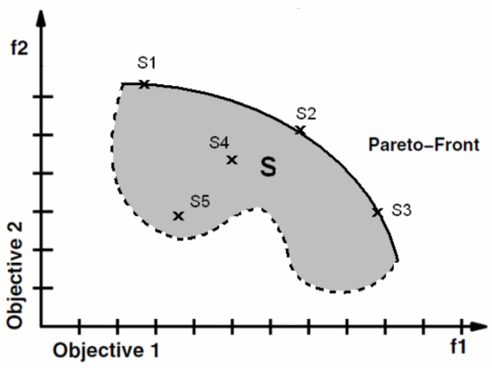
The solution:
A set of solutions that are non-dominated, which forms a Pareto front.
Each member of the set is no worse than any of the others in the set, but also cannot be said to be better.

Slide 15
Advanced Techniques: (2) Co Evolution
Co-evolutionary model of software engineering
A software system consist of elements in a number of populations that could be productively co-evolved both competitively and co-operatively.
Optimisation is an important concern
Subject of change
Each may have its own fitness function
The Method:
In Co-Evolutionary Computation, two or more populations of solutions evolve simultaneously with the fitness of each depending upon the current population of the other.
Example
Bug fixing:
Population 1: patches able to pass test cases
Population 2: test cases to find the shortcomings of patches
As the prey
As the predators

Slide 16
Software Cybernetics: Beyond SBSE
“Cybernetic software engineering (CSE) treats software development as a control problem and applies control theoretic principles to guide software process improvements and quality assurance.”
[J.W. Cangussu, S. D. Miller, K. Y. Cai, A. P. Mathur, "Software Cybernetics", in Encyclopedia of Computer Science and Engineering, John Wiley & Sons.]
Understanding SBSE as Software Cybernetics
Control problem:
In general: Steering or controlling the system to a desired state in a state space
In SBSE: Finding the optimal solution (in a solution space)
Control theoretic principles:
In general: Feedback control loops
In SBSE: To obtain feedback through fitness function

Slide 17
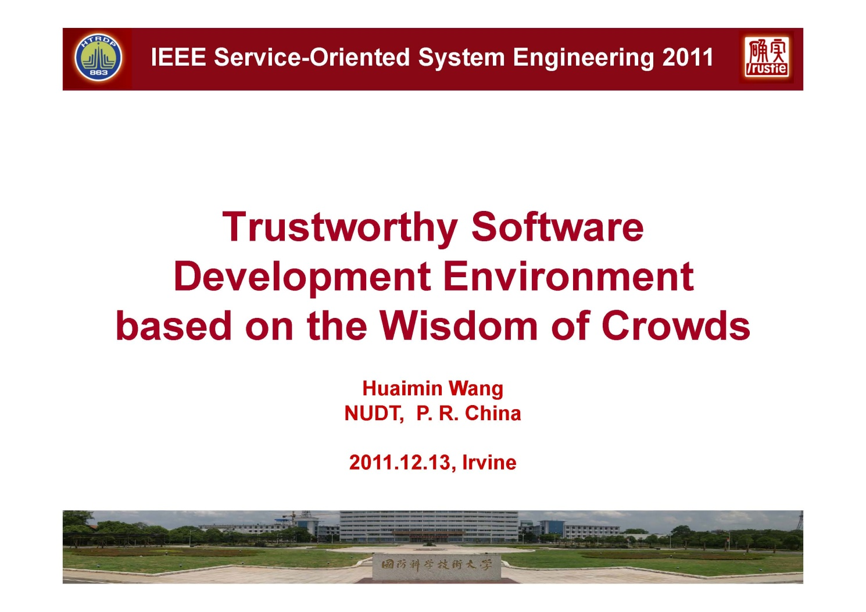
CASE 2: Trustie
Available: http://tech.brookes.ac.uk/sose2011/SOSE-KeynoteHMWang.pdf.

Slide 18
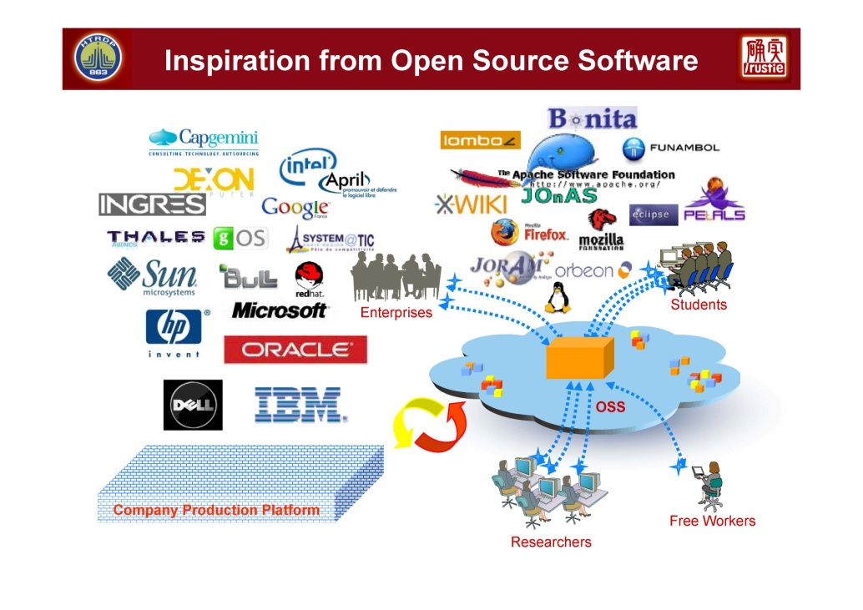
Inspirations of Trustie
Crowdsourced system, e.g. wikipedia, YouTube, etc.
Open source software
Common features
Openness
Peering
Sharing
Acting globally
Rick Kazman and Hong-Mei Chen. The Metropolis Model: New logic for development of crowdsourced system, Communications of the ACM, July 2009, vol. 52, no. 7
Tapscott, D., & Williams, A. D. (2008). Wikinomics: How Mass Collaboration Changes Everything, USA: Penguin Group

Slide 19
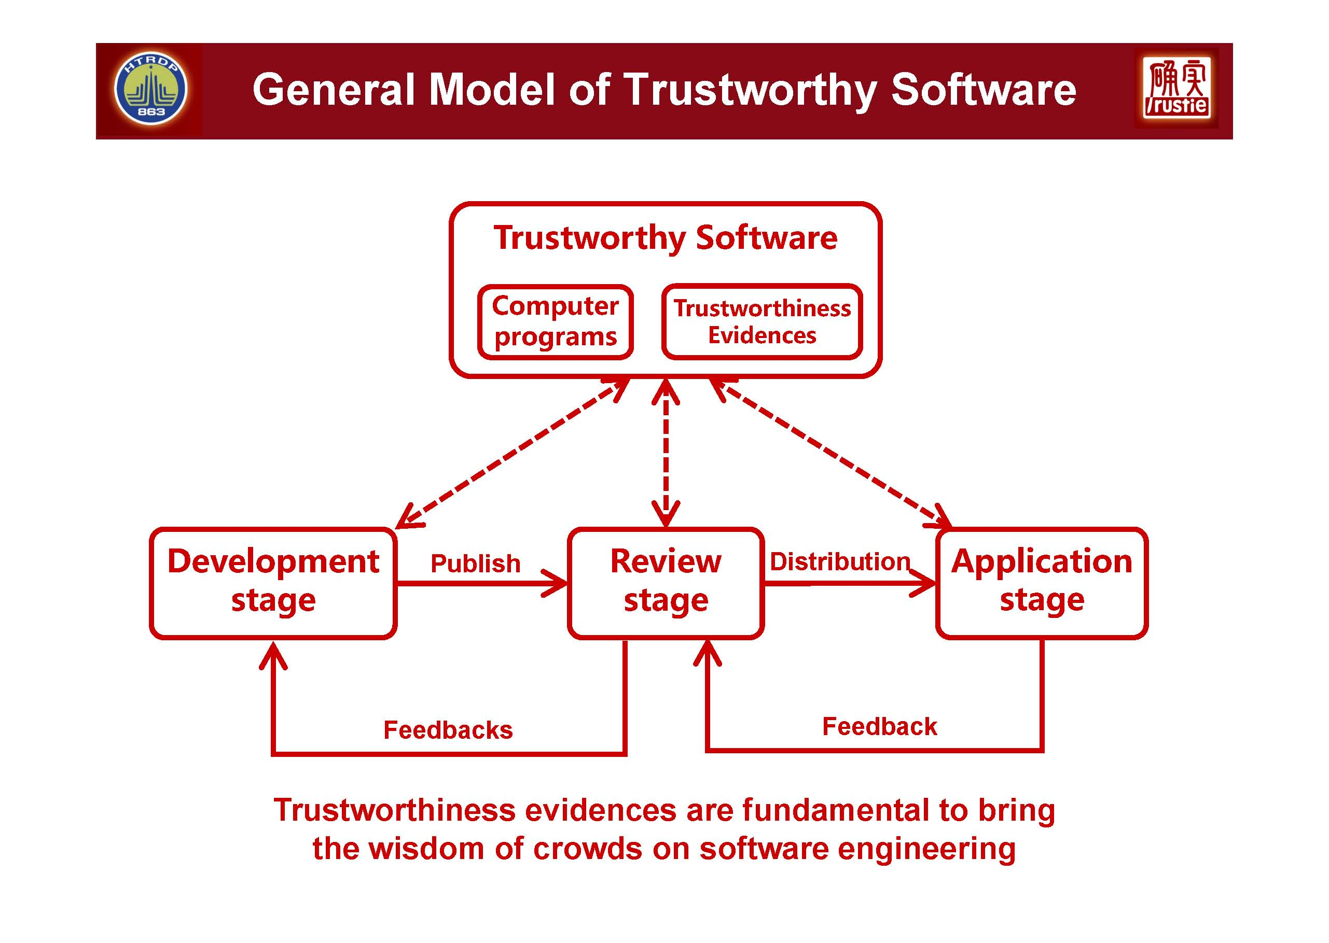

Slide 20
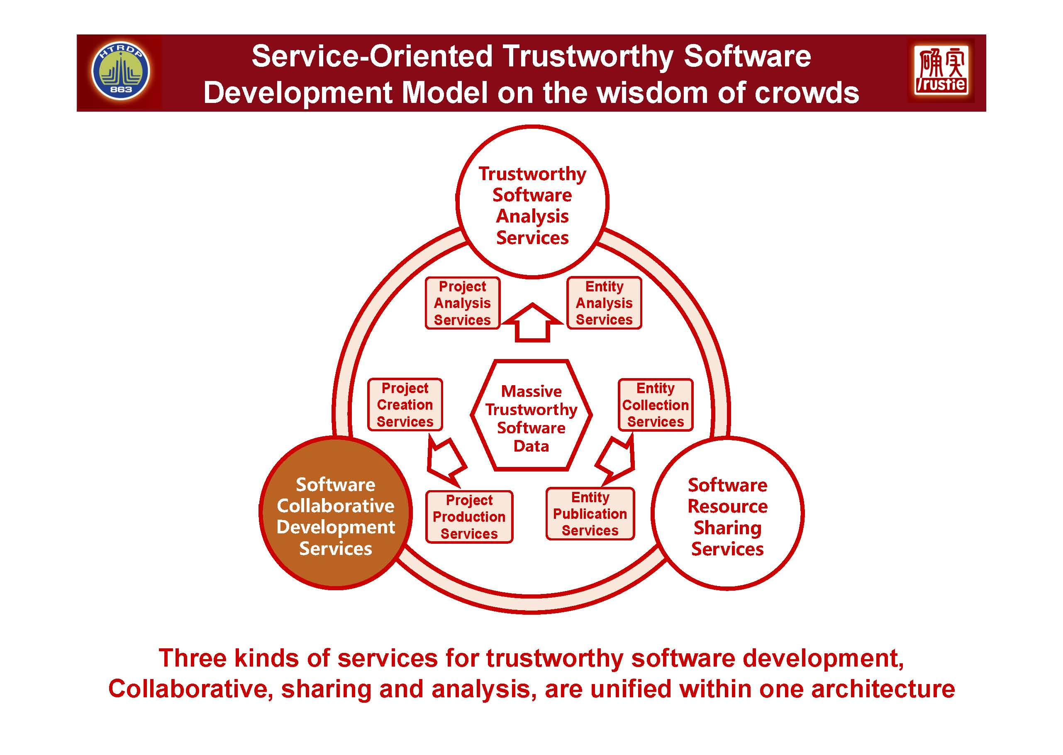

Slide 21
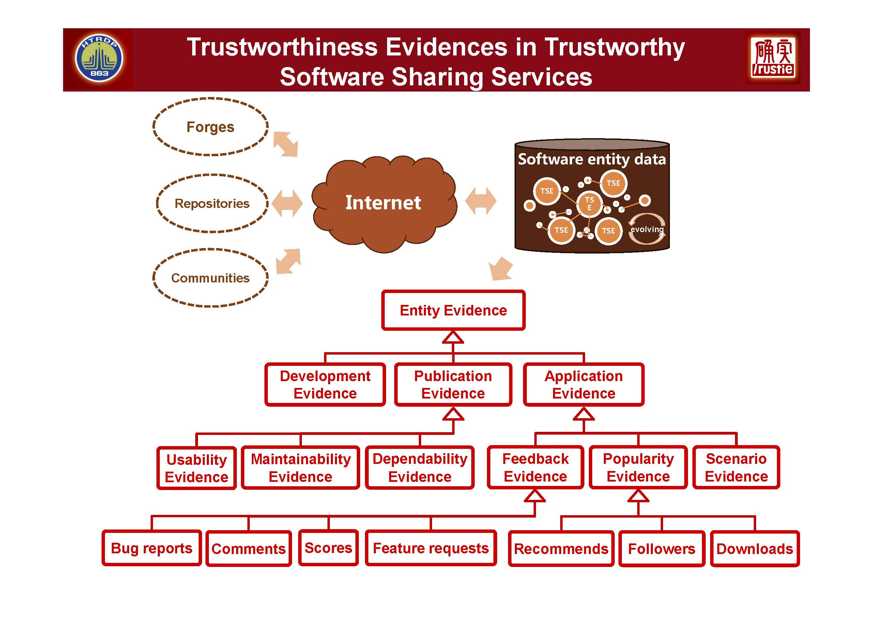

Slide 22
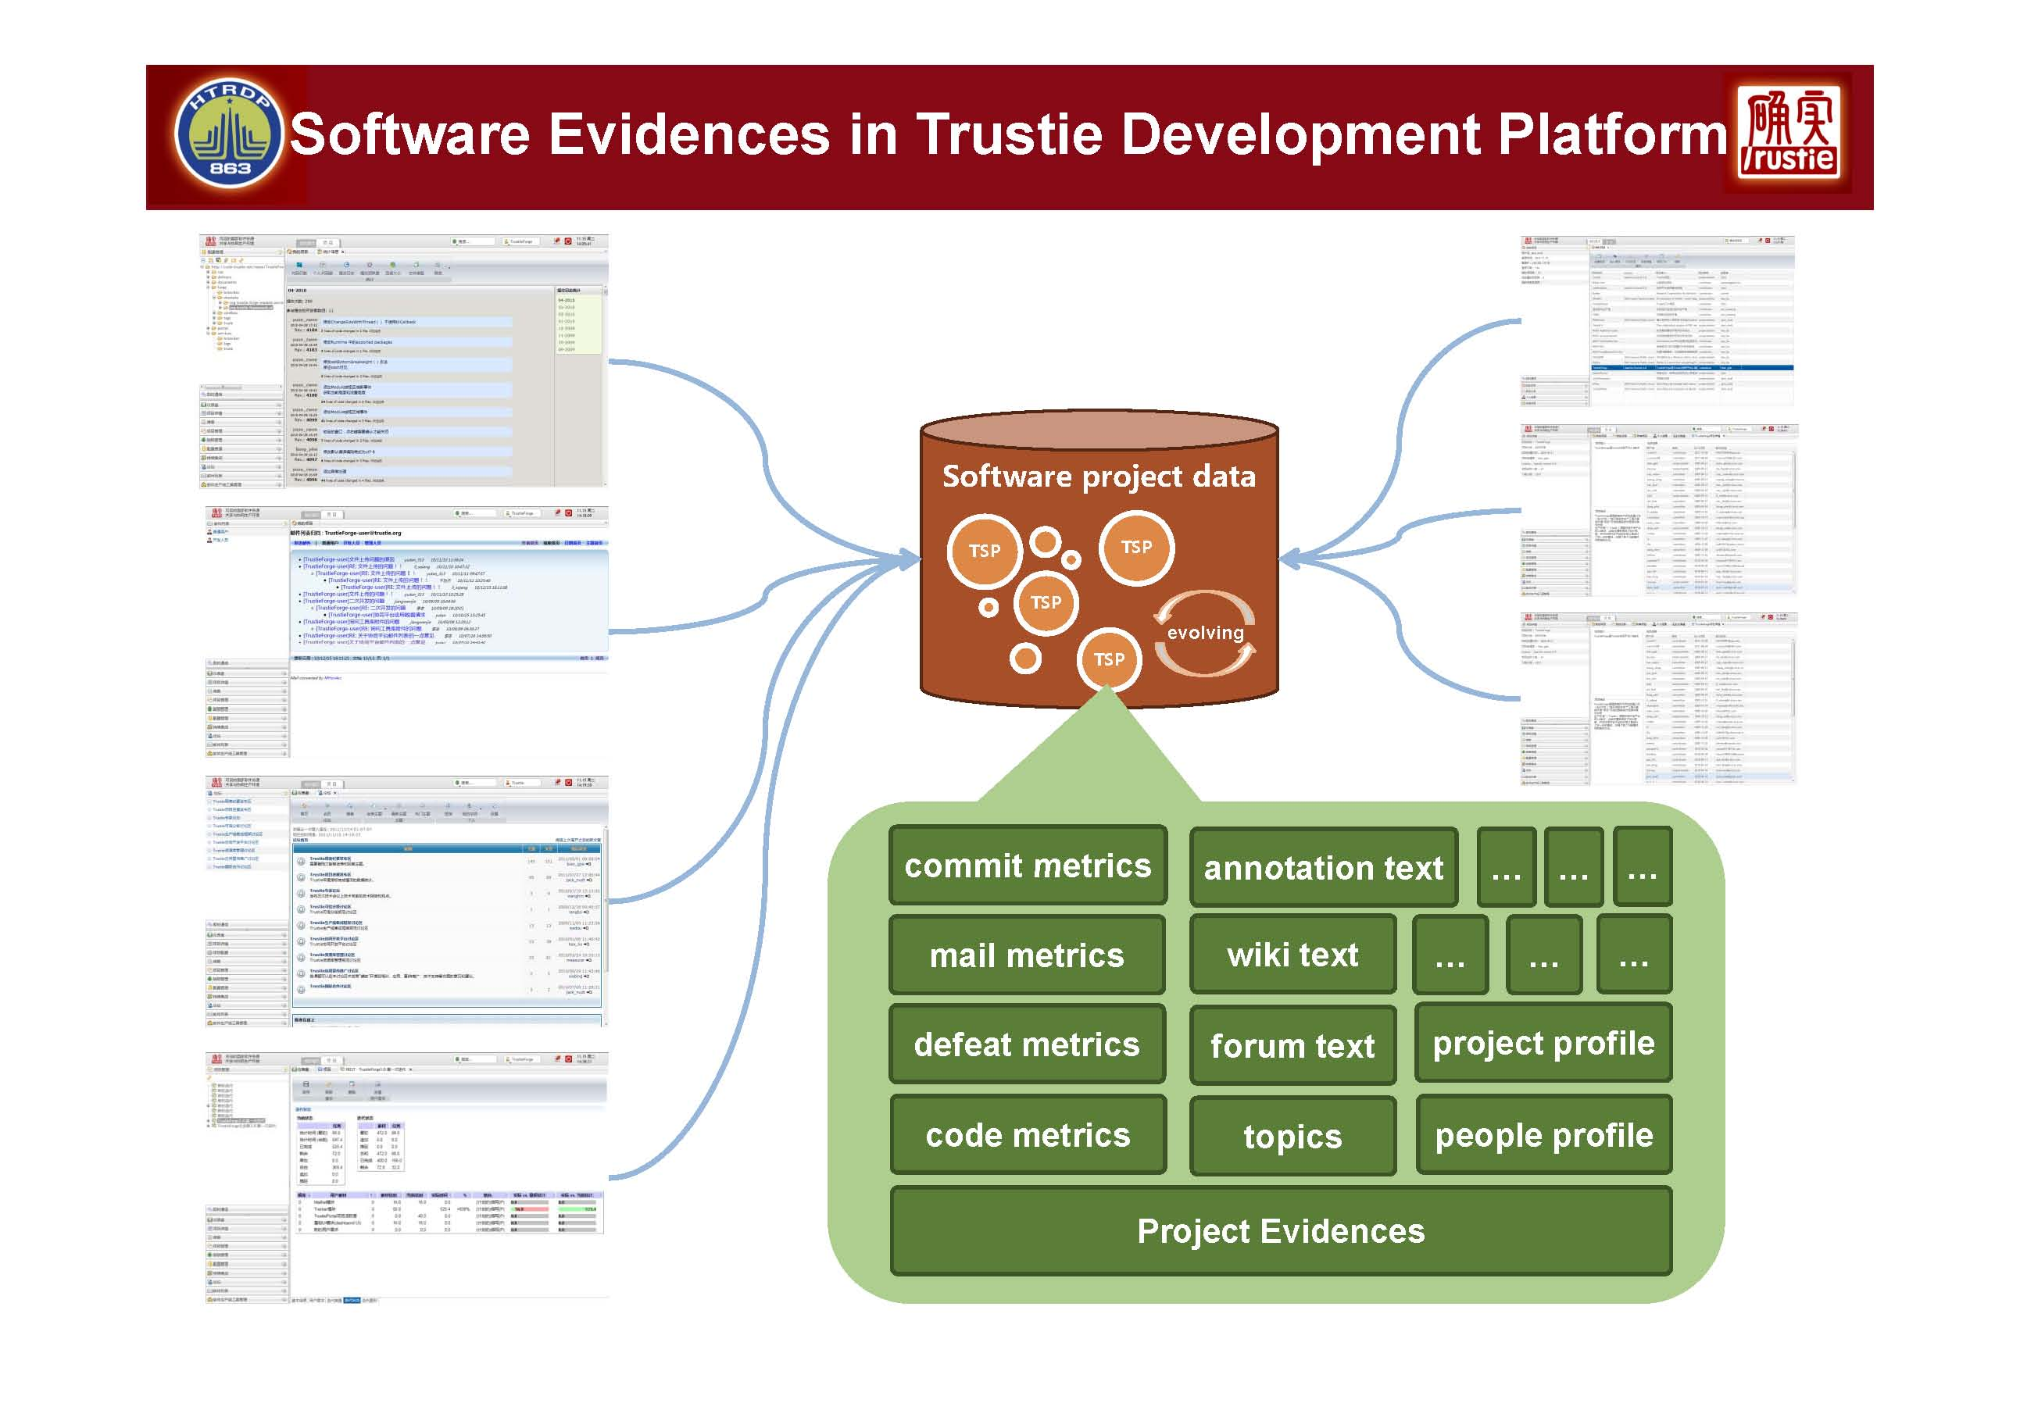

Slide 23
Understanding Trustie as Software Cybernetics
Trustie is a novel approach to view software development:
Shift of focus from control to communication
Regarding development as a system to as complex Systems
‘…systems thinking is founded upon two pairs of ideas, those of emergence and hierarchy, and communication and control.’
-- Peter Checkland (1981) Systems Thinking, Systems Practice.
The goal that Trustie want to achieve is still software quality!

Slide 24
Complex Systems and Emergent Behaviour
A complex system consists of many ‘agents’ who communicate and interact to collaborate in order to achieve a goal
Each agent can only observe a small part of the whole system and its environment
Each agent react to the changes or the state of the small part of the system/environment according to relatively simple behaviour rules, which in term affect the state (also a small part) of the system/environment
Collectively, the system demonstrate a high degree of intelligence, which is called the emergent behaviour
The environment plays a key role in such as system as a communication media
This is a much better model of software development project!, especially, for large scale projects!

Slide 25

CASE 3: From MAS To CAMLE
Multi-Agent Systems (MAS) and Agent-Oriented Software Development Methodology

Slide 26
Emergent Behaviour
A phenomenon in multi-agent systems
Autonomous agents perform certain actions with only limited access to local information and make decisions individually
The whole system demonstrates properties and behaviours that have strong global features
A huge gap between individual agents’ behaviours and those of the whole system
Notoriously difficult to specify and reason about emergent behaviours
Examples
Ant colony
Fish
Birds
Human society

Slide 27
Research on Complex Systems in Cybernetics
Emergent behaviours in natural systems
Studied mostly using simulation
Subject of research in the complex systems
Artificial systems are developed in ad hoc methods, mostly through trial-and-error.
Lack of systematic studies to understand the basic features
Lack of methodology and tool supports
Existing formal methods does not
apply well
Importance of the emergent behaviours
starts to be recognised recently in the
context of service oriented computing.

Slide 28
Applications of Emergent Behaviour
Amalthaea: a multi-agent system for web information retrieval and filtering developed by MIT Media Lab
a collection of relatively simple agents that each only retrieves or selects one particular type of information on the web,
organised into an evolutionary ecosystem that can provide the user with the most interested information
tracking user’s interests even when they are changing from time to time.
Resource allocation in a distributed environment
each agent has a very simple behaviour of bidding and buying/selling resources
achieve optimised usage of shared resource at system level
Other applications
e-commerce (such as online auctions),
distributed computing (such as ant colony optimisation),
peer-to-peer networks, and many others

Slide 29
Agent-Oriented Software Development
Basic ideas
Agent: Active, autonomous, sociable computational entity
Agent as the basic building block, i.e. the unit of software construction
The best known works
Gaia (Zambonelli, Jennings, and Wooldridge, 2003 )
Based on organization-oriented abstraction in which software systems are conceived as organized society and agents are seen as role players. The implementation is towards object-oriented. No languages at all.
Tropos (Bresciani, Giorgini, Giunchiglia, Mylopoulos and Perini, 2004)
Uses of notions related to mental states like belief, intention, plan, goals, etc., to represent the abstraction of agent’s state and capability.
The implementation is based on AI technology.
i* (Yu, E. et al.)
Focus on requirements analysis using agent concepts.
Notation for requirements specification.
AUML (Bauer, Muller, and Odell, 2001)
Extension of UML notation with notation to represent agents and agent classes.
In lack of a well-defined semantics and meta-model. Currently, it only has a static meta-model.
SLABS/CAMLE (Zhu, 2000)

Slide 30
Why Need a New Methodology?
Static aspect: What constitute a system?
Dynamic aspect: How does a system work?
 | Static View | Dynamic View
Structured methods | Operations + data stores; Hierarchical structure; | Control flows + Data flows
Object oriented methods | Objects encapsulate attributes & methods; Objects are statically classified by classes; Inheritance + whole-part relationships between classes; | Message passing = Method calls; Dynamic binding;
New technology and infrastructure
Problems mapping into a solution awkwardly
Solutions directly supported by technology & infrastructure
Problems nicely represented in a methodology

Slide 31
Meta-Model of CAMLE
Classifier
Relation
Agent
Caste
Inheritance
State
Aggregation
Action
Migration
Behavior rules
Environment description

Slide 32
Agent and Caste
Agents are active computational entities that situate in their designated environments and contains the following three functional parts
Data: the state of the agent (visible, or internal)
Operations: the actions that an agent can take (visible or internal)
Behaviour: the rules the control the agent’s actions and state changes
Castes are modular units in the construction of agent-oriented systems. Each caste encapsulate a set of interrelated functional parts of data, operations, behaviour rules and the environments.

Slide 33
Relationship Between Agents and Castes
If an agent has a casteship of a caste, it has all the data, operation behaviour and environment features defined by the caste.
Dynamic casteship:
An agent can change its casteship relation with a caste at run-time by join a caste or quit from a caste.
Multiple casteship:
An agents can have casteship with a number of castes.
The relationship between agents and castes is similar to the relationship between objects and classes, but there are fundamental differences.

Slide 34
Part-Whole Relationship Between Agents
Aggregate:
The part is independent of the whole, but in collaborative to the whole
If the whole is destroyed, the part is not effected
Composite:
The part is controlled by the whole
When the whole is destroyed, the parts are also destroyed
Congregation:
The parts are autonomous, cooperative and rely on the whole to benefits from the membership.
When the whole is destroyed, the part is still alive but will not benefit as the part, i.e. it will lost certain casteship.

Slide 35
Dynamics and Communication Mechanism
Agents communicate with each other by
Taking visible actions
Visible actions can be observed by other agents in the system
Visible variables: whose values can be read by other agents in the systems, but not changed
Observing other agents’ actions:
An agent only selectively observes a subset of other agents in the system. This subset forms the agent’s environment
Takes corresponding actions defined by its behaviour rules

Slide 36
Agent’s Environment
Intuitively, the elements in the environment of an agent can be
Objects
Software agents
Other agents
Users
Object is a degenerate form of agent.
Environment can be explicitly declared by specifying the subset of agents in the system
All of them can be regarded as agents!

Slide 37
Designated Environment
Explicit specification of environment by declaring which agent is in its environment
All: Caste -- All the agents in the caste
Agent: Caste -- A specific agent of the caste
Var: Caste -- A variable agent in the caste
An agent can change its environment
By joining a caste
By quitting a caste
By changing the value of environment variables
The environment of an agent can also change beyond the agent’s control
Other agents join or quit a caste that is a part of the agent’s environment
Consequently, the environment is not completely open, not closed, not fixed.

Slide 38
Structure of Agents
Agent name:
It is the identity of the agent.
Environment description:
It indicates a set of agents that interact with the agent.
State space:
It consists of a collection of variables that defines the state space.
Divided into the visible part and the internal state
Actions:
They are the atomic actions that the agent can take.
Each action has a name and may have parameters.
An action can be visible or internal
Behaviour rules.
It is the body of the agent that determines its behaviour.

Slide 39
The Body of Agents
Begin
Initialisation of internal state;
Loop
Perception of the visible actions and the visible
states of the agents in its environment;
Decision on which action to take according to
the situation in the environment and its
internal state, which can be
(1) visible or internal actions;
(2) changes of visible or internal state;
(3) joining into or retreating from a caste;
end of loop;
end
This is just an illustration and only for atomic agents.

Slide 40
Example: Autonomous Sorting
In this MAS, the agents are sociable.
They can introduce one to another by passing through the identity of an agent that it knows.
The systems consists of two types of agents
Linker
carries a value
connects to two other agents through channels Higher and Lower.
the Higher channel only connects to an agent that carries a greater value
the Lower channel only connects to an agent that carries a less value
Mediator
only introduce agents to each other at random, which triggers the Linker agents to change their connections.
The emergent behaviour
When all linkers are connected, the values carried by them are sorted.
It is a simplified version of the sorting program implemented by the DIET project

Slide 41
Overview
Tool-Level
Maintenance & Testing Tools
(AquIS)
Modelling Tools & Env.
Formal Reasoning
(Scenario Calculus)
Programming Env.
Method-Level
MAS Architecture of Growth Environment
Development of Web Services
Development process model
(Growth Model)
Modelling,
Analysis & Design
(CAMLE)
Specification (SLABS)
Implementation
& Programming
(SLABSp)
Meta-Level
Caste-Centric Meta-Model of MAS

Slide 42
Understanding CAMLE
Based on a model of software as complex systems
To support the construction of software based on such a metaphor or conceptual model directly
Software running on the internet today fit so well to this model, although the model was propose 12 years ago
Facebook
YouTube
Tweeter
LinkedIT
Services
etc.
Structure:
State: the information posted on the wall;
Action: post info to wall, make comments, request connection, etc. ➔ action becomes event that other people can observe;
Behaviour rules: actions according to what happens to the agents that you are interested in;
Environment: the other people who are the ‘friends’
Key features:
Autonomous: each people can only change its own state;
Active behaviour: take action as you like
Sociability: search for other people and request of link

Slide 43
What is Software Cybernetics? Summary
On the first order level
How software systems are decomposed into parts and how the parts communicate and interact with each other
The object or system under observation and control are software and the controllers are also software
On the second order level
The software systems and their developers and users as well as the hardware platforms, physical environment, etc. form a more complicated system
The development processes, including maintenance and evolution of software systems are observed and controlled, even optimized and automated by using software development tools and environments
On the third order level?
Software and IT technologies and the IT industry, even the whole human society forms a big system, which develops, evolves and so on

Slide 44
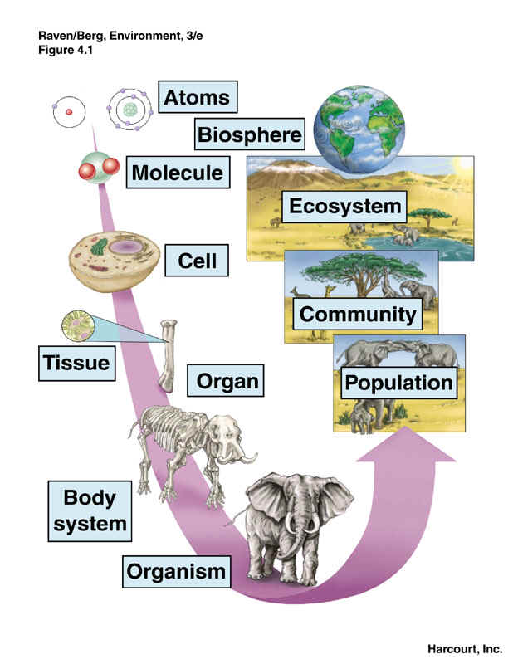
Focusing on Hierarchy?
‘…systems thinking is founded upon two pairs of ideas, those of emergence and hierarchy, and communication and control.’
-- Peter Checkland (1981) Systems Thinking, Systems Practice.

Slide 45
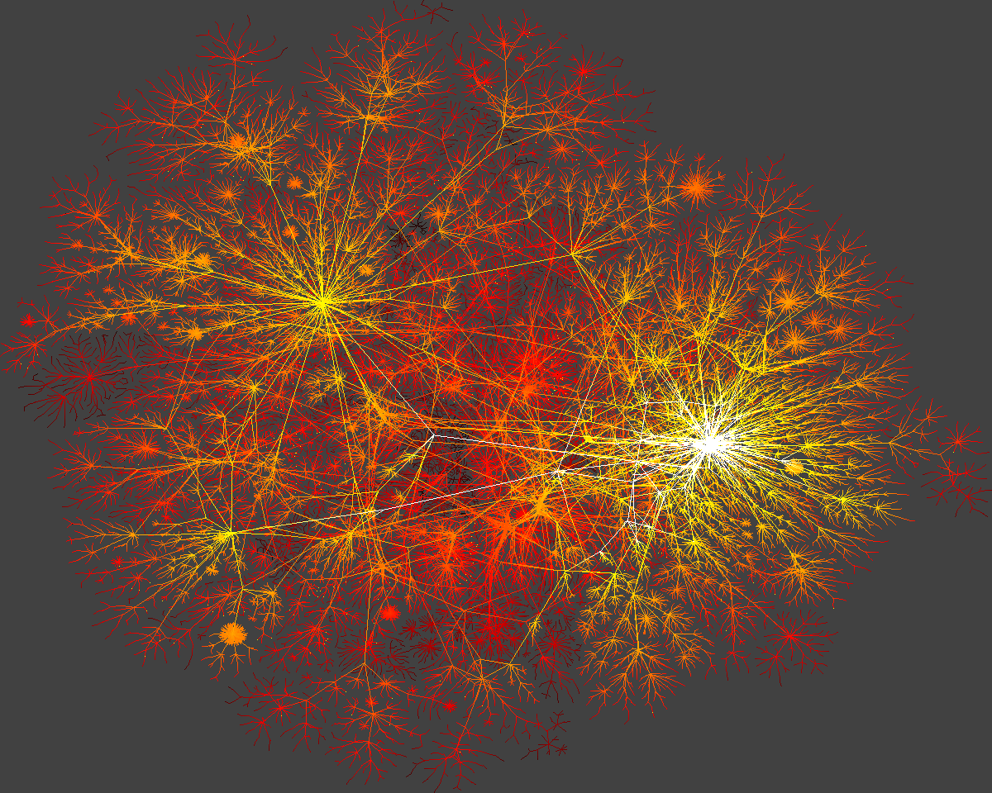
CASE 4: Food Chain Model of SW?
A Challenge for Software Cybernetics Research:
Can we interpret, even predict, software and IT technology development phenomena?

Slide 46
The Phenomena
Web technology has been developed rapidly in the past two decades
…
shopbots
Grid
Agent
E-commerce
Enterprise
portal
Java
Distant
learning
…
ASP
Telephony
Web
services
Semantic
Web
Content
Share
P2P
CGI script
XML
HTTP
HTML
Web
Web-based media
email
finger
TCP/IP
protocol
telnet
ftp
Broadband
Cable
Wireless
[Zhu, H. 2004]

Slide 47
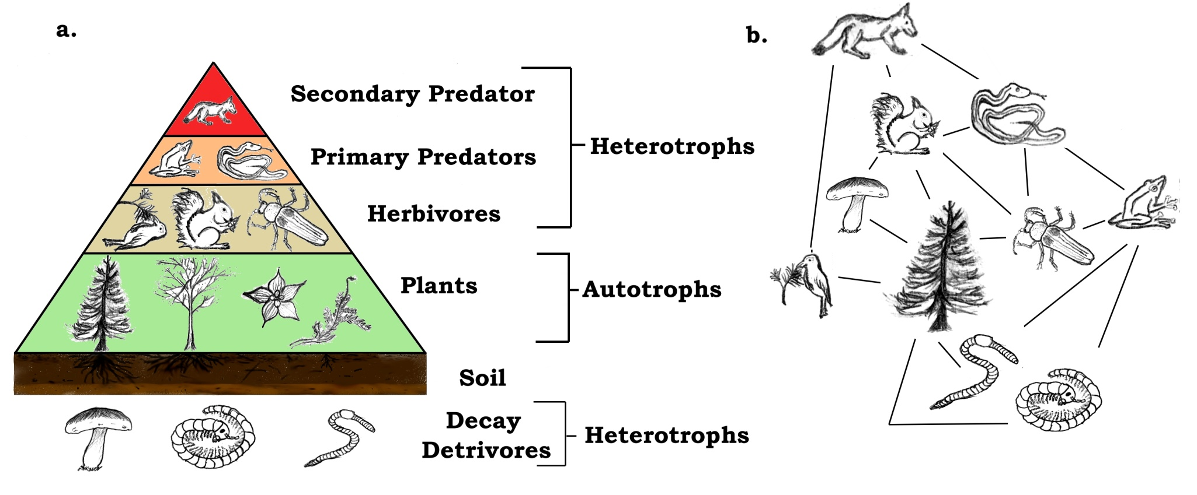
Food Web
A food web (or food cycle) depicts feeding connections (what eats what) in an ecological community.
Figure from Wikipedia

Slide 48
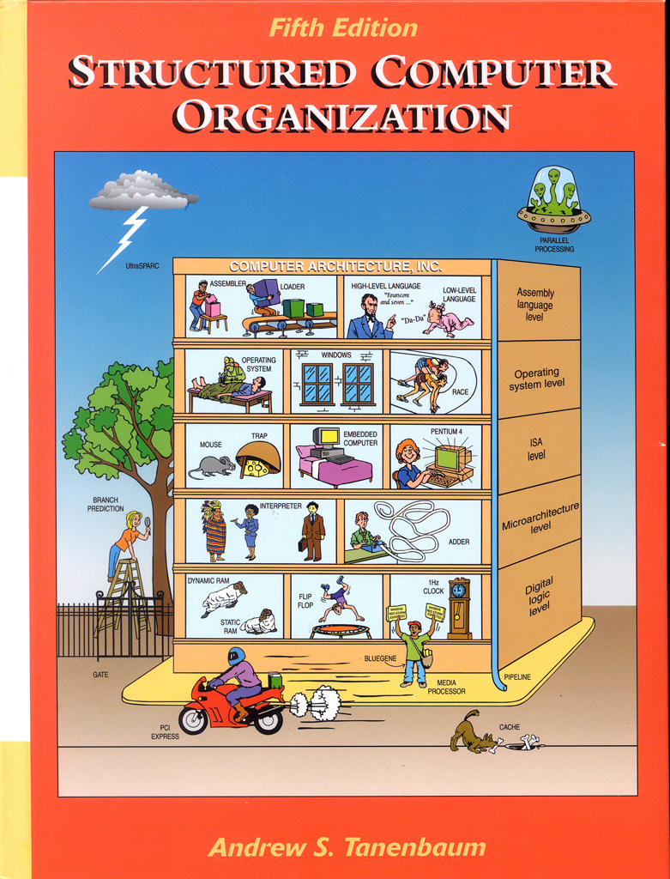
Hierarchical structure of computer hardware

Slide 49
Logical Structure of Operating Systems

Slide 50
Computer and IT Technology Pyramid
e.g. Search engines, office automation, e-commerce, banking and finance,
Programming languages, markup languages, database query languages, etc. )
Applications
Software development tools and platforms
e.g. Virtual machine, VMM, Software Component techniques, Multimedia
e.g. OS, DBMS, Network packages, hardware drivers,
Smart phones
Middleware
e.g. Routes, cables, wireless communication,
mobile phone, etc.
Systems software
Computer hardware
Communication networks hardware
Micro-electronics
Electro-mechanical systems
e.g. CPU, Memory, Mass storage, etc.
e.g. digital circus, analogue circus, etc.
e.g. sensors, activators, etc.

Slide 51
Food Chain and Food Chain Length
Food Chain
a linear sequence of links in a food web starting from a trophic species that eats no other species in the web and ends at a trophic species that is eaten by no other species in the web.
Food chain length
A common metric used to quantify food web trophic structure
A key parameter of food web to answer questions like:
the identity or existence of a few dominant species (called strong interactors or keystone species)
the total number of species and food-chain length (including many weak interactors) and
how community structure, function and stability is determined

Slide 52
A “food web” of software technologies?
Regarding a set of software technology as an ecosystem:
Technology dependence relation (what depends on what) ➔ “Technology Web”
Technology stack, Technology stack depth ➔ Measurement of technology web
Predict technology stability, Keystone techniques, etc.?
analogue to food web
analogue to food chain and food chain strength
Can we develop a theory to analyze the healthiness of a technology web?

Slide 53
The Technology Web of Web Technology
Semantic
Web Services
SaaS
Grid
Agent
Semantic
Web
Web
services
ASP
Java
shopbots
Ontology
OWL-S
Telephony
XML
E-commerce
P2P
Content
Share
Web-based media
CGI script
Web email
Enterprise portal
HTML
HTTP
email
Distant learning
PC
TCP/IP
finger
Social network
Mobile
Device
telnet
ftp
Smart
phone
Mobile
Communication
Mobile
phone

Slide 54
Cloud Computing
Challenges and Opportunities
Application of software cybernetics thought to understand cloud software engineering

Slide 55
Cloud Computing and Software Engineering
Software engineering for cloud computing
The engineering (i.e. the development, operation and maintenance ) of software systems in cloud computing
Software systems that realize cloud computing
Software delivered as services in cloud computing
Cloud computing for software engineering
An application of cloud computing to software engineering, i.e. using cloud computing facilities for the development, operation and maintenance of software (of all types, also include cloud software)
We use the phrase cloud software engineering to include both of the above.

Slide 56
Why cloud software engineering is difficult?
Essences of Software Engineering
Complexity. It is an essential property of software.
Conformity. Software is expected to conform to the standards imposed by other components, such as hardware, or by external bodies, or be existing software.
Changeability. Software suffers from constant needs of changes.
Invisibility. Any forms of representations that are used to describe software will lack any form of visual link that can provide an easily grasped relationship between the representation and the system.
Brooks, F. P. Jr, No silver bullet: essence and accidents of software engineering, IEEE Computer, 1987, pp10~19.

Slide 57
Essences of Cloud Software Engineering
Complexity
services can be dynamically discovered and composed at runtime into composite services
Conformity
to the platform and environment
to the semantics of services
when they are dynamically
searched and composed
Changeability
users’ requirements and platform changes
the services changes
the ontology in which semantics of services are defined changes
the users and tenants (and the human society) is changing
Invisibility
the documents, even the source code, of the software from third party services are not available
Cloud software engineering need software cybernetics to provide novel ideas in order to crack the hard problems!

Slide 58

Computing Paradigm as a Socio-Technical System
What are the technologies used to?
Technology
Relationships between the resource owner, customers and users
How resources are managed?
What are the management goals?
Computation resources
Business model
Management model
Managers
Users
Customers
What are the types and numbers of computation resources in a computation system?

Slide 59
Characteristics of Cloud Computing
Technology
Internet
Virtualization
Security
Web
Mobile communication
QoS
Cluster
Client-server programming
Load balancing
etc.
Business model
Pay-for-use
Service level agreement
Multiple customers and users
Management
Centralized resources management
Optimized for the owners economic benefits
Resource
Types:
compute
Storage
Communication
Database
Software
Number:
Huge scale
Constraint: Service Level Agreement

Slide 60
Emergent behavior in cloud computing systems
Regarding a cloud as a socio-technical system, which consists of various types and a huge number of autonomous active entities, emergent behaviour will demonstrate its importance.
The communication and collaboration mechanisms for the autonomous entities to interact are of particular importance for the emergent behavior of such software systems.
Users, tenants, services, computers, etc.
The challenge:
How to specify, design, implement verify, validate and test such systems are unknown to the software engineering.
Potential software cybernetics solution:
The theories of complexity in cybernetics could shed a new light to this problem.

Slide 61
A Model of Cloud SW
SignAsServiceProvider
ServiceLevelAgreement
SignAsCustomer
ResourceManager
+ResourceRequest
Pay
Customer
Bill
ResourceAllocator
ResourceMonitor
CloudUI
Results in
Authorises
ResoruceControler
Usage
User
+GetState
RequestService
Automatic,
Autonomic,
Self-adaptive,
Optimization w.r.t. SLA
+SetState
Resouce
+SetAssiment
+Type
Automatic and continuous integration and testing,
Self-configuration and composition,
Self adaptation, etc.
+PerformanceParameters
+State
+Assignment
Hardware
Software
Services
CPU
Database
Storage
Platform
Communication Bandwidth
Application

Slide 62
Quality Model of Cloud Computing
Customer concerns:
Operation: Security, privacy, availability, reliability
Transition: Interoperability (locked in)
Revision: Maintainability, etc.
Management concerns:
Operation: Monitoring, control, Energy efficiency, running overhead, book keeping and billing, etc.
Transition: Legal implications
Revision: Maintenance of resources
Technology concerns:
Operation: Pervasive access to resources, elastic scale (supported by virtualization), fault-tolerance
Transition: Rapid development and deployment
Revision: Online testing, online integration, continuous and online integration and evolution, etc.

Slide 63
The Challenges:
Manage a huge number of resources, which are of a large number of types and have operation/management models
Achieve different optimization objectives and quality goals and their combinations from traditional software
Serve a large number of users of many different tenants, who may well have different SLAs, i.e. QoS requirements, which must be achieved at the same time
Potential software cybernetics solution:
To develop cloud software as autonomic and self-adaptive in order to provide QoS.

Slide 64
Models of SW Delivered by Clouds
Cloud Architecture
Software as a Service
Platform as a Service
Infrastructure as a Service
Hardware as a Service
Figure 1: Layered architecture of cloud services

Slide 65
Cloud Architecture
IaaS = Infrastructure as a Service
Delivery of computer infrastructure as a service
Typical examples: GoGrid, Flexiscale, etc.
PaaS = Platform as a Service
A platform provided to software developers for developing cloud applications
Includes all systems and environments
Covers end-to-end lifecycle of developing, testing, deploying, and hosting of applications that are delivered as services
Typical examples: GAE, Azure, EC2, etc.
SaaS = Software as a Service (Application Service Provider (ASP) model)
Supporting multiple customers simultaneously
Using a single instance of object code, underlying database, and other common resources
Typical examples: Salesforce.com, NetSuite, etc.

Slide 66
Multi-Tenancy Architecture
Tenant
User
User
User
User
User
User
Tenant
SaaS
Data
Data
Data
Data
Data
Data
Code/Meta-data
C-data
C-data
Code/Meta-data
Building the software for a new tenant is by integration and composition of existing software.
Change of one component have impact on many customers.
Code
Code
Code
Code
Code
PaaS Platform
Code
Code
Code
Code
IaaS (Cloud infrastructure/hardware)

Slide 67
A SOA Approach to SaaS
Tenant
User
User
Requirements Analysis
User
Ontology of Applic-ation Domain
SaaS ..
Data
Data
Data
Requirements Spec
Meta-data
C-data
Code (service)
Code (service)
Code (service)
Design and Implementation
PaaS Platform
Ontology of platform services
Code (service)
Code (service)
Code (service)
New services
New service
Meta-data
Service Registry
Meta-data
Integration & Testing
Ontology of HW
Infrastructure
Deploy

Slide 68
The challenge:
How to modify services in a SaaS is a hard problem.
Potential software cybernetics solution:
Evolutionary architecture of service ecosystem.
Note:
The heart of the long lasting debate between multi-tenancy (single instance) and multi-instance approaches is which one can provide best support to service evolution.
It is also complicated by its relation to other issues of cloud computing, such as security.

Slide 69
Conclusion
So, now questions?

