Slide 1
2018 IEEE Congress on Services Tutorial
Programming Microservices
in
A Service Agent Oriented Programming Language
and An Integrated DevOps Environment
Hong Zhu
School of Engineering, Computing and Mathematics
Oxford Brookes University, Oxford, UK Email: hzhu@brookes.ac.uk,

Slide 2
Outline
1. Introduction to Microservices
Context, Basic concepts, Advantages, Problems, Current practices
2. Programming in CAOPLE
Parallel programming models
CAOPLE language: Conceptual model, Language facilities, Examples, Demonstration
3. Supporting Microservices in CIDE
Runtime Environment, Functions, Architecture, Tools, Demonstration
4. Conclusion
Summary, Work in progress, Future work

Slide 3
Part 1: Introduction to Microservices
SaaS and Cloud Native Applications
Key features and challenges
Microservices Architecture
Characteristics
Advantages and Benefits
Problems and Challenges
Current Practices
Docker and container technologies
DevOps principles and supporting tools

Slide 4
Examples of Cloud Native Applications
Application | Domain
Booking.com | Hotel booking
EasyChair | Conference management
Ebay | Online shopping
Facebook | Web portal and Social networking media
Google | Web search engine
Gmail | Message communication
Just Eat | Online order for Take Away restaurants
Lastminute.com | Travel agency
LinkedIn | Social networking media for professionals
NetFlix | Online media distribution
Moodle | Online teaching and learning platform
ResearchGate | Social networking media for researchers
Rightmove | Estate agency
SalesForce.com | Customer relationship management
WhatsApp | Instant message communication

Slide 5
SaaS : Software-as-a-Service
A cloud computing model in which computer applications are delivered to the users as services through a communication network
In contrasts to conventional practice of selling applications as products to the customer and be owned by the customer (COWS)
Revolutionized software and computer applications
How computers are used
What functions can be offered
How software are engineered

Slide 6
Characteristics of Big SaaS (1)
Big Tenancy
Serving a large number of tenants and users that may well be interrelated in a complex way
Examples (Data from the Internet as on 20 June 2018)
Just Eat (Started in 2001, Demark)
75,400 takeaway restaurants
13 countries
19 million users
Booking.com (Started in 1998, Holland)
28,753,797 listed properties
228 countries
1,550,000+ room-nights reserved per day
Hong Zhu, et al. Big SaaS: The Next Step Beyond Big Data, Proc. of the 8th IEEE Int’l Congress on Big Data, June 27 - July 2, 2015, pp775-784.
Notes:
References:
Hong Zhu, et al. Big SaaS: The Next Step Beyond Big Data, Proc. of the 8th IEEE Int’l Congress on Big Data, June 27 - July 2, 2015, pp775-784.

Slide 7
Characteristics of Big SaaS (2)
2. Big Data
Large volumes of data are collected, stored, updated, and processed.
Example
Rightmove.com (Data from the Internet, on 20 June 2018)
Customers base:
20,427 Agency and New Homes customers
Amount of data:
Size: 1 million UK residential properties
Data types: Pictures, Text descriptions, location information, layout, etc.
Traffic:
Average: 125 million visits per month (over past 3 months)
Peak: 142 million visits in March 2018
Time on site:
Average: nearly 1 billion minutes per month (over past 3 months )

Slide 8
Characteristics of Big SaaS (3)
3. Big Code
The program is typically large in size and high in complexity.
Example
Many SaaS applications are connected to social media, or even offer their own domain-specific social networking, such as SalesForce and Moodle.
Many already have mobile phone or tablet apps.
Trend:
In the near future, SaaS will extend to Internet of Things, Wireless Sensor Networks, robots, etc., making the size and complexity of the code even greater.

Slide 9
Characteristics of Big SaaS (3)
4. Big Value
SaaS applications produce a great value through
Providing extra services that were hitherto impossible
Reaching customers hitherto impossible by reducing the cost
Example: Rightmove.com (Started in 2000, UK)
Property sellers are 5x more likely to find a buyer here than any other website.
On the London Stock Exchange in March 2006
Current market value: 4,742.90M GBP

Slide 10
The Challenges
Reliability
Tolerant to HW/SW failures
Societal risks
Modifiability
Customisation
Evolution
Security
Separation of tenants
Performance
Scalability
Efficiency
Operability
Complex environment: more dynamic, more diversity
Continuous operation

Slide 11
The Notion of Societal Risk
Societal risk is a risk (the chance of accidents) that could cause lost to a society (a group of users) in one system failure.
Societal risk is measured and expressed as the relationship between the probability of a catastrophic incident and the number of users affected.
F-N curve: plots the expected frequency (F) of failure and the number (N) of users affected by each failure.

Slide 12
SaaS Differs from COWS in Societal Risks
Illustrative F-N curve to demonstrate the differences between SaaS and COWS in societal risks
Consequence
(Number of users affected per failure)
SaaS
COWS
Failure rate (Frequency of failure occurrences)
Challenge:
It is crucial for SaaS application developers to improve reliability and reduce the societal risk significantly to an acceptable level.

Slide 13
Examples of Big SaaS Failures
Googlemail: A major failure in March 2011
150,000 users could not access their emails
4 days to repair and recover
Amazon WS: A failure in 21st April, 2011
Most of its US-East region
Thousands of businesses and major websites
75 million users of the PlayStation network
Amazon lost millions of dollars and many customers.
More than 12 hours.
Microsoft’s Hotmail: A database error in 2010
17,000 accounts lost inbox and folders
More than 3 days to restore the data for most accounts
Salesforce.com: A major failure of data centers in 2012
Outage of NA1, NA5, and NA6 in North America, and the “sandbox” instances of regions CS0, CS1, CS3, and CS12
8 hours to fix the issues

Slide 14
How Is Happening in Industry?
Software architecture
Microservices
Serverless
Software platform
Docker and container technology
PaaS
Software engineering methodology (Process)
DevOps (Continuous Integration, Continuous Testing, Continuous Delivery)
Automated tools
New types of automated tools (deployment, monitoring, registering, and migrating micorservices)

Slide 15

Architectural Models of SaaS
Tenant 1
Tenant 2
Tenant 3
Tenant 1
Tenant 2
Tenant 3
Tenant 1
Tenant 2
Tenant 3
Load Balancer
1: Ad-Hoc/Custom
2: Customization
Tenant 1
Tenant 2
Tenant 3
Tenant 1
Tenant 2
Tenant 3
5: MicroServices:
System efficiency
Load Balancer
Monolithic architecture
3: Multi-tenancy
4: Scalability
Reference: Chong, F. and Carraro, G., Architecture Strategies for Catching the Long Tail, Microsoft Corporation, April 2006.
Notes:
Reference:
Chong, F. and Carraro, G., Architecture Strategies for Catching the Long Tail, Microsoft Corporation, April 2006.

Slide 16
Key Features of Microservices
Services as the components
Runs in its own process
Independently deployable
Interacts with each other through communication
Each service is specialised
Each service implements one function and only a function
Fine granularity
Large in numbers, but small in size
Dynamically duplicated and distributed
A service can be dynamic created and removed from system at runtime
A service may have multiple copies, if needed
A service can be moved from one machine to another
in comparison with monolithic approach

Slide 17
Benefits of MS Architecture
Improving system performance
Scalability (Elastic)
Efficiency (Load balance)
Reliability (Redundancy and Fault isolation)
Supporting SW development
Multiple-Team collaboration (Change of ownership)
Continuous testing
Continuous deployment
Continuous integration
Reducing high societal risks!
Evolution => Ecosystem

Slide 18
Current State
Microservices are widely adopted in industry. It has been popular since 2010.
Well-known examples:
NetFlix, Amazon, Ebay, Google, Facebook, Microsoft’s Azure, etc.
Statistics:
73% of organisations provide both internal and external APIs according to 2016 Smartbear global survey
Expert opinions:
“A common feature of successful IT companies [in the Unicorn group] nowadays is that they have all taken an aggressive approach towards adoption of the microservices architecture”. [Santoli, Mar 2016]

Slide 19
The Problems of MS
Development
How to program a large set of fine-grained services running in parallel
The conceptual integrity of the system is difficult to manage
The need a good concurrent and distributed programming model
Operation
How to reduce the communication overhead due to the large number of fine-grained services
➔ The need for a lightweight facility to enable MS to communicate with each other.
How to achieve dynamic load balancing and scale out
➔ The need of a deployment mechanism and facility that enable services to be deployed flexibly and uninterruptively
Maintenance and Evolution
How to test and integrate new services to the exist collection of services
➔ The need of testing and debugging facilities for distributed and parallel systems

Slide 20
Container Technology
Basic Ideas of Container Technologies
Optional

Slide 21
Key Features of Container Technology
Lightweight virtualization:
Share memory, processors, the file system, and operating system kernel.
Scalability and efficiency:
Thousands of containers can be deployed on one host easily and they can restart quickly too
Processes can be deployed to containers flexibly at a cost much less than that of starting a new virtual machine.
Security:
Provides separation to the customers
Analysis:
Improved the infrastructure on which MS executes
The programs running in the containers are still programmed in traditional programming languages
The complexity of the programming for developing MS increases!

Slide 22
Docker
Docker is a Software Containerization Platform
Wrapping a piece of software in a complete file system
Each container contains everything needed to run: code, runtime, system tools, system libraries, etc.
Based on open standards, enabling containers to run on all major Linux distributions and on Windows.
Running multiple containers on a single machine that share the same operating system kernel.
Images are constructed from layered file systems and share common files.
Disk space usage is efficient
Image downloads are quick and efficient
They start instantly and use less RAM
Container Orchestration Engines: Automating the deployment of applications
Distribute a number of containers to a cluster of machines in pre-scripted configuration.
It enables the software to run the same, regardless of its environment.

Slide 23
Docker Architecture
Docker Host: a physical or virtual machine
Docker Engine: the software running on the docker hosts to implement the container functionalities
Docker Client: a workstation for the developer or operator. Docker command are executed to operate a cluster
Registry: A library of container images where they can be searched for and retrieved from

Slide 24
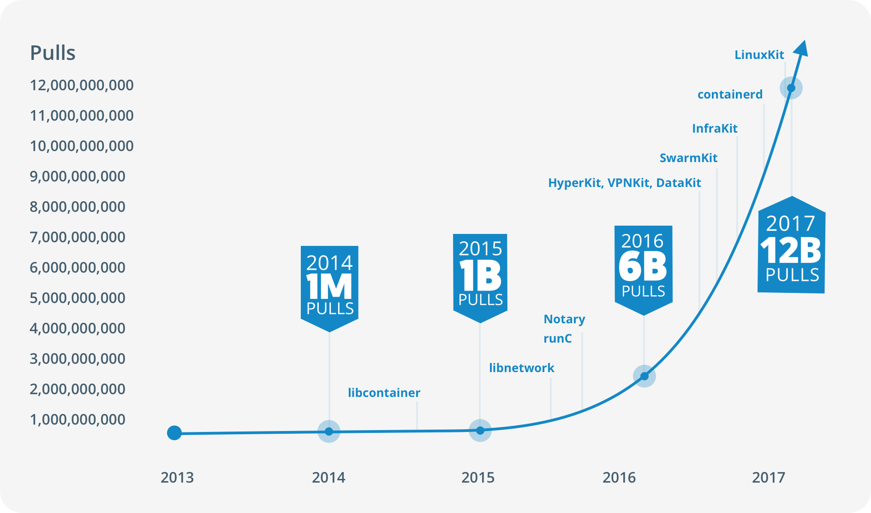
The Growth of Docker’s Popularity
Docker Web Page at URL:
https://www.docker.com/what-container
The launch of Docker

Slide 25
Container’s Support to Microservices
Microservices | Container
A service | A container image
An instance of a service | A container
Creation of instances | Pull container images from a registry Deployment of containers to machines
Registration of services | Push image to a container hub
Search services | Search and pull container images from a container hub

Slide 26
Process of Using Containers
Write
Program
In any programming language, e.g. Java, Python, R, etc.
Using IDE, e.g. Eclipse, etc.
Write
A Dockerfile
A list of Docker command to assemble an image
Build
A Docker Image
Ready to run on a container machine
Test the Dockerfile
Docker registry is a SaaS registry
Docker Hub is a public registry
Search, manage, push & pull images
Ship: Push Image to a Docker Registry
Deployment of Contains to machine
Use a container orchestration engine, e.g. Kubernetes, Docker Swarm, etc.

Slide 27
Dockerfile
Common Command for Dockerfiles
Example: Create a new text file and name it “Dockerfile”
FROM openjdk
CMD ["java", "-version"]

Slide 28
Build A Docker Image
Notes:
The docker build command builds the image.
-t provides a name for the image.
hello-java is the name of the image.
. is the context for the command. This context is used as the base directory for copying any files to the image. No files are copied in this case.
(2) The openjdk image is downloaded from Docker Hub. It also downloads the complete chain of base images.
(3) The CMD instruction adds a new layer to the image.

Slide 29
Run A Docker Container
Command:
docker run hello-java
Output:

Slide 30
Run A Docker Container: The Options

Slide 31
Docker Hub
Public Container Registry (100,000+ Free Apps)
URL: https://hub.docker.com
Common Docker Commands to Interact with Docker Hub

Slide 32
Deployment of Containers
Deployment of multi-container/multi-host applications to a cluster can be complicated and error-prone
Container Orchestration Engines
Main Functions:
Run containers: start and stop containers on hosts;
Monitoring containers: performance, workload, fault diagnosis, etc.;
Managing containers: when a container fails, restart it
Load balancing:
Scaling: creation of new containers when workload is high, stop containers when workload is low
Scheduling: distributes communications to instances
Typical examples:
Docker Swarm, Kubernetes, Apache Mesos, Amazon EC2 Container Service, Rancher Labs, Joyent Triton, etc.

Slide 33
Kubernetes Architecture
Cluster: a set of physical or virtual machines
Node: one physical or virtual machine
Master: a node
that manage the
cluster
Worker: a node
that runs
containers
Kubelet: a service
running on each
node

Slide 34
Deploying Containers Using Kubernetes
Process:
Defining an Application in a Kubernetes Configuration File
Run the Application on the Kubernetes Cluster with the file
Kinds of Elements in a Configuration File
Pod:
The smallest deployable units that can be created, scheduled, and managed;
Replication Controller:
Ensures a specified number of pod replicas are running on worker nodes at all times. (Pod inside a replication controller are re-created when the worker node reboots or fails.)
Enables upscaling/downscaling of the number of replicas.
Service:
Defines a logical set of pods and a policy by which to access them
Assigns an IP address that does not change over time

Slide 35
Example of Pod

Slide 36
Example of Replication Controller

Slide 37
Example of Service
An example of complete Kubernetes configuration file

Slide 38
Run Application on Kubernetes Cluster

Slide 39
DevOps
DevOps Principles
Integration:
The development of software should be integrated with deployment, operation and maintenance in both the process and teams.
Shift-to-the-left:
Development, operation and maintenance activities should be done as early as possible.
Reference: S. Sharma & B. Coyne, DevOps for Dummies, 2nd IBM Limited Edition, 2015.
Typical DevOps delivery pipeline:

Slide 40
DevOps Tools
Cluster monitoring tools:
Nagios/Icinga, Monit, Collectd/Collectl
Log analysis tool:
ELK (Elasticsearch, Logstash and Kibana)
Service registration and access tools:
Consul, Zookeeper, etcd
Configuration and deployment tools:
Jenkins, Puppet, Vagrant, Ansible
Docker + (Docker Swarm/Kubernetes) are also considered as DevOps tools
Observations:
A further development of agile methodology, inherits many principles of agile methodology, but geared to for large scale systems running on clusters
Applied together with container to address the complexity of operation
Focus is on process and tool support
Problems:
Tools are not integrated with IDE
Tools are mostly for the operation team, not for developers
Tools are complex to uses and integrate

Slide 41
Adoption Rates of DevOps
DevOPs has been adopted by many major players in the cloud computing service providers and applied together with microservices architecture and container technology.

Slide 42
Summary
Software structure: (Ecosystem of microservices)
A SaaS system in microservices architecture consists of a large number of services of fine granularity.
Each service may have multiple copies at runtime.
A copy of service may be created and deleted dynamically.
A copy of a service need to be easily and quickly deployed and distributed to a cluster of computers in the network.
Structure of human resource: (Ecosystem of small teams)
Multiple teams of developers and operators
Ownership of microservices to small teams: “you develop it , you run it”
Integration of technical skills of development, deployment and operation
Development/Operation process: (DevOps)
Integration of development and operation
Pipeline: Continuous testing, continuous deployment and continuous integration
Technical Support:
Container technology + DevOp tools

