Slide 1
2018 IEEE Congress on Services Tutorial
Programming Microservices
in
A Service Agent Oriented Programming Language
and An Integrated DevOps Environment
Hong Zhu
School of Engineering, Computing and Mathematics
Oxford Brookes University, Oxford, UK Email: hzhu@brookes.ac.uk,

Slide 2
Part 2: Programming in CAOPLE
Paradigms of programming languages
Actor
Reactive
Intelligent agent
Service agent
CAOPLE programming language
Caste declaration
Agent creation
Communication and event driven computation
Adaptive behaviour
Data types and type checking

Slide 3
Programming Languages in SE Paradigms
The maturity in the establishment of a SE paradigm is always manifested by the development and the wide acceptance of a new paradigm of programming languages.
Structural SE => Imperative procedural programming languages:
Fortran, COBAL, Basic, and C programming languages
Object-oriented SE => Object-oriented programming languages:
Smalltalk, Eiffel, C++, Java, C#，etc.
Programming language is a key element of software engineering paradigm.
SaaS Engineering is still in seek of an appropriate programming languages.

Slide 4
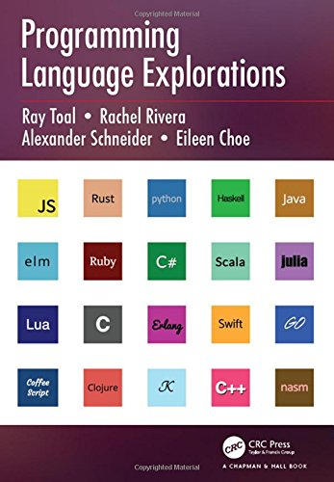
Software Languages for SaaS
Programming languages:
Python, Go, Scala, etc.
Script languages:
Node.js (JavaScript), etc.
Markup and data representation languages:
XML, JSON, etc.
Query languages:
SQL, XQuery, etc.
Web application languages:
PHP, etc.
Service description languages:
WSDL, SAOPL, UUDI, OWL-S, etc.

Slide 5
Candidates of The New SE Paradigm
Which language paradigm is suitable for SaaS?
Approach | Philosophical Model
Functional | Computation is function application
Logic | Computation is logic inference
Actor | Computation is interaction between actors
Reactive | Computation is propagation of data changes
AI Agent | Computation is collaboration among autonomous intelligent agents
Service Agent | Computation is the collaboration among service agents
Our proposal [Zhu 2000]

Slide 6
Actor-Based Approaches
The Actor model was proposed and studied for programming concurrent and parallel systems [Hewitt, 1973; Apha, 1987]
Actors are the universal primitives of computation, i.e. the building blocks of a concurrent and parallel system.
Active: An actor is a computational entity that is capable of
Send messages to other actors directly by referring to their IDs;
Create new actors locally or remotely;
Perform computation in response to messages it receives.
Modify its private state
Autonomous: An actor can only affect each other through messages, i.e. not to operate on other actor’s state.
Actors are globally organized by the system hierarchically
Controlling the lifecycles of actors
Processing exceptions and failures
Managing actor’s IDs

Slide 7
Actor’s Communication Mechanism
Direct addressing:
For an actor A to be able to send a message to an actor B, A must have the unique reference to B (i.e. the name or identifier of B). The message is delivered to actor B directly.
Location transparent:
Although the sender of a message needs to know the reference of the receiver, it does not need to know the location of the receiver. The reference is sufficient for the delivery of the message.
Asynchronous:
A message is delivered asynchronously, i.e. not blocking the message sender for the delivery of messages.

Slide 8
Actor’s Reference Capability Model
An actor can obtain the unique references of other actors through the following ways.
Initial condition:
The references to certain fixed actors in the system’s environment are known for all actors.
Parenthood:
When an actor A creates B, A obtains the unique reference of B.
Endowment:
When actor A creates B, B is born with the subset of references that A chose to endow it with.
Introduction:
If A has the reference to actor C, A can send the reference to C to actor B (provided that A also has the reference to B so that C’s reference can be sent to B).

Slide 9
Implementations of Actor Model
Pure actor system:
Everything is an actor, even the primitive data types, such as integers, real numbers and strings, are actors
No such practical programming language exists as far as we know
Actor as a special kind of system component:
Extends an exiting programming language with a library of code that enables the actor model
Example:
Akka library for Scala and Java
More than 50 such libraries listed in the Wikipedia
More than 20 programming languages have claimed that the actor model is implemented or supported

Slide 10
Akka’s Actor Model
An actor is an object with four lifecycle methods, which should be overridden when coding a specific actor:
preStart(): invoked when the actor is started after it is created;
postStop(): invoked when the actor is stopped;
preRestart(): A supervisor failure strategy can choose to restart a failed child actor. During a restart, this method is invoked just before the actor’s restart;
postRestart(): invoked just after the restart the actor enabling re-initialization of the actor.

Slide 11
Akka’s Supervision Hierarchy
Actor Hierarchical Structure:
In an actor system, when an actor A creates an actor B, B is a child of A, and A is the parent of B.
Root Guardian:
Root Guardian is the actor on the top of the whole hierarchical structure
It has two child actors automatically generated by the system: the user guardian and the system guardian
User Guardian:
A user can create multiple actor systems. These actor systems are children of the User Guardian.
System Guardian:
System’s internal actors are placed under the System Guardian.

Slide 12
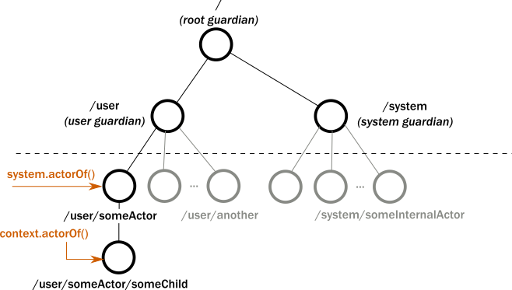
Akka’s Supervision Hierarchy
Single point of failure!
Actor’s lifecycle management:
The parent is responsible for exception handling of its children, and to terminate its children.
A child’s life depends on its parent.
Actor search facility: search as query of the paths.

Slide 13
Reactive Approach
Reactive programming
Asynchronous event-driven: the availability of new information drives the logic of information processing forward
Continuous time-varying values are propagated of the changes in a data-driven manner
History:
Backdated to 1980s of functional reactive and data-flow declarative programming languages
Recently, ReactiveX [ReactiveX Website,http://reactivex.io. ]
Developed for cloud computing and extracted wide attention from the industry due to the use by Netflix
Polyglot in the sense that it is implemented in and extends to a variety of languages (currently 18 languages and 3 platforms/frameworks)
The most popular ones: RxJava, RxPython, RxJS.

Slide 14
ReactiveX’s Implementation
Based on the Observer design pattern
Provides two abstract classes as the building blocks of reactive programs:
Observable (the Subject class in the Observer design pattern)
An Observable object may emit any number of items (including zero items), and then terminate either by successful completion or due to an error.
Subscriber (the Observer class in the Observer pattern).
A subscriber reacts to whatever item the Observable emits.
The subscriber’s reactions are defined by overriding three abstract methods of the abstract class Subscriber:
onNext() for the reaction when receives an item;
onComplete() for the reaction when the Observer terminates successfully;
onError() for the reaction when the Observer fails with an error
A subscriber links to an Observable object by invoking the subscribe(Subscriber: sub) method of the observable object

Slide 15
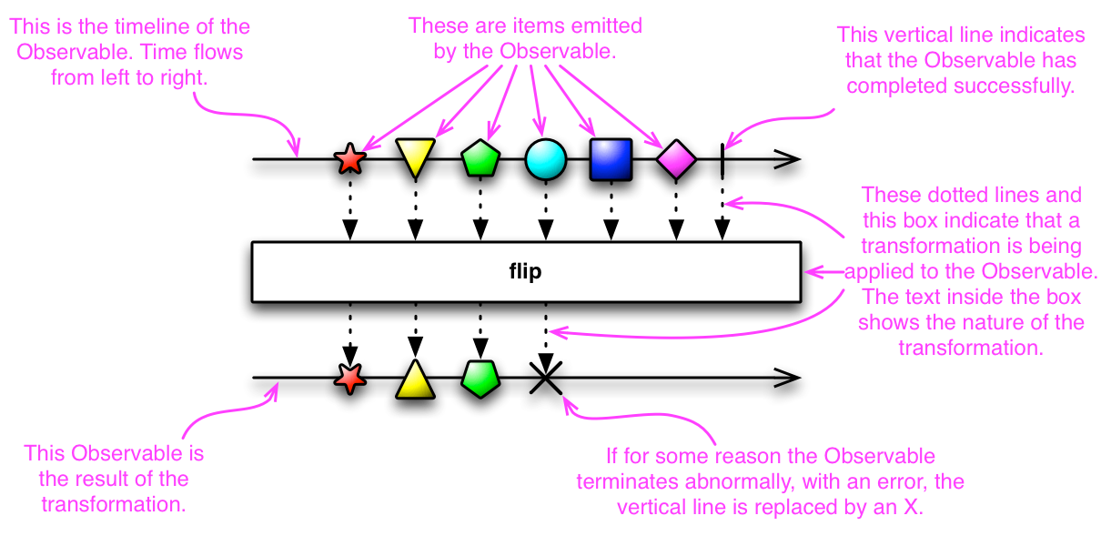
ReactiveX’s “List” Operators
ReactiveX provides a collection of operators with which users can filter, select, transform, combine, and compose sequences of values or even infinite streams of values. This makes Observable more composable and flexible to uses.

Slide 16
Intelligent Agent Models
Basic Ideas:
Agents have metal states of Believe, Desire and Intension, etc.;
Intelligent agents as the basic building blocks to construct software systems
History:
It has long been considered suitable for dynamic environments such as the Internet [Jennings, 2000],
Many research efforts have been reported in the literature [Henderson-Sellers and Giorgini 2005].
It is considered as potentially suitable for service oriented computing [Singh & Huhns 2004].
Current state:
The IT industry has been slow to adopt the approach.
The main barriers:
Existing models of intelligent agents seems too strongly linked to AI to be regarded as easy and general enough to programming
Difficult to debug
Lack of efficient implementations

Slide 17
Service Agent Model [Zhu, 2000]
Agents are service providers (and/or requesters) as in the real world
Estate agents provide services in buying and selling properties
Travel agents provide services in buying and selling air-tickets
Agents are classified into castes
Castes are building blocks of program (like classes)
Castes are templates of agents, which can be created dynamically at run time
Caste are hierarchically structured through the inheritance relation
An agent can move between castes dynamically
An agent can be a member of multiple castes

Slide 18
The Structure of Agents/Castes
Agents have the following elements in their structure
Actions that the agent can perform.
When an agent takes an action, it will generate a corresponding event.
Variables, which represents its state of the agent.
An agent can change its state, but not by any other entities in the system
An agent’s state can be declared as visible by other agents, such its value can be obtained by other agents (but still not to be changed)
Body, which the agent executes to determine when and which action to take and update its variables
Environment, describes which agents in the system it observes for their events.

Slide 19
Key Features of Agents
Autonomous
Stronger encapsulation of data, operation and behaviour: an agent’s state can only be changed by the agent itself
Lifecycle independent, no global organization of agents
Each agent runs in its own process: executing in parallel and non-blocking each other
Collaborative
Asynchronous communication mechanism
Event-driven rather than messaging
Implicit without directing to a specific agent
Explicit only when needed
Identity is recognizable in communication
Distributed
Situated in a distributed environment: located in a cluster at runtime
Location transparent

Slide 20
Key Features of Castes
Caste
Classifier of agents
Agents are classified according to their caste membership.
Template of agents
Agents are created and instantiated from castes
Compilation and deployment unit
A caste can be deployed (added) into the system without rebuild the whole system or restart the system
Relationships between castes
Inheritance: generalisation/specialisation
Whole-part: organisation vs individual
Migration: change of role ➔ adaptive behaviours

Slide 21
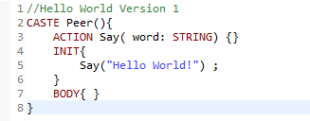
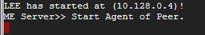
Example: Hello World
This can be compiled, and then deployed, and executed by creating instances.

Slide 22
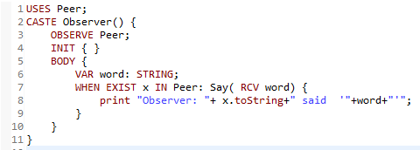
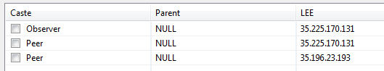
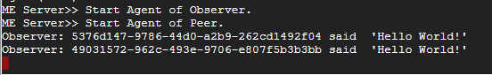
Example: (Observer of “Hello World”)
Obtain the value of the action parameter
Get the agent’s ID

Slide 23
Communication Mechanism
Agent A takes a visible action → Agent B observes the action
The observe-clause in a caste declaration defines the events that an agent listens to.
Comparison with “Subscribe-and-Publish”
Subscriber does not need to unsubscribe
Subscriber does not need to know the publisher’s ID and location
Subscribing to a group of publishers rather than just one
Publisher does not need to know the IDs and locations of the subscribers
This is more suitable for service orientation.

Slide 24
“Deployment” Mechanism
The creation of an instance of a service is equivalent to create an agent. This can be done in the way format as creation of an object in object-oriented programming language.
AgentCreationStmt ::=
create [AgentVar of] casteName ([params])
[@ locationExp]
The location (optional) can be a constant, or an expression of String type that represents an IP address.
When the location (an IP address) is given, an agent is created on the LEE at the IP address.
When the location is omitted, an agent is created on the same LEE where this agent is running.
If an agent type variable is given, the reference ID of the created agent is assigned to the variable.

Slide 25
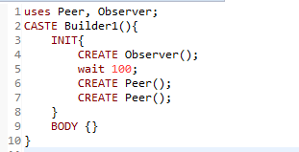
Example: Dynamic Creation of Agents

Slide 26
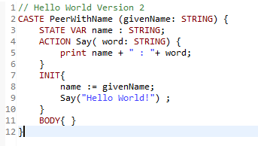
Example: Hello World Version 2

Slide 27
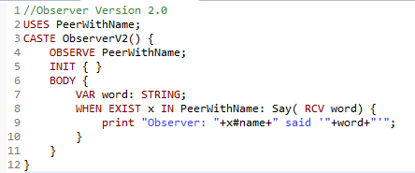
Example: Observer Version 2
Get the value of the agent’s state variable

Slide 28
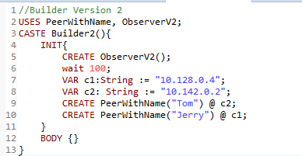
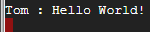
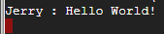
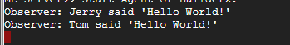
Example: Builder Version 2

Slide 29
Event-Driven Computation
Statements that enables event-driven computation:
WhenStatement ::=
when Scenario { statements } ;
TillStatement ::=
till Scenario [ { Statement } ]
{ || scenario [ { Statement } ] }
[ timeout ( IntExp ) [ { Statement } ] ] ;
Scenario ::=
AgentVar : ActionID( [ Params ] )
| exist AgentVar in CasteName : ActionID( [ Params ] )

Slide 30
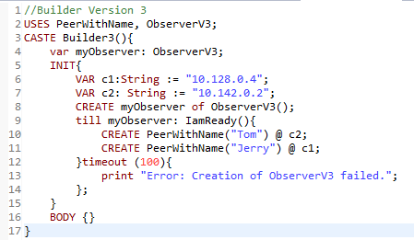
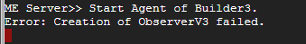
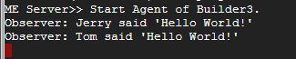
Example: The Till Statement
If the timeout value is set too small, e.g. 50 ms

Slide 31
Agent Operations: More Than Deployment
An agent operation statement changes the caste membership of the agent, thus changes its behaviour
JoinStmt ::= join casteName ([params])
QuitStmt ::= quit [ casteName ]
SuspendStmt ::= suspend casteName
ResumeStmt ::= resume casteName
EvolveStmt ::= evolve [ casteName ] to casteName([params])
DestroyStmt ::= destroy [ agentVar ]

Slide 32
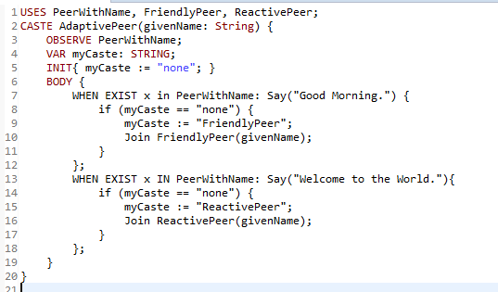
Example: AdaptivePeer

Slide 33
How to Write “API”s
Caste ServiceRequestor to define a set of actions that a service requestor takes to send service requests to a service provider;
Caste ServiceProvider to define a set of actions that delivers the results to the service requestor;
ServiceProvider observes the ServiceRequestor;
ServiceRequestor observes the ServiceProvider;
Observe
Service
Provider Interface
Service
Requestor Interface
Observe
Service
Provider Implementation
Service
Requestor

Slide 34
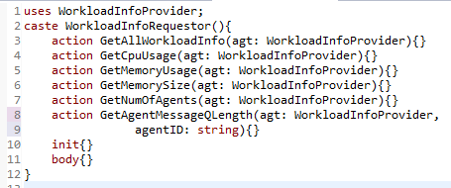
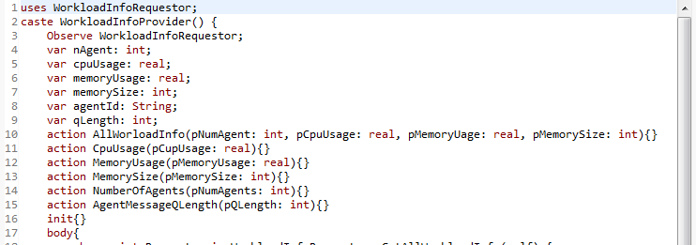
Example: Check Workload on a Node

Slide 35
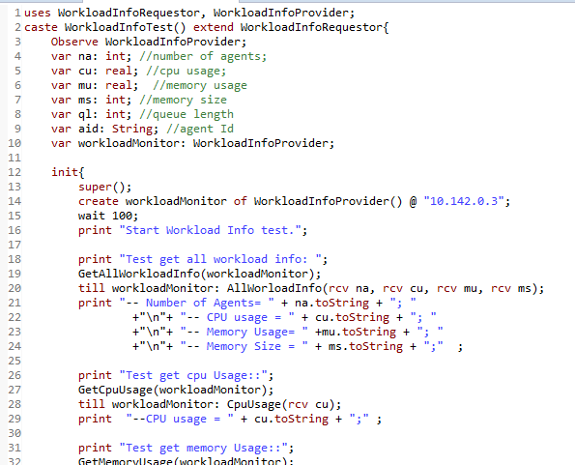

Slide 36
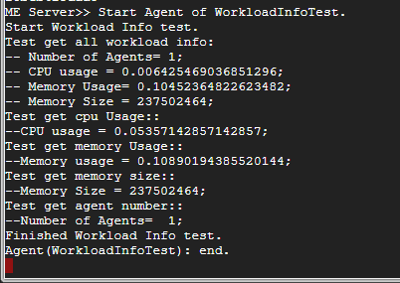

Slide 37
Data Types
CAOPLE is a strong typing language. Type consistence is checked at compilation time.
Predefined Data Types
Int, Real, Bool, String
Agent Data Types
Agnet [{ casteName }] : reference to an agent of the caste
User Defined Data Types
Record Types
Struct { { FieldName : TypeName ; }⁺ }
List Types
List { TypeName }
Enumerate Types
Enum {EnumValue {, EnumValue} }
Type information is also carried to runtime and checked at runtime, too.

Slide 38
Literals
Syntax:
StructuredLiteral ::= TypeName : StructuredLitValue
StructuredLitValue ::= RecordLiteral | ListLiteral
RecordLiteral ::= { FieldName : FieldValueLiteral
{ , FieldName : FieldValueLiteral } }
ListLiteral::= [ [ElementValueLiteral
{, ElementValueLiteral }] ]
Examples:
Person: { name:"Hong Zhu",
DoB: Date:{day:9, month:2, year:1961} }
Date:{ day: null, month: null, year:1961}
IntList: [1, 2, 3, 4, 5]

Slide 39
Definition Packages
A definition package defines a set of interrelated types and constants of the data to be processed by the agents and passed between them.
DefPackage ::=
[ Imports ] Definition PackageName { Definitions }
Imports ::= Import PackageName { , PackageName } ;
Definitions ::= { TypeDef | ConstDef }+
TypeDef ::= Type DataTypeName = TypeExpr ;
ConstDef ::= Const ConstName = LiteralValue ;

Slide 40
Prevention of Data Racing
Prevention of write-write type of data racing:
An agent’s state variables can only be modified by the agent itself
Each agent is one thread
Prevention of write-read type data racing:
re-definition of the semantics of the with-statement
WithStatement::= with var = expr { statements }
where expr is a variable of a structured data type.
Example: assume that conf.date’s initial value is <day=28, month=02, year=2015>;
with date= conf.date {
date.day := 02;
date.month := 07;
date.year := 2018;
};
The value of conf.date will be updated to <day=02, month=07, year=2018> after finishing the execution of the with-statement.

Slide 41
Matching Caste/Agent to MS
Meanings of the word “service”:
A service is the functionality provided by a computer system and delivered to the users; see [*]. → service
A service is the computational entity that provides the services in the first sense. → agent
Meanings of the word “microservices”:
MS are identical copies of a service where each copy is a runtime computational entity. → agent
a MS is a template from which instances can be generated and deployed to different servers → caste
[*] Singh, P. M., and Huhns, N. M., (2005) Service-Oriented Computing: Semantics, Processes, Agents. Wiley.

Slide 42
Summary
Service agent is a concurrent programming model
A metaphor of human society
It matches the microservices architecture
Language facility is at a high level of abstraction
Services (i.e. agents) are first class entities and only building blocks of SW systems, not packages
Deployment and configuration as as agent creation and operations
No low level communication jargons, such as socket, port, send and receive, messages, etc.
No low level synchronisation mechanism, such as synchronise statement, critical regions, PV operations, etc.
Network transparency: agents can be instantiated on any machine

Slide 43
Comparison
 | Actors | Reactive | Agent
Runtime elements | Actors, [objects] | Observables, Subscribers, objects | Agents
Program units | Actor types, [Classes] | Sub-Observables, Sub-Subscribers, Class | Castes
Uses of Reference Capability model | Lifecycle management, Communication address | Lifecycle management, Subscription for communication | Lifecycle management [optional], Communication address [optional]
Communi-cation mechanism | Asynchronous, Direct addressing, | Asynchronous, Subscribe-publish, Explicit event-driven | Asynchronous, Implicit event-driven, Sender ID identifiable
System structure | Centrally organised hierarchy | Flat, no central organisation | Parent-child hierarchy, Inheritance hierarchy, no central organisation
Location transparency | Implicit by reference | No | Yes

Slide 44
CAOPLE’s Characteristics
Purely Agent-Oriented
Agent is the only type of building block of a system
vs: Agent + Object approach
Caste-Centric
Every agent must be created by instantiation of a caste
A program code consists of a suite of castes
vs: code agents directly
Imperative
Behaviours of the agents are specified in imperative statements
vs: AI approaches, such as
Logic / Rules approach (such as BDI agents);
Game theory approach (unitity functions);
Organisational / Social model approaches; etc.

Slide 45
References
Xu, C., Zhu, H., Bayley, I., Lightfoot, D., Green, M., and Marshall, P., “CAOPLE: A Programming Language for Microservices SaaS”, in Proc. of SOSE 2016, pp42-52.
Desheng Liu, Hong Zhu, Chengzhi Xu, Ian Bayley, David Lightfoot, Mark Green and Peter Marshall, CIDE: An Integrated Development Environment for Microservices, in Proc. of SCC 2016, pp808-812.

