Slide 1
2018 IEEE Congress on Services Tutorial
Programming Microservices
in
A Service Agent Oriented Programming Language
and An Integrated DevOps Environment
Hong Zhu
School of Engineering, Computing and Mathematics
Oxford Brookes University, Oxford, UK Email: hzhu@brookes.ac.uk,

Slide 2
Part 3: Integrated DevOps Envrionment
CAVM: CAOPLE virtual machine
Architecture and operations
CIDE: CAOLE Integrated DevOps Environment
Architecture
Programming environments
Cluster management facilities
Deployment management facilities
Runtime agent management facilities

Slide 3
Overview of the CAVM-2 Virtual Machine
The source code of a CAOPLE program unit is compiled into an object code file
A caste declaration is compiled into an deployable object caste file with extension .cst, which is executable on CAVM-2 virtual machine
A definition package is compiled into an object files (not deployable, not executable), but can be used in compilation of castes
CAVM-2 virtual machine is written in Java
It can be run on different operating systems without any change if Java is supported
Already tested on Windows, Ubuntu, and iOS
A typical application situation is in the heterogeneous system, where a number of different operating systems of various versions are used.
CAVM-2 virtual machine is light weight and easy to install
Size of the .jar file is <3 MB
Proof of concept prototype, performance is not the main concern

Slide 4
Overall Architecture
Cluster
RE
CIDE
Cluster Manager
CE
ME
Deployment Manager
LEE
ME
Programming GUI
Agent
Manager
ME
LEE
Compiler
& Code Lib
Runtime Environment
CE
CE
Communication Engine
CIDE
ME
LEE
Logic Execution Engine
CIDE
RE
Registration Engine
ME
ME
Management engine, server/client
LEE
ME

Slide 5
Components of CAVM: 1. CE and LEE
CE = Communication Engine
Manages a library of caste object code .cst files;
A .cst file is delivered to an LEE upon request;
Answers queries about whether a .cst file is in its library;
Manages a registry for the agents for each caste stored on the CE;
When an agent of a caste in a its library is crated, it is added to the registry;
When an agent of the caste is terminated, it is removed from the registry
Manages the communication from each agent registered on the CE;
When an agent takes an action, the event is distributed to the agents who observes the caste;
LEE = Logic Execution Engine
Runs agents by executing the instructions of .cst files
Manages a registry of agents running on the LEE
Manages communications with CEs

Slide 6
Components of CAVM: 2. ME and RE
ME = Management Engine
Server-side:
Manages (switches on and off) the CE and LEE on the node
Answers queries about the states of the CE and LEE
Provides a facility to start and terminate agents on the LEE
Provides command line style of console for the operation of the CAVM machine
Client-side: (inside the CIDE)
Interface for managing and enquiring the state CE and LEE
Interface for managing agents on LEE
RE = Registration Engine
Register CE’s in the system scope (optional)
Only needed when broadcasting is prohibited in the cluster
Useful when only a subset of the nodes in the network is in your scope
Facilitate the communications between LEE and CE when needed

Slide 7
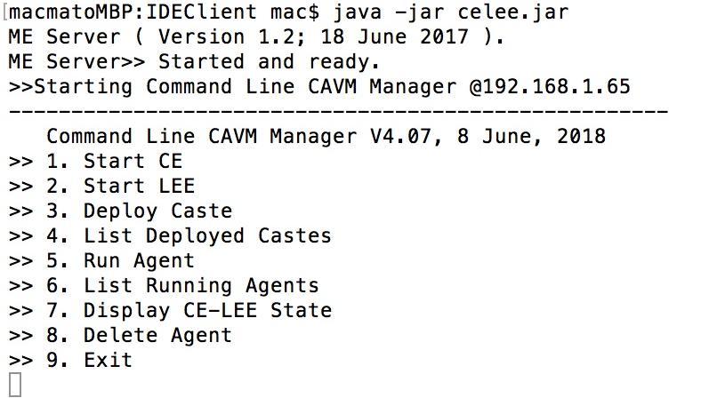
ME Console

Slide 8
CIDE: CAOPLE Integrated DevOps Environment
Design Principles:
Shift to the left: bring operation activities into the developers’ environment
Support the the complete DevOps lifecycle
Skill set shift:
User friendly GUI to reduce cognitive load on the developers
Process automation to reduce repeated operations
Support continuous testing, continuous integration and continuous delivery
Access to multiple clusters for testing, staging, and product
Operations on agents (i.e. microservices) without disturb the whole system)
Supporting ecosystem structure of development teams
Enabling multiple developers to access to the same cluster

Slide 9
The Architecture of CIDE

Slide 10
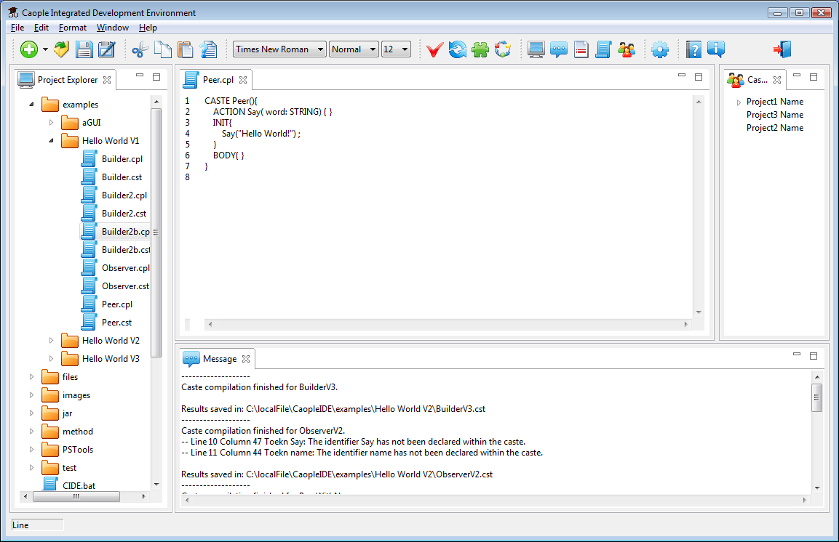
CIDE-1 Programming Environment
Compilation
Management tools
Code editor
Compiler output message

Slide 11
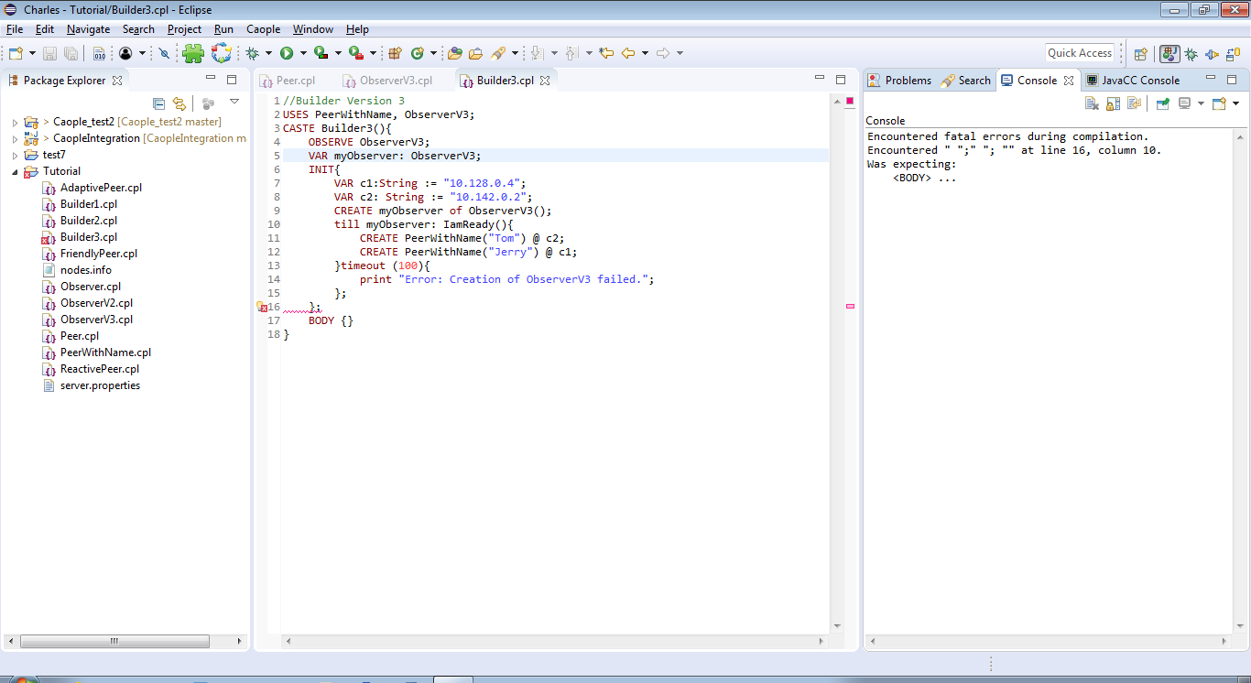
CIDE-2 Programming Environment as A Plug-in
Project management
Compiler
Github
Coloured code editor
CIDE tools
Error message
Indication of error location helps debugging

Slide 12
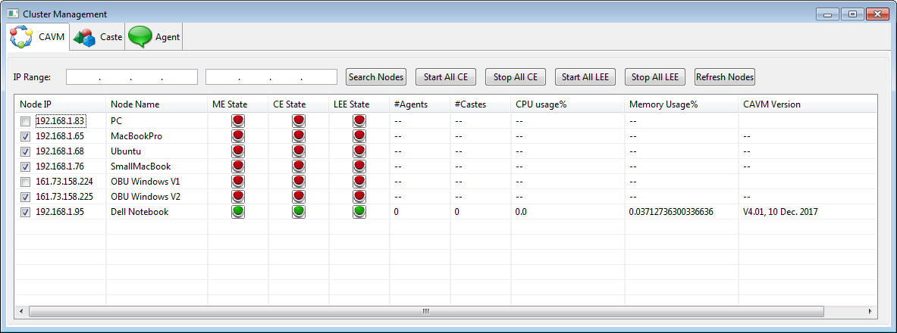
Cluster Management Tool
Group operations on selected virtual machines
Search for nodes in the network
Click on CE/LEE to turn it on/off
Click on ME to refresh the states
List of nodes in the network
States of the virtual machine:
Green: on,
Red: off,
Blue: waiting
Workload information
Selected nodes are in the working cluster

Slide 13
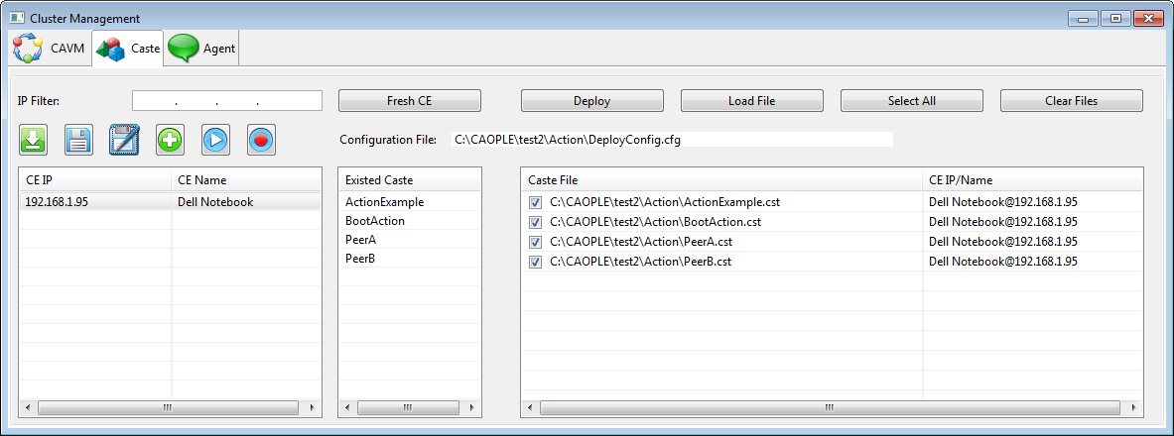
Deployment Management Tool
Load a configuration file
Save to the current configuration file
Save to a configuration file
Create a new configuration file
Execute the loaded configuration file
Record manual deployments
List of CEs available
Click to select a CE
Deployed castes on the selected CE
Files to be deployed
The CE that the file is deployed to

Slide 14
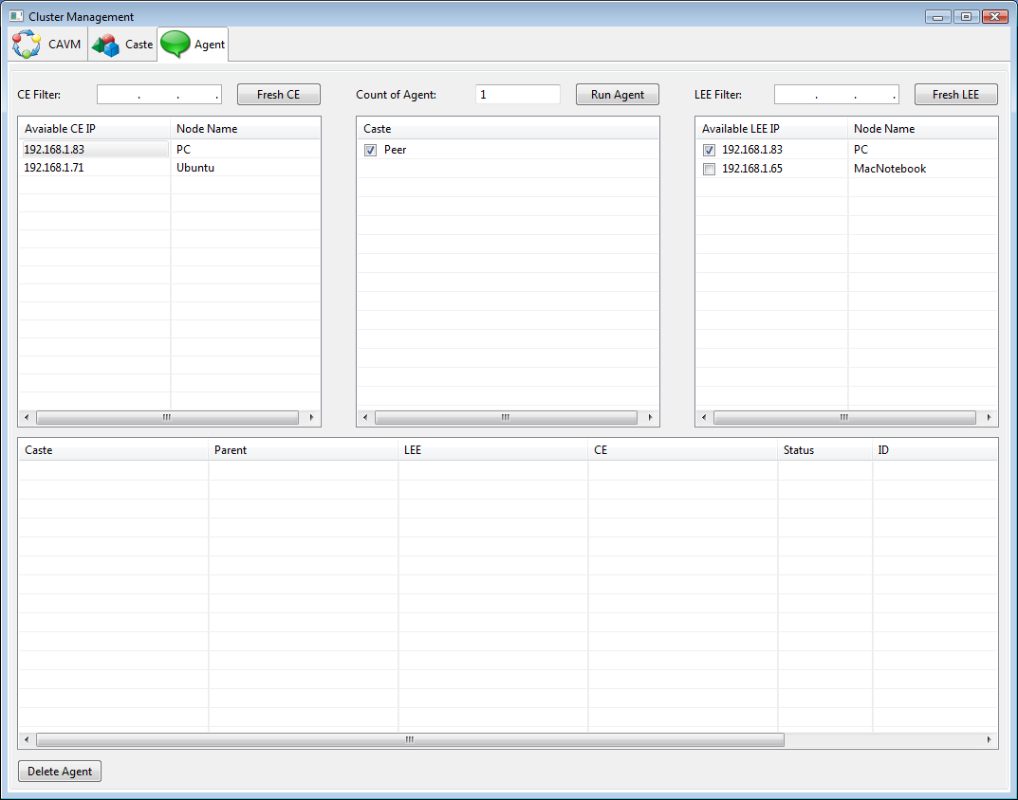
Runtime Agent Management Tool
Select the CE where the caste is stored
Select the LEE where the agent is to run
Select the caste that an agent is to start
Information about the agents running on the selected LEE is displayed here.

Slide 15
4. Conclusion
Summary
Characteristics of new SE paradigm for SaaS in Microservices
Benefits of CAOPLE/CIDE for SaaS in Microservices
Work in progress and future work

Slide 16
Summary 1: The New Paradigm
SaaS in microservices architecture is driving software engineering practice towards a new paradigm
Software structure: microservice architecture
Building blocks of the systems are autonomous active computational entities (microservices, container, or agents)
They are distributed over a network, executed in parallel
They are dynamically instantiated from templates (microservices, container images or caste)
Their communications are asynchronous (non-blocking) and the connections are dynamically established
Development process: DevOps
Development, deployment and operation processes are integrated and pipelined
Continuous testing, integration and delivery
Container Technology:
Platform for fast creation of instances, distribution of code, and monitoring the system
Philosophical Model: Computing is the collaboration between autonomous active service agents distributed over a network.

Slide 17
Summary 2: Benefits of CAOPLE/CIDE
High level of abstraction for implementing SaaS with a nice metaphor
Reducing the complexity of program
Otherwise caused by coding at low level communication primitives and network location sensitivity
Realisation of code-once-run-anywhere, thus reducing the complexity of testing, deployment, server provision, etc.
Otherwise caused by heterogeneous hardware and software platforms
Supporting DevOps principles in one Integrated DevOps Environment
Reducing the cognitive load; otherwise caused by complexity of the infrastructure

Slide 18
Work in Progress and Future Work
Further development of CAOPLE/CIDE
Debugging facility in an environment of concurrent and distributed system
Libraries for graphical user interface
Libraries to work with NoSQL databases
CAVM for Android and other mobile phone platform
Libraries and language facilities for artificial intelligence
Theoretical research problems
Formal reasoning about microservices, especially emergent behaviours and properties, such as load balance, scalability, processing capability, fault tolerance, etc.
Design patterns of microservices, and their implementations in CAOPLE
Case studies
Development of real applications in CAOPLE/CIDE

Slide 19
Acknowledgement
The work reported in here is based on the research in collaboration with colleagues of the AFM research group at Oxford Brookes University, and colleagues and students at NUDT, China. In particular, I am most grateful to Dr. Lijun Shan, Sufeng Wang, Prof. Bin Zhou, Dr. Rui Shen, Prof. Ji Wang, and Prof. Xinjun Mao of NUDT participate in the early stages of the research. Dr. Ian Bayley, Dr. Mark Green, Peter Marshall, and David Lightfoot of AFM group are the members of AOP research group. Dr. Chengzi Xu made significant contribution to the development of the new version of CAOPLE compiler and virtual machine CAVM-2, and Dr. Desheng Liu, who contributed significantly to the development of CIDE while they were visitors to the AFM.

